Slide 1
Chapter 6: CPU Scheduling

Slide 2
Chapter 6: CPU Scheduling
Basic Concepts
Scheduling Criteria
Scheduling Algorithms
Thread Scheduling
Multiple-Processor Scheduling
Real-Time CPU Scheduling
Operating Systems Examples
Algorithm Evaluation

Slide 3
Objectives
To introduce CPU scheduling
  the basis for multiprogrammed OS
To describe various CPU-scheduling algorithms
To discuss how to select a CPU-scheduling algorithm
  evaluation criteria
To examine the scheduling algorithms of different OSs

Slide 4
Basic Concepts
Maximum CPU utilization
  multiprogramming
CPU–I/O Burst Cycle
  a cycle of CPU execution and I/O wait
  CPU burst followed by I/O burst
  CPU burst distribution is of main concern

Slide 5
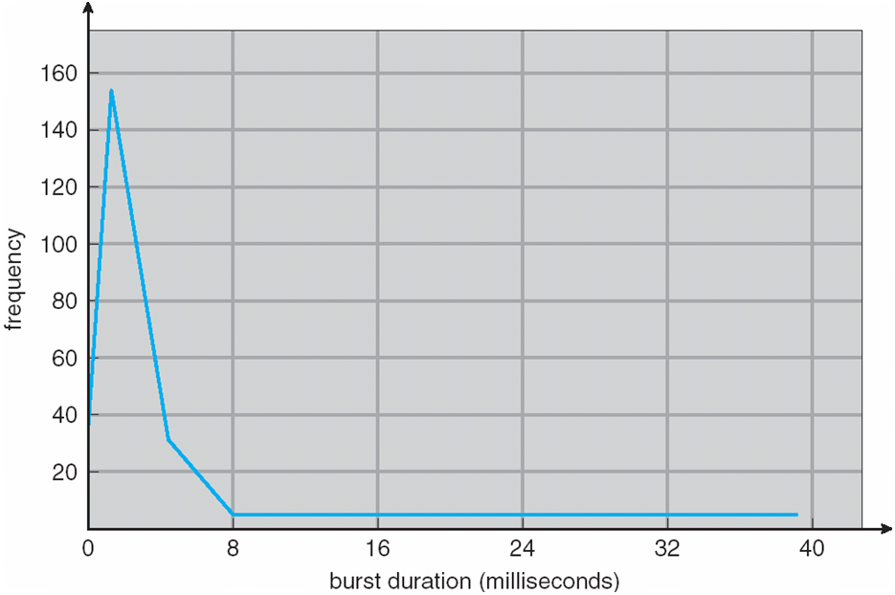
Histogram of CPU-burst Times

Slide 6
CPU Scheduler
Short-term scheduler
  Selects from among the processes in ready queue, and
  allocates the CPU to one of them
  Queue may be ordered in various ways
Scheduling time
  1. Switches from running to waiting state
  2. Switches from running to ready state
  3. Switches from waiting to ready
  Terminates
Scheduling types
  nonpreemptive
    Scheduling under 1 and 4 is
  preemptive
    access to shared data
    preemption while in kernel mode
    interrupts occurring during crucial OS activities

Slide 7
Dispatcher
Can pass control of CPU to the process selected
  switching context
  switching to user mode
  jumping to the proper location in the user program to restart that program
Dispatch latency
  The time OS takes for the dispatcher to stop one process and start another running

Slide 8
Concepts
CPU utilization
  keep the CPU as busy as possible
Throughput
  # of processes that complete their execution per time unit
Turnaround time
  amount of time to execute a particular process
Waiting time
  amount of time a process has been waiting in the ready queue
Response time
  amount of time from when a request was submitted until the first response is produced

Slide 9
Scheduling Algorithm Optimization Criteria
Max CPU utilization
Max throughput
Min turnaround time
Min waiting time
Min response time

Slide 10
FCFS Scheduling - case1
Process Burst Time
P₁ 24
P₂ 3
P₃ 3
Suppose the arriving order: P₁ , P₂ , P₃
The Gantt Chart for the schedule is:
Waiting time for P₁ = 0; P₂ = 24; P₃ = 27
Average waiting time: (0 + 24 + 27)/3 = 17
P₁
P₂
P₃
0
24
27
30

Slide 11
FCFS Scheduling – case 2
Suppose the arriving order:
P₂ , P₃ , P₁
The Gantt chart for the schedule is:
Waiting time for P₁ = 6; P₂ = 0; P₃ = 3
Average waiting time: (6 + 0 + 3)/3 = 3
Much better than case1
  Short process first
P₂
P₃
P₁
0
3
6
30

Slide 12
Shortest-Job-First Scheduling
SJF
  Associate with each process the length of its next CPU burst
  Use these lengths to schedule the process with the shortest time
SJF is optimal
  Gives minimum average waiting time for a given set of processes
  The difficulty is knowing the length of the next CPU request
  Could ask the user

Slide 13
Example of SJF
ProcessArriva l Time Burst Time
P₁ 0.0 6
P₂ 2.0 8
P₃ 4.0 7
P₄ 5.0 3
SJF scheduling chart
Average waiting time = (3 + 16 + 9 + 0) / 4 = 7
P₄
P₁
P₃
P₂
0
3
9
16
24

Slide 14
Determining Length of Next CPU Burst
Estimate the next CPU burst
Then pick process with shortest predicted next CPU burst
Using the length of previous CPU bursts, and
Using exponential averaging
  Commonly, α set to ½
  Preemptive version called shortest-remaining-time-first

Slide 15
Prediction of the Length of the
Next CPU Burst

Slide 16
Examples of Exponential Averaging
α =0
  τ_{n+1} = τ_{n}
  Recent history does not count
α =1
  τ_{n+1} = α t_{n}
  Only the actual last CPU burst counts
If we expand the formula, we get:
    τ_{n+1} = α t_{n}+(1 - α)α t_{n} -1 + …
    +(1 - α )^{j} α t_{n} _{-j} + …
    +(1 - α )^{n +1} τ₀

Slide 17
Example of Shortest-remaining-time-first
Consider varying arrival times and preemption to the analysis
ProcessA arri Arrival TimeT Burst Time
P₁ 0 8
P₂ 1 4
P₃ 2 9
P₄ 3 5
Preemptive SJF Gantt Chart
Average waiting time
  [(10-1)+(1-1)+(17-2)+5-3)]/4 = 26/4 = 6.5 msec
P₁
P₂
P₄
P₁
P₃
0
1
5
10
17
26

Slide 18
Priority Scheduling
A priority number (integer) is associated with each process
  Smallest integer = highest priority
The CPU is allocated to the process with the highest priority
  Preemptive
  Nonpreemptive
Problem
  Starvation
    low priority processes may never execute
  Solution: Aging
    increase the priority of the process as time progresses

Slide 19
Example of Priority Scheduling
ProcessA arri Burst TimeT Priority
P₁ 10 3
P₂ 1 1
P₃ 2 4
P₄ 1 5
P₅ 5 2
Priority scheduling Gantt Chart
Average waiting time = 8.2 msec
P₂
P₅
P₁
P₃
P₄
0
1
6
16
18
19

Slide 20
Round Robin (RR)
Each process gets a small unit of CPU time (q)
After q has elapsed
  the process is preempted, and
  added to the end of the ready queue
  Timer interrupts every quantum to schedule next process
No process waits more than (n-1)q time units
  If there are n processes in the ready queue and the time quantum is q
Performance
  q large ⇒ FIFO
  q small ⇒ q overhead is too high
    Incurs too many context switch

Slide 21
Example of RR with Time Quantum = 4
Process Burst Time
P₁ 24
P₂ 3
P₃ 3
The Gantt chart is:
Typically, higher average turnaround than SJF, but better response
q should be large compared to context switch time
  q usually 10ms to 100ms, context switch < 10 usec
P₁
P₂
P₃
P₁
P₁
P₁
P₁
P₁
0
4
7
10
14
18
22
26
30

Slide 22
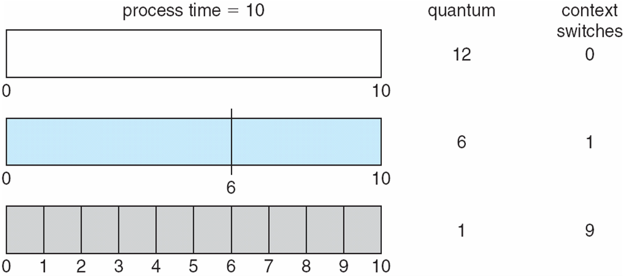
Time Quantum and Context Switch Time

Slide 23
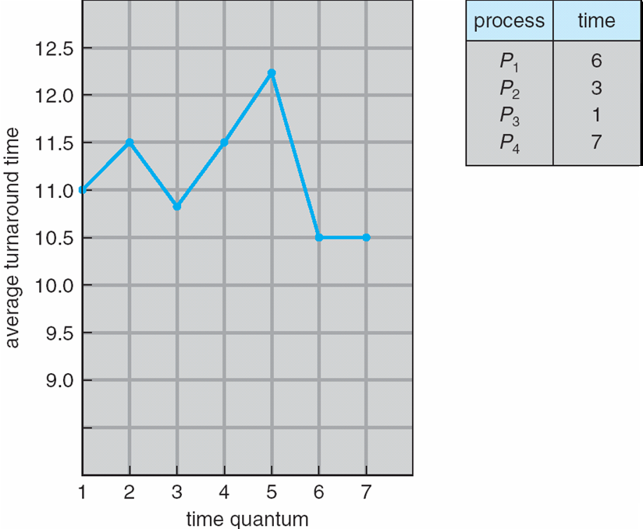
Turnaround Time Varies With
The Time Quantum
80% of CPU bursts should be shorter than q

Slide 24
Multilevel Queue
Ready queue is partitioned into separate queues
  foreground (interactive)
  background (batch)
Each queue has its own scheduling algorithm:
  foreground – RR
  background – FCFS

Slide 25
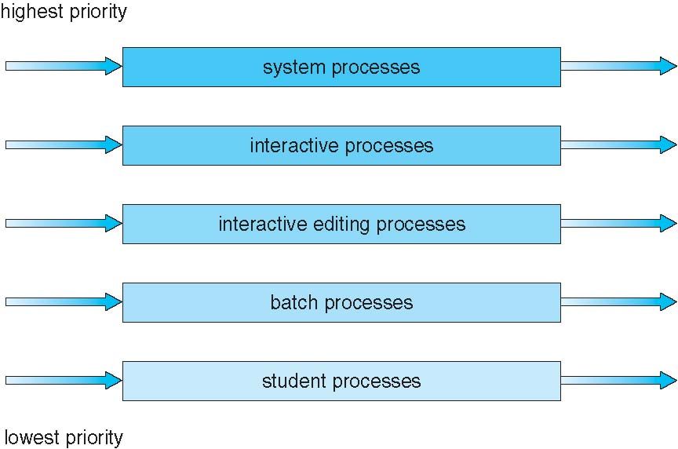
Multilevel Queue Scheduling

Slide 26
Multilevel Feedback Queue (MFQ)
A process can move between the various queues
  Such as aging implementation
MFQ scheduler defined by the following parameters:
  number of queues
  scheduling algorithms for each queue
  method used to determine when to upgrade a process
  method used to determine when to demote a process
  method used to determine which queue a process will enter when that process needs service

Slide 27
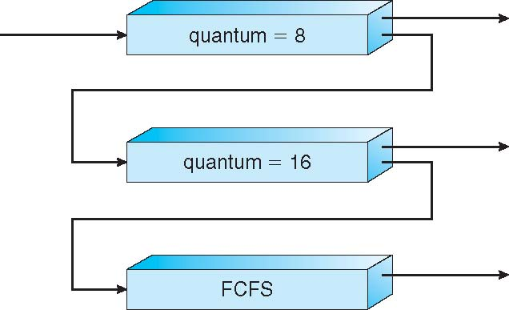
Example of MFQ
Three queues:
  Q₀ – RR with time quantum 8 ms
  Q₁ – RR time quantum 16 ms
  Q₂ – FCFS
Scheduling
  A new job enters Q₀ with FCFS
  When it gains CPU, job receives 8 ms
    If it does not finish in 8 ms, job is moved to Q₁
  At Q₁ job is again served FCFS and receives 16 additional ms
    If it still does not complete, it is preempted and moved to queue Q₂

Slide 28
Thread Scheduling
Distinction
  between user-level and kernel-level threads
Process-Contention Scope (PCS)
  User-level threads scheduling to run on LWP
  Scheduling competition is within the process
  Typically done via priority set by programmer
System-Contention Scope (SCS)
  Kernel thread scheduling
  Competition among all threads in system

Slide 29
Pthread Scheduling
Either PCS or SCS
  Can be specified during thread creation
  PTHREAD_SCOPE_PROCESS schedules threads using PCS scheduling
  PTHREAD_SCOPE_SYSTEM schedules threads using SCS scheduling
Can be limited by OS
  Linux and Mac OS X only allow PTHREAD_SCOPE_SYSTEM

Slide 30
Pthread Scheduling API
#include <pthread.h>
#include <stdio.h>
#define NUM THREADS 5
int main(int argc, char *argv[]) {
int i, scope;
pthread t tid[NUM THREADS];
pthread attr t attr;
/* get the default attributes */
pthread attr init(&attr);
/* first inquire on the current scope */
if (pthread attr getscope(&attr, &scope) != 0)
fprintf(stderr, "Unable to get scheduling scope\n");
else {
if (scope == PTHREAD SCOPE PROCESS)
printf("PTHREAD SCOPE PROCESS");
else if (scope == PTHREAD SCOPE SYSTEM)
printf("PTHREAD SCOPE SYSTEM");
else
fprintf(stderr, "Illegal scope value.\n");
}

Slide 31
Pthread Scheduling API
/* set the scheduling algorithm to PCS or SCS */
pthread attr setscope(&attr, PTHREAD SCOPE SYSTEM);
/* create the threads */
for (i = 0; i < NUM THREADS; i++)
pthread create(&tid[i],&attr,runner,NULL);
/* now join on each thread */
for (i = 0; i < NUM THREADS; i++)
pthread join(tid[i], NULL);
}
/* Each thread will begin control in this function */
void *runner(void *param)
{
/* do some work ... */
pthread exit(0);
}

Slide 32
Multiple-Processor Scheduling (MPS)
Homogeneous processors in a system
  Asymmetric multiprocessing
    only one processor accesses the system data structures
  Symmetric multiprocessing (SMP)
    each processor is self-scheduling
    all processes in common ready queue, or
    each has its own private queue of ready processes
Processor affinity
  process has affinity for processor on which it is currently running
  soft affinity
  hard affinity
  Variations including processor sets

Slide 33
NUMA and CPU Scheduling
Note that memory-placement algorithms can also consider affinity

Slide 34
Load Balancing
One type of MPS
If use SMP
  need to keep all CPUs loaded for efficiency
Load balancing
  attempts to keep workload evenly distributed
  Push migration
    periodic task checks load on each processor, and
    if found not balanced, pushes task from overloaded CPU to other CPUs
  Pull migration
    idle processors pulls waiting task from busy processor

Slide 35
Multicore Processors
Multiple cores are placed on a same physical chip
  Faster and consumes less power
Multiple threads per core also growing
  Takes advantage of memory stall
  Make progress on another thread while memory retrieve happens

Slide 36
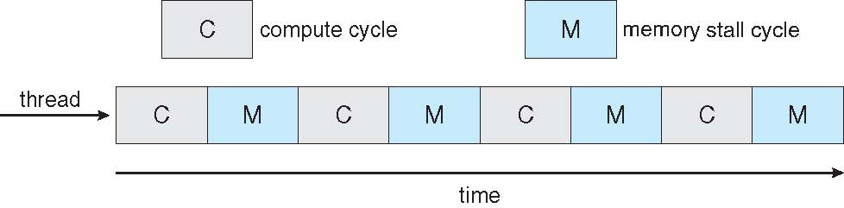

Multithreaded Multicore System

Slide 37
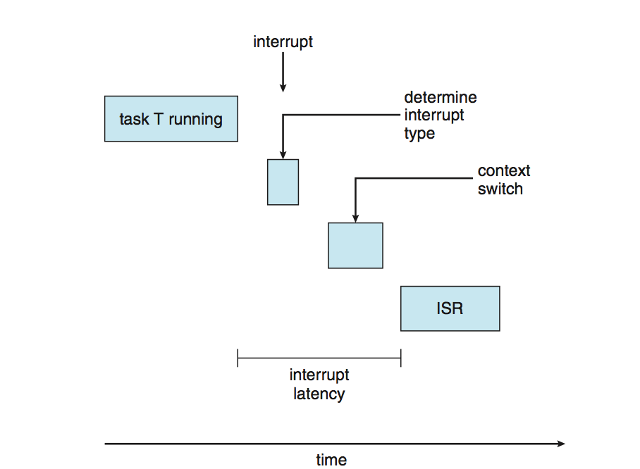
Real-Time CPU Scheduling
Soft real-time systems
  no guarantee to get task served
Hard real-time systems
  task must be serviced by its deadline
Performance
  Affected by two types of latencies
  Interrupt latency
    time from arrival of interrupt to start of routine that services interrupt
  Dispatch latency
    time for schedule to take current process off CPU and switch to another

Slide 38
Real-Time CPU Scheduling (Cont.)
Conflict phase of dispatch latency
  Preemption of any process running in kernel mode
  Release by low-priority process of resources needed by high-priority processes

Slide 39
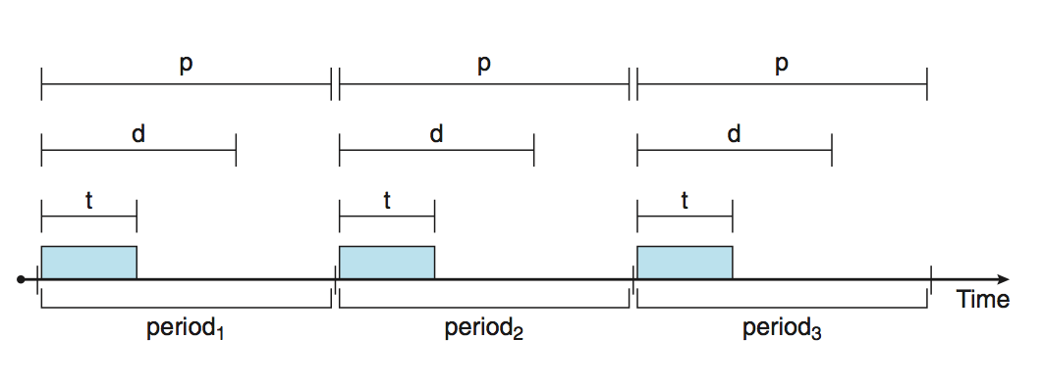
Priority-based Scheduling
Real-time scheduling
  scheduler must support preemptive, priority-based scheduling
  But only guarantees soft real-time
  For hard real-time must also provide ability to meet deadlines
Processes have new characteristics
  periodic ones require CPU at constant intervals
  Has processing time t, deadline d, period p
  0 ≤ t ≤ d ≤ p
  Rate of periodic task is 1/p

Slide 40
Virtualization and Scheduling
Virtualization software
  schedules multiple guests onto CPU(s)
  Each guest doing its own scheduling
    Not knowing it does not own the CPUs
    Can result in poor response time
    Can affect time-of-day clocks in guests

Slide 41
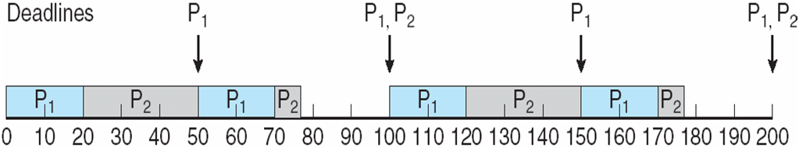
Rate Montonic Scheduling
A priority is assigned
  Based on the inverse of its period
  Shorter periods = higher priority
  Longer periods = lower priority
Example
  P₁ is assigned a higher priority than P₂.

Slide 42
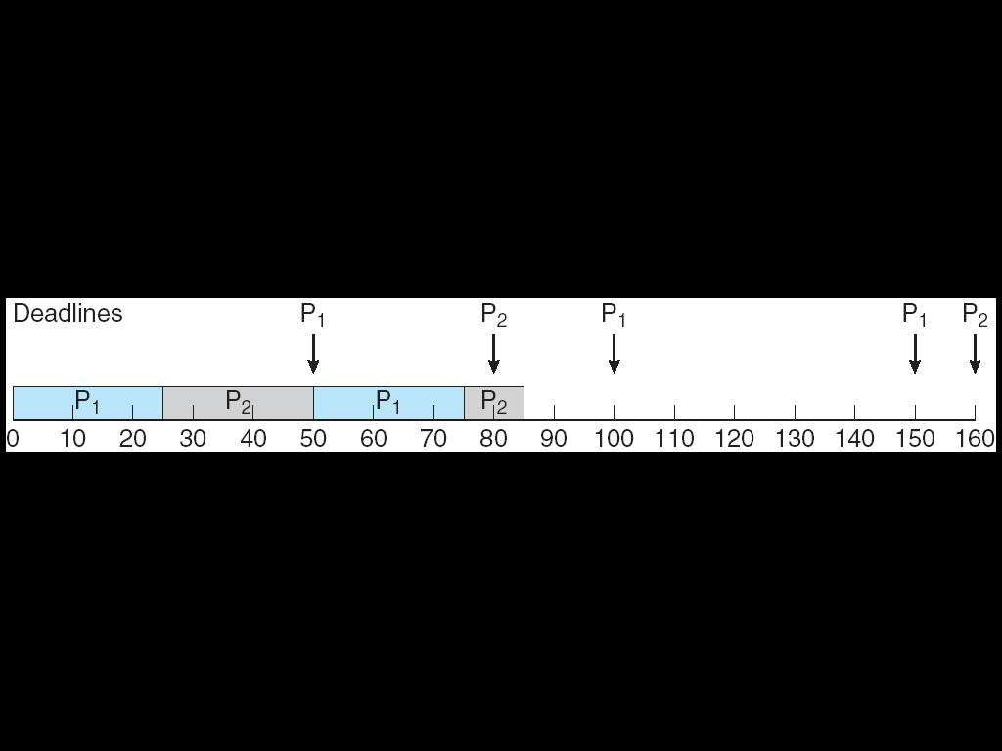
Missed Deadlines with
Rate Monotonic Scheduling

Slide 43
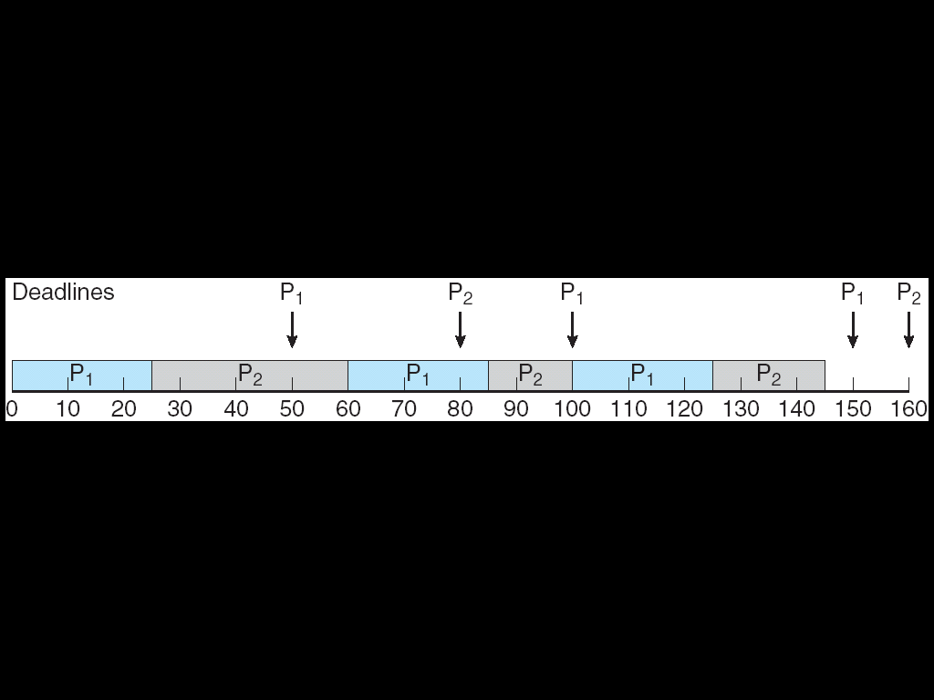
Earliest Deadline First Scheduling
EDF
Priorities are assigned according to deadlines:
  the earlier the deadline, the higher the priority
  the later the deadline, the lower the priority

Slide 44
Proportional Share Scheduling
T shares
  are allocated among all processes in the system
An application
  receives N shares where N < T
This ensures
  each application will receive N / T of the total processor time

Slide 45
POSIX Real-Time Scheduling
The POSIX.1b standard
API provides functions for managing real-time threads
Two scheduling classes for real-time threads:
  SCHED_FIFO
    threads are scheduled using a FCFS strategy with a FIFO queue
  SCHED_RR
    similar to SCHED_FIFO except time-slicing occurs for threads of equal priority
Two functions for getting and setting scheduling policy:
pthread attr getsched policy(pthread attr t *attr, int *policy)
pthread attr setsched policy(pthread attr t *attr, int policy)

Slide 46
POSIX Real-Time Scheduling API
#include <pthread.h>
#include <stdio.h>
#define NUM THREADS 5
int main(int argc, char *argv[])
{
int i, policy;
pthread t tid[NUM THREADS];
pthread attr t attr;
/* get the default attributes */
pthread attr init(&attr);
/* get the current scheduling policy */
if (pthread attr getschedpolicy(&attr, &policy) != 0)
fprintf(stderr, "Unable to get policy.\n");
else {
if (policy == SCHED OTHER) printf("SCHED OTHER\n");
else if (policy == SCHED RR) printf("SCHED RR\n");
else if (policy == SCHED FIFO) printf("SCHED FIFO\n");
}

Slide 47
POSIX Real-Time Scheduling API (Cont.)
/* set the scheduling policy - FIFO, RR, or OTHER */
if (pthread attr setschedpolicy(&attr, SCHED FIFO) != 0)
fprintf(stderr, "Unable to set policy.\n");
/* create the threads */
for (i = 0; i < NUM THREADS; i++)
pthread create(&tid[i],&attr,runner,NULL);
/* now join on each thread */
for (i = 0; i < NUM THREADS; i++)
pthread join(tid[i], NULL);
}
/* Each thread will begin control in this function */
void *runner(void *param)
{
/* do some work ... */
pthread exit(0);
}

Slide 48
Operating System Examples
Linux scheduling
Windows scheduling
Solaris scheduling

Slide 49
Linux Scheduling Through Version 2.5
Prior to version 2.5
  standard UNIX scheduling algorithm
Version 2.5
  Moved to constant order O(1) scheduling time
  Preemptive, priority based
  Two priority ranges: time-sharing and real-time
    Real-time range from 0 to 99 and nice value from 100 to 140
  Map into global priority with numerically lower values indicating higher priority
  Higher priority gets larger q
  Task run-able as long as time left in time slice (active)
  If no time left (expired), not run-able until all other tasks use their slices
  All run-able tasks tracked in per-CPU run-queue data structure
    Two priority arrays (active, expired)
    Tasks indexed by priority
    When no more active, arrays are exchanged
  Worked well, but poor response times for interactive processes

Slide 50
Linux Scheduling in Version 2.6.23 +
Completely Fair Scheduler (CFS)
  scheduler maintains per task virtual run time in variable vruntime
  Associated with decay factor based on priority of task – lower priority is higher decay rate
  Normal default priority yields virtual run time = actual run time
  To decide next task to run, scheduler picks task with lowest virtual run time
Scheduling classes
  Each has specific priority
  Scheduler picks highest priority task in highest scheduling class
  Based on proportion of CPU time
  2 scheduling classes included, others can be added
    default
    real-time
Quantum calculated
  based on nice value from -20 to +19
  Lower value is higher priority

Slide 51
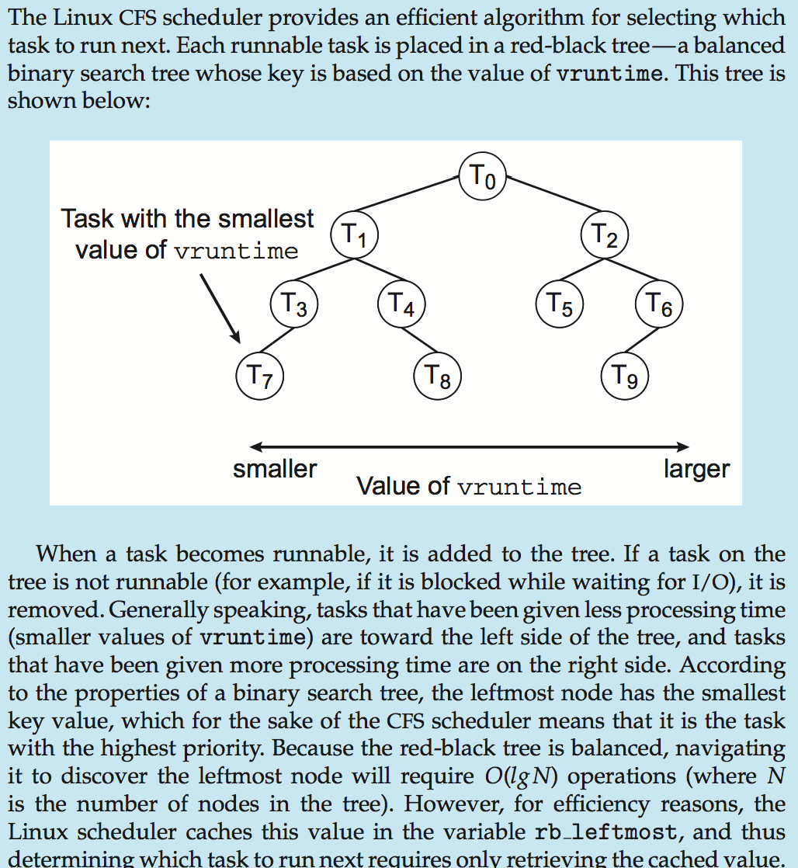
CFS Performance

Slide 52
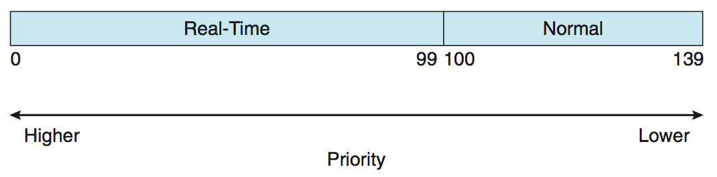
Linux Scheduling (Cont.)
Real-time scheduling according to POSIX.1b
  Real-time tasks have static priorities
Real-time plus normal map into global priority scheme
Nice value of -20 maps to global priority 100
Nice value of +19 maps to priority 139

Slide 53
Windows Scheduling
Windows uses priority-based preemptive scheduling
Highest-priority thread runs next
Dispatcher is scheduler
Thread runs until
  (1) blocks, (2) uses time slice, (3) preempted by higher-priority thread
Real-time threads can preempt non-real-time
32-level priority scheme
Variable class is 1-15
real-time class is 16-31
Priority 0 is memory-management thread
Queue for each priority
If no run-able thread, runs idle thread

Slide 54
Windows Priority Classes (skip)
Win32 API identifies several priority classes to which a process can belong
  REALTIME_PRIORITY_CLASS, HIGH_PRIORITY_CLASS, ABOVE_NORMAL_PRIORITY_CLASS,NORMAL_PRIORITY_CLASS, BELOW_NORMAL_PRIORITY_CLASS, IDLE_PRIORITY_CLASS
  All are variable except REALTIME
A thread within a given priority class has a relative priority
  TIME_CRITICAL, HIGHEST, ABOVE_NORMAL, NORMAL, BELOW_NORMAL, LOWEST, IDLE
Priority class and relative priority combine to give numeric priority
Base priority is NORMAL within the class
If quantum expires, priority lowered, but never below base
If wait occurs, priority boosted depending on what was waited for
Foreground window given 3x priority boost
User-mode scheduling (UMS)
  Added from Windows 7
  Applications create and manage threads independent of kernel
  For large number of threads, much more efficient
  UMS schedulers come from programming language libraries like C++ Concurrent Runtime (ConcRT) framework

Slide 55
Windows Priorities

Slide 56
Solaris
Priority-based scheduling
Six classes available
  Time sharing (default) (TS)
  Interactive (IA)
  Real time (RT)
  System (SYS)
  Fair Share (FSS)
  Fixed priority (FP)
Given thread can be in one class at a time
  Each class has its own scheduling algorithm
  Time sharing is multi-level feedback queue
    Loadable table configurable by sysadmin

Slide 57
Solaris Dispatch Table

Slide 58
Solaris Scheduling

Slide 59
Solaris Scheduling (Cont.)
Scheduler
  converts class-specific priorities into a per-thread global priority
  Thread with highest priority runs next
  Runs until
    (1) blocks
    (2) uses time slice
    (3) preempted by higher-priority thread
  Multiple threads at same priority selected via RR

Slide 60
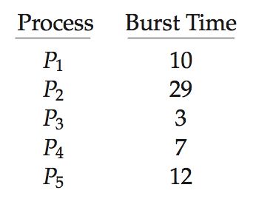
Algorithm Evaluation
How to select CPU-scheduling algorithm for an OS?
  Determine criteria
  then evaluate algorithms
Deterministic modeling
  Type of analytic evaluation
  Takes a particular predetermined workload, and
  defines the performance of each algorithm for that workload
Consider 5 processes arriving at time 0:

Slide 61
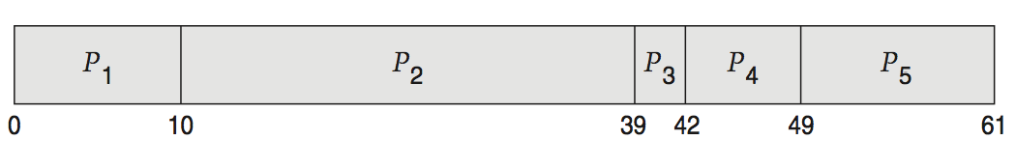
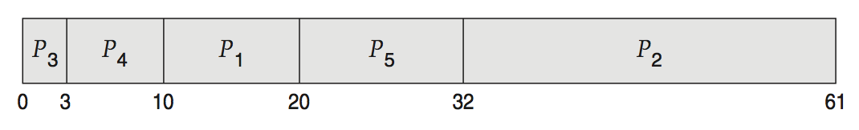
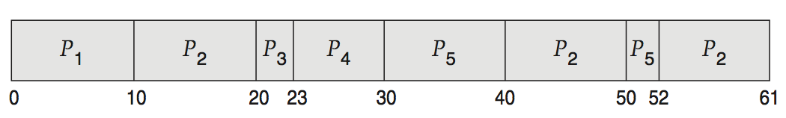
Deterministic Evaluation
For each algorithm, calculate minimum average waiting time
Simple and fast, but requires exact numbers for input, applies only to those inputs
  FCS is 28ms:
  Non-preemptive SFJ is 13ms:
  RR is 23ms:

Slide 62
Queueing Models
Describe
  the arrival of processes, and CPU and I/O bursts probabilistically
  Commonly exponential, and described by mean
  Computes average throughput, utilization, waiting time, etc.
Computer system
  described as network of servers, each with queue of waiting processes
  Knowing arrival rates and service rates
  Computes utilization, average queue length, average wait time, etc.

Slide 63
Little’s Formula
n = average queue length
W = average waiting time in queue
λ = average arrival rate into queue
Little’s law
  in steady state, processes leaving queue must equal processes arriving, thus n = λ x W
  Valid for any scheduling algorithm and arrival distribution
Example
  if on average 7 processes arrive per second, and
  normally 14 processes in queue, then
  average wait time per process = 2 seconds

Slide 64
Simulations
Queuing models limited
Simulations more accurate
  Programmed model of computer system
  Clock is a variable
  Gather statistics indicating algorithm performance
  Data to drive simulation gathered via
    Random number generator according to probabilities
    Distributions defined mathematically or empirically
    Trace tapes record sequences of real events in real systems

Slide 65
Evaluation of CPU Schedulers by Simulation

Slide 66
Implementation
Even simulations have limited accuracy
Just implement new scheduler and test in real systems
  High cost, high risk
  Environments vary
Most flexible schedulers
  can be modified per-site, or
  per-system, or
  APIs to modify priorities
  But again environments vary

Slide 67
End of Chapter 6

