Slide 1
Chapter 5: Process Synchronization

Slide 2
Chapter 5: Process Synchronization
Background
The Critical-Section Problem
Peterson’s Solution
Synchronization Hardware
Mutex Locks
Semaphores
Classic Problems of Synchronization
Monitors
Synchronization Examples
Alternative Approaches

Slide 3
Objectives
To introduce the critical-section problem
Software solution
Hardware solution
To examine several problems
classical process-synchronization
To explore several tools
solve process synchronization problems

Slide 4
Background
Concurrent execution
May be interrupted at any time, partially completing execution
Concurrent access to shared data
may result in data inconsistency
Maintaining data consistency requires the orderly execution of cooperating processes
Producer and consumer problem

Slide 5
Producer
while (true) { /* produce an item in next produced */
while (counter == BUFFER SIZE) ;
/* do nothing */
buffer[in] = next produced;
in = (in + 1) % BUFFER SIZE;
counter++;
}

Slide 6
Consumer
while (true) {
while (counter == 0)
; /* do nothing */
next consumed = buffer[out];
out = (out + 1) % BUFFER SIZE;
counter--;
/* consume the item in next consumed */
}

Slide 7
Race Condition
counter++ could be implemented as
register1 = counter register1 = register1 + 1 counter = register1
counter-- could be implemented as
register2 = counter register2 = register2 - 1 counter = register2
Execution interleaving with “count = 5” initially:
S0: producer execute register1 = counter {register1 = 5} S1: producer execute register1 = register1 + 1 {register1 = 6} S2: consumer execute register2 = counter {register2 = 5} S3: consumer execute register2 = register2 – 1 {register2 = 4} S4: producer execute counter = register1 {counter = 6 } S5: consumer execute counter = register2 {counter = 4}

Slide 8
Critical Section Problem
Consider system of n processes {p₀, p₁, … p_{n-1}}
Each process has critical section code
Only one process is allowed to write in critical section
Critical section problem
design protocol to solve this
Each process enters critical section with permission

Slide 9
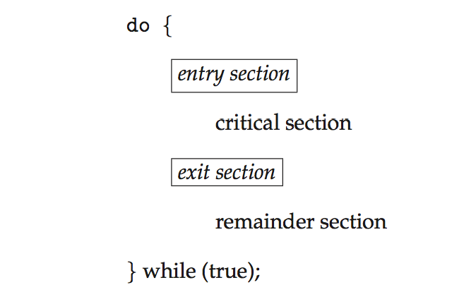
Critical Section
General structure of process p_{i} with CS

Slide 10
Solution to Critical-Section Problem
Mutual Exclusion
If process P_{i} is executing in its CS, then no other processes are allowed
Progress
If no one executes in it CS, waiting process can get in
Bounded Waiting
Guarantee limited waiting time to enter CS
Two approaches depending on kernel mode
Preemptive
allows preemption of process
Non-preemptive
Not allow preemption of a running process

Slide 11
Peterson’s Solution
Two process solution
Share two variables int turn; Boolean flag[2]
“turn” indicates whose turn to enter CS
“flag[i]=true” indicates P_{i} is ready to enter CS
Assumption
load and store instructions are atomic
cannot be interrupted

Slide 12
Algorithm for Process P_{i}
do {
flag[i] = true;
turn = j;
while (flag[j] && turn == j);
critical section
flag[i] = false;
remainder section
} while (true);
Provable that
Mutual exclusion is preserved
Progress requirement is satisfied
Bounded-waiting requirement is met

Slide 13
Synchronization Hardware
Protecting critical regions via locks
Uniprocessors – could disable interrupts
Currently running code would execute without preemption
Generally too inefficient on multiprocessor systems
Operating systems using this not broadly scalable
Special atomic hardware instructions
Atomic = non-interruptible
Either test memory word and set value
Or swap contents of two memory words

Slide 14
Solution to CS Problem Using Locks
do {
acquire lock
critical section
release lock
remainder section
} while (TRUE);

Slide 15
test_and_set Instruction
Definition:
boolean test_and_set (boolean *target)
{
boolean rv = *target;
*target = TRUE;
return rv:
}

Slide 16
Solution using test_and_set()
Shared boolean variable lock, initialized to FALSE
Solution:
do { while (test_and_set(&lock))
; /* do nothing */
/* critical section */
lock = false;
/* remainder section */
} while (true);

Slide 17
compare_and_swap Instruction
Definition:
int compare and swap(int *value, int expected, int new value) {
int temp = *value;
if (*value == expected)
*value = new value;
return temp;
}

Slide 18
Solution using compare_and_swap
Shared Boolean variable lock initialized to FALSE
Each process has a local Boolean variable key
Solution:
do { while (compare and swap(&lock, 0, 1) != 0)
; /* do nothing */
/* critical section */
lock = 0;
/* remainder section */
} while (true);

Slide 19
Bounded-waiting Mutual Exclusion with test_and_set
do { waiting[i] = true; key = true; while (waiting[i] && key)
key = test_and_set(&lock);
waiting[i] = false;
/* critical section */
j = (i + 1) % n;
while ((j != i) && !waiting[j])
j = (j + 1) % n;
if (j == i)
lock = false;
else
waiting[j] = false;
/* remainder section */
} while (true);

Slide 20
Mutex Locks
Software solution
acquire() and release() must be atomic
Implemented via hardware atomic instructions
Boolean variable indicates if lock is available or not
First acquire() a lock, then release() it
This solution requires busy waiting
The lock is therefore called a spinlock

Slide 21
acquire() and release()
acquire() { while (!available)
; /* busy wait */
available = false;;
}
release() {
available = true;
}
do {
acquire lock
critical section
release lock
remainder section
} while (true);

Slide 22
Semaphore
Another way but does not require busy waiting
Semaphore S – integer variable
Two standard atomic operations modify S
wait() and signal()
Originally called P() and V()
wait (S) {
while (S <= 0)
; // busy wait
S--;
}
signal (S) {
S++;
}

Slide 23
How to use Semaphore
Types
Counting semaphore
integer value can range over an unrestricted domain
Can be implemented as a binary semaphore
Binary semaphore
integer value can range only between 0 and 1
mutex lock
Synchronizing problem
Consider P₁ and P₂ that require S₁ to happen before S₂
P1:
S₁;
signal(synch);
P2:
wait(synch);
S₂;

Slide 24
Semaphore Implementation
No two processes can
execute wait () and signal () on
the same semaphore
at the same time
The implementation becomes a CS problem
where the wait and signal code are placed in the critical section
May incur Busy Waiting
It is a good solution

Slide 25
Semaphore Implementation with no Busy waiting
Each semaphore is with an associated waiting queue
Each entry in a waiting queue has two data items:
value
pointer to next record in the list
Two operations
block
place the process invoking the operation on the appropriate waiting queue
wakeup
remove one of processes in the waiting queue, and
place it in the ready queue

Slide 26
Semaphore Implementation with no Busy waiting (Cont.)
typedef struct{
int value;
struct process *list;
} semaphore;
wait(semaphore *S) {
S->value--;
if (S->value < 0) { add this process to S->list;
block();
}
}
signal(semaphore *S) {
S->value++;
if (S->value <= 0) { remove a process P from S->list;
wakeup(P);
}
}

Slide 27
Deadlock and Starvation
Deadlock
two or more processes are waiting each other
Let S and Q be two semaphores initialized to 1
P₀ P₁
wait(S); wait(Q);
wait(Q); wait(S);
. .
signal(S); signal(Q);
signal(Q); signal(S);
Starvation
A process may never be removed from the semaphore queue in which it is suspended
Solution
priority-inheritance protocol

Slide 28
Classical Problems of Synchronization
Bounded-Buffer
Readers and Writers
Dining-Philosophers

Slide 29
Bounded-Buffer Problem
n buffers
each can hold one item
Semaphore initialization
mutex = 1
full = 0
empty = n

Slide 30
Bounded Buffer Problem (Cont.)
the producer process
do {
... /* produce an item in next_produced */
...
wait(empty);
wait(mutex);
... /* add next produced to the buffer */
...
signal(mutex);
signal(full);
} while (true);

Slide 31
Bounded Buffer Problem (Cont.)
the consumer process
do {
wait(full);
wait(mutex);
... /* remove an item from buffer to next_consumed */
...
signal(mutex);
signal(empty);
... /* consume the item in next consumed */
... } while (true);

Slide 32
Readers-Writers Problem
Concurrent processes share a data set
Readers
only read the data set; they do not perform any updates
Writers
can both read and write
Shared Data
Data set
Semaphore rw_mutex initialized to 1
Semaphore mutex initialized to 1
Integer read_count initialized to 0

Slide 33
Readers-Writers Problem (Cont.)
Writer process
do { wait(rw mutex);
... /* writing is performed */
...
signal(rw mutex);
} while (true);

Slide 34
Readers-Writers Problem (Cont.)
Reader process
do { wait(mutex); read count++; if (read count == 1)
wait(rw mutex); signal(mutex);
... /* reading is performed */
... wait(mutex); read count--; if (read count == 0)
signal(rw mutex); signal(mutex);
} while (true);

Slide 35
Readers-Writers Problem Variations
First variation
no reader kept waiting unless writer has permission to use shared object
Second variation
once writer is ready, it performs write asap
Both may have starvation leading to even more variations
Solved by kernel providing reader-writer locks

Slide 36
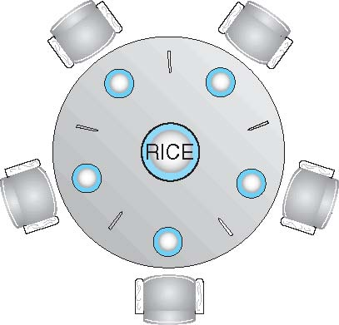
Dining-Philosophers Problem
Philosophers spend their lives thinking and eating
Don’t interact with their neighbors, occasionally try to pick up 2 chopsticks (one at a time) to eat from bowl
Need both to eat, then release both when done
In the case of 5 philosophers
Shared data
Bowl of rice (data set)
Semaphore chopstick [5] initialized to 1

Slide 37
Dining-Philosophers Problem Algorithm
The structure of Philosopher i:
do {
wait ( chopstick[i] );
wait ( chopStick[ (i + 1) % 5] );
// eat
signal ( chopstick[i] );
signal (chopstick[ (i + 1) % 5] );
// think
} while (TRUE);
What is the problem with this algorithm?

Slide 38
Problems with Semaphores
Incorrect use of semaphore operations:
signal (mutex) …. wait (mutex)
wait (mutex) … wait (mutex)
Omitting of wait (mutex) or signal (mutex) (or both)
Deadlock
Starvation

Slide 39
Monitors
Another way to synchronize processes
Features
A high-level abstraction
a convenient and effective mechanism
Abstract data type
internal variables only accessible by code within the procedure
Only one process may be active within the monitor at a time
Disadvantage
not powerful enough to model some synchronization schemes
monitor monitor-name
{
// shared variable declarations
procedure P1 (…) { …. }
…
procedure Pn (…) {……}
Initialization code (…) { … }
}
}

Slide 40
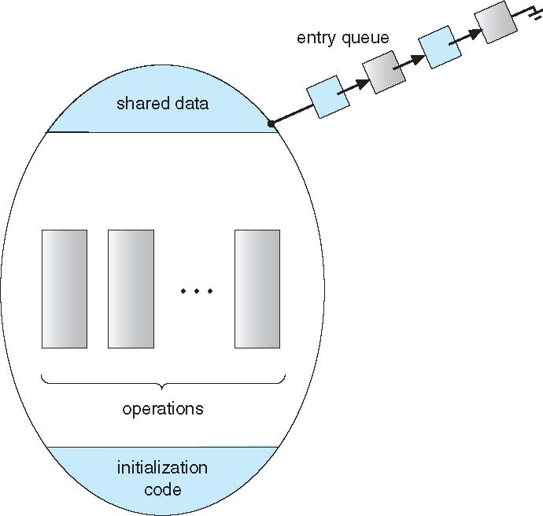
Schematic view of a Monitor

Slide 41
Condition Variables
condition x, y;
Two operations on a condition variable:
x.wait ()
a process that invokes the operation is suspended until x.signal ()
x.signal ()
resumes one of processes (if any) that invoked x.wait ()
If no x.wait () on the variable, then it has no effect on the variable

Slide 42
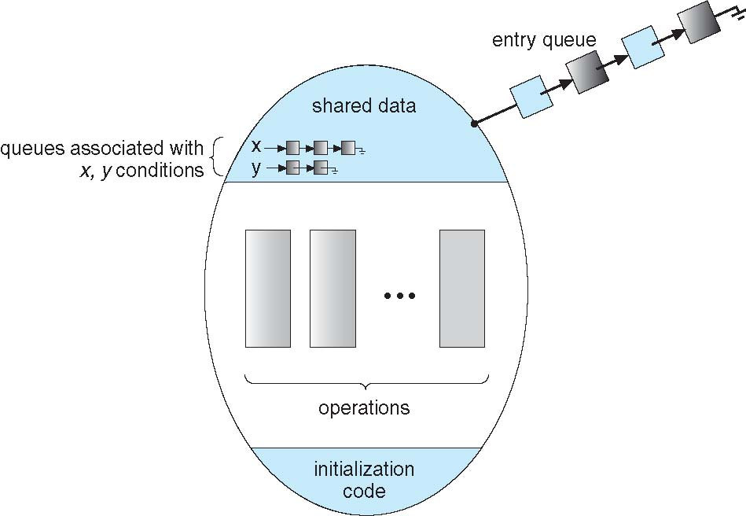
Monitor with Condition Variables

Slide 43
Condition Variables Choices
Question?
If process P invokes x.signal (), with Q in x.wait () state, what should happen next?
If Q is resumed, then P must wait
Options include
Signal and wait
P waits until Q leaves monitor or waits for another condition
Signal and continue
Q waits until P leaves the monitor or waits for another condition
Depends on implementing language
Pascal
P executing signal immediately leaves the monitor, Q is resumed
Implemented in other languages including Mesa, C#, Java

Slide 44
Monitor Solution to Dining Philosophers
monitor DiningPhilosophers
{
enum { THINKING; HUNGRY, EATING) state [5] ;
condition self [5];
void pickup (int i) {
state[i] = HUNGRY;
test(i);
if (state[i] != EATING) self [i].wait;
}
void putdown (int i) {
state[i] = THINKING;
// test left and right neighbors
test((i + 4) % 5);
test((i + 1) % 5);
}

Slide 45
Solution to Dining Philosophers (Cont.)
void test (int i) {
if ( (state[(i + 4) % 5] != EATING) &&
(state[i] == HUNGRY) &&
(state[(i + 1) % 5] != EATING) ) {
state[i] = EATING ;
self[i].signal () ;
}
}
initialization_code() {
for (int i = 0; i < 5; i++)
state[i] = THINKING;
}
}

Slide 46
Solution to Dining Philosophers (Cont.)
Each philosopher i
invokes the operations pickup() and putdown() in the following sequence:
DiningPhilosophers.pickup (i);
EAT
DiningPhilosophers.putdown (i);
No deadlock
Starvation is possible

Slide 47
Monitor Implementation Using Semaphores
Variables
semaphore mutex; // (initially = 1)
semaphore next; // (initially = 0)
int next_count = 0;
Each procedure F will be replaced by
wait(mutex);
…
body of F;
…
if (next_count > 0)
signal(next)
else
signal(mutex);
Mutual exclusion within a monitor is ensured

Slide 48
Monitor Implementation – Condition Variables
For each condition variable x, we have:
semaphore x_sem; // (initially = 0)
int x_count = 0;
The operation x.wait can be implemented as:
x-count++;
if (next_count > 0)
signal(next);
else
signal(mutex);
wait(x_sem);
x-count--;

Slide 49
Monitor Implementation (Cont.)
x.signal implementation
if (x-count > 0) {
next_count++;
signal(x_sem);
wait(next);
next_count--;
}

Slide 50
Resuming Processes within a Monitor
Question
If several processes queued on condition x,
and x.signal() executed,
which should be resumed?
conditional-wait
construct of the form x.wait(c)
Where c is priority number
Process with lowest number (highest priority) is scheduled next

Slide 51
A Monitor to Allocate Single Resource
monitor ResourceAllocator
{
boolean busy;
condition x;
void acquire(int time) {
if (busy)
x.wait(time);
busy = TRUE;
}
void release() {
busy = FALSE;
x.signal();
}
initialization code() {
busy = FALSE;
}
}

Slide 52
Synchronization Examples
Solaris
Windows XP
Linux
Pthreads

Slide 53
Solaris
Implements a variety of locks to support
Multitasking
multithreading (including real-time threads), and
multiprocessing
Features
Uses adaptive mutexes
for efficiency when protecting data from short code segments
Starts as a standard semaphore spin-lock
If lock held, and by a thread running on another CPU, spins
If lock held by non-run-state thread, block and sleep waiting for signal of lock being released
Uses condition variables
Uses readers-writers locks
when longer sections of code need access to data
Uses turnstiles to order the list of threads
waiting to acquire either an adaptive mutex or reader-writer lock
Turnstiles are per-lock-holding-thread, not per-object

Slide 54
Windows XP
Uses interrupt masks
on uniprocessor systems
to protect access to global resources
Uses spinlocks
on multiprocessor systems
Spinlocking-thread will never be preempted
Provides dispatcher objects
may act mutexes, semaphores, events, and timers
Events
An event acts much like a condition variable
Timers notify one or more thread when time expired
Dispatcher objects
either signaled-state (object available)
or non-signaled state (thread will block)

Slide 55
Linux
Points
Prior to kernel Version 2.6, disables interrupts to implement short critical sections
Version 2.6 and later, fully preemptive
Provides:
semaphores
Spinlocks
On single-cpu system, spinlocks replaced by enabling and disabling kernel preemption
reader-writer versions of both

Slide 56
Pthreads
Pthreads API is OS-independent
Provides
mutex locks
condition variables
Non-portable extensions include
read-write locks
spinlocks

Slide 57
Atomic Transactions
System Model
Log-based Recovery
Checkpoints
Concurrent Atomic Transactions

Slide 58
System Model
Assures that operations happen as a single logical unit of work
Related to field of database systems
Challenge is assuring atomicity despite computer system failures
Transaction
collection of instructions or operations that performs single logical function
Here we are concerned with changes to stable storage – disk
Transaction is series of read and write operations
Terminated by commit (transaction successful) or abort (transaction failed) operation
Aborted transaction must be rolled back to undo any changes it performed

Slide 59
Types of Storage Media
Goal is to assure transaction atomicity where failures cause loss of information on volatile storage
Volatile storage
information stored here does not survive system crashes
Example: main memory, cache
Nonvolatile storage
Information usually survives crashes
Example: disk and tape
Stable storage
Information never lost
replication or RAID to devices with independent failure modes

Slide 60
Log-Based Recovery
Record
to stable storage information about all modifications by a transaction
write-ahead logging
each log record describes single transaction write operation, including
Transaction name
Data item name
Old value
New value
<T_{i} starts> written to log when transaction T_{i} starts
<T_{i} commits> written when T_{i} commits

Slide 61
Log-Based Recovery Algorithm
Using the log
system can handle any volatile memory errors
Undo(T_{i}) restores value of all data updated by T_{i}
Redo(T_{i}) sets values of all data in transaction T_{i} to new values
Undo(T_{i}) and redo(T_{i}) must be idempotent
Multiple executions must have the same result as one execution
If system fails,
restore state of all updated data via log
If log contains <T_{i} starts> without <T_{i} commits>, undo(T_{i})
If log contains <T_{i} starts> and <T_{i} commits>, redo(T_{i})

Slide 62
Checkpoints
The problem using Log-based recovery
Log could become long, and
recovery could take long
Checkpoints
shorten log and recovery time
Checkpoint scheme
Output all log records currently in volatile storage to stable storage
Output all modified data from volatile to stable storage
Output a log record <checkpoint> to the log on stable storage
Recovery
only includes Ti
Ti started executing before the most recent checkpoint, and all transactions after Ti
All other transactions already on stable storage

Slide 63
Concurrent Transactions
Must be equivalent to serial execution – serializability
Could perform all transactions in critical section
Inefficient, too restrictive
Concurrency-control algorithms provide serializability

Slide 64
Serializability
Consider two data items A and B
Consider Transactions T₀ and T₁
Execute T₀, T₁ atomically
Execution sequence called schedule
Atomically executed transaction order called serial schedule
For N transactions, there are N! valid serial schedules

Slide 65
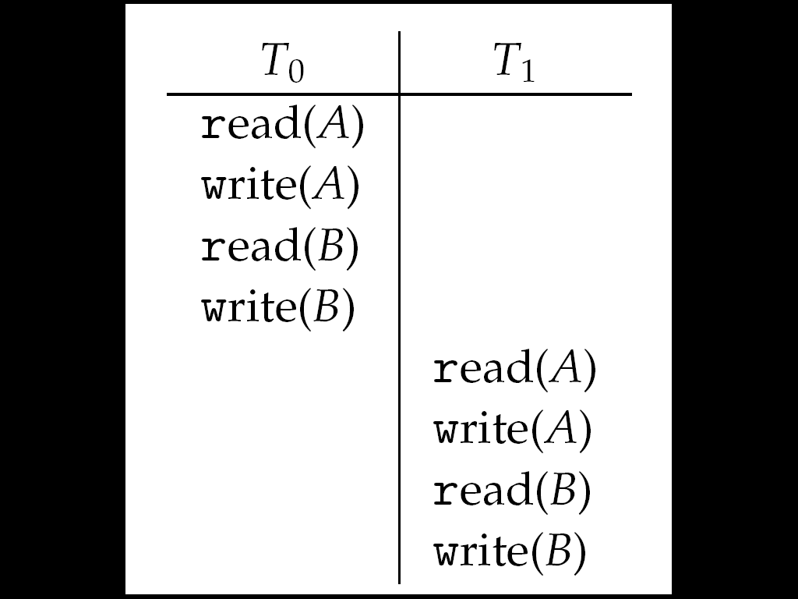
Schedule 1: T₀ then T₁

Slide 66
Nonserial Schedule
Non-serial schedule
allows overlapped execute
Resulting execution not necessarily incorrect
Example
Consider schedule S, operations O_{i}, O_{j}
Conflict if access same data item, with at least one write
If O_{i}, O_{j} consecutive and operations of different transactions & O_{i} and O_{j} don’t conflict
Then S’ with swapped order O_{j} O_{i} equivalent to S
If S can become S’ via swapping nonconflicting operations
S is conflict serializable

Slide 67
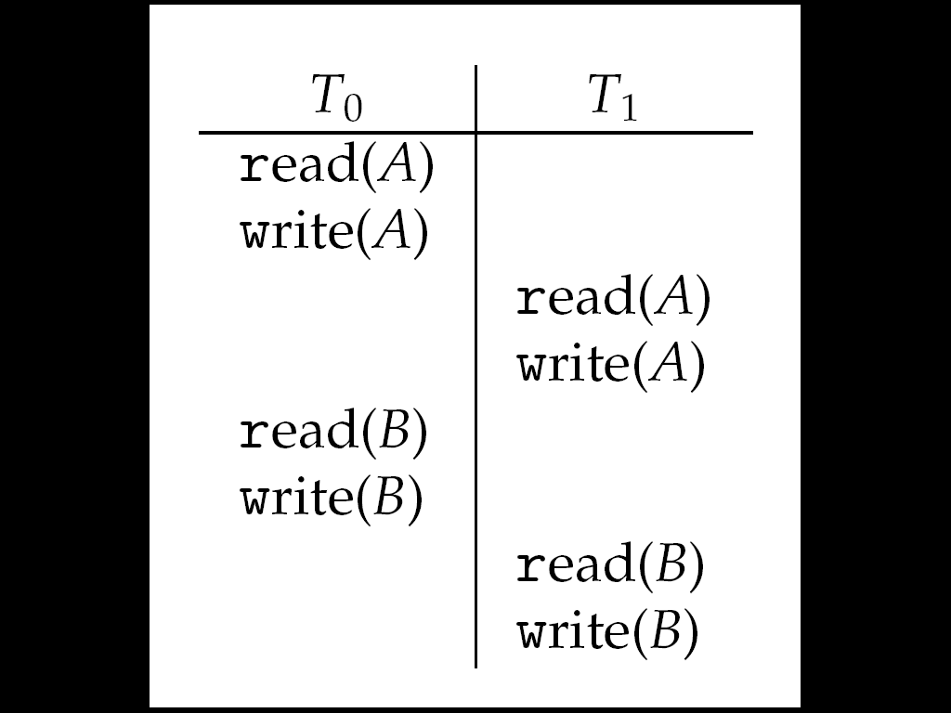
Schedule 2: Concurrent Serializable Schedule

Slide 68
Locking Protocol
Ensure serializability
by associating lock with each data item
Follow locking protocol for access control
Locks
Shared
T_{i} has shared-mode lock (S) on item Q, T_{i} can read Q but not write Q
Exclusive
Ti has exclusive-mode lock (X) on Q, T_{i} can read and write Q
Requirements
every transaction on item Q acquire appropriate lock is required
If lock already held, new request may have to wait
Similar to readers-writers algorithm

Slide 69
Two-phase Locking Protocol
Generally ensures conflict serializability
Each transaction issues lock and unlock requests in two phases
Growing – obtaining locks
Shrinking – releasing locks
Does not prevent deadlock

Slide 70
Timestamp-based Protocols
Timestamp-ordering
Select order among transactions in advance
Transaction T_{i} associated with timestamp TS(T_{i}) before T_{i} starts
TS(T_{i}) < TS(T_{j}) if Ti entered system before T_{j}
TS can be generated from system clock or as logical counter incremented at each entry of transaction
Timestamps determine serializability order
If TS(T_{i}) < TS(T_{j}), system must ensure produced schedule equivalent to serial schedule
where T_{i} appears before T_{j}

Slide 71
Timestamp-based Protocol Implementation
Data item Q gets two timestamps
W-timestamp(Q)
largest timestamp of any transaction that executed write(Q) successfully
R-timestamp(Q)
largest timestamp of successful read(Q)
Updated whenever read(Q) or write(Q) executed
Timestamp-ordering protocol
assures any conflicting read and write executed in timestamp order
Suppose Ti executes read(Q)
If TS(T_{i}) < W-timestamp(Q), Ti needs to read value of Q that was already overwritten
read operation rejected and T_{i} rolled back
If TS(T_{i}) ≥ W-timestamp(Q)
read executed, R-timestamp(Q) set to max(R-timestamp(Q), TS(T_{i}))

Slide 72
Timestamp-ordering Protocol
Suppose Ti executes write(Q)
If TS(T_{i}) < R-timestamp(Q)
value Q produced by T_{i} was needed previously and T_{i} assumed it would never be produced
Write operation rejected, T_{i} rolled back
If TS(Ti) < W-timestamp(Q)
T_{i} attempting to write obsolete value of Q
Write operation rejected and T_{i} rolled back
Otherwise, write executed
Any rolled back transaction
T_{i} is assigned new timestamp and restarted
Algorithm ensures
conflict serializability and
freedom from deadlock

Slide 73
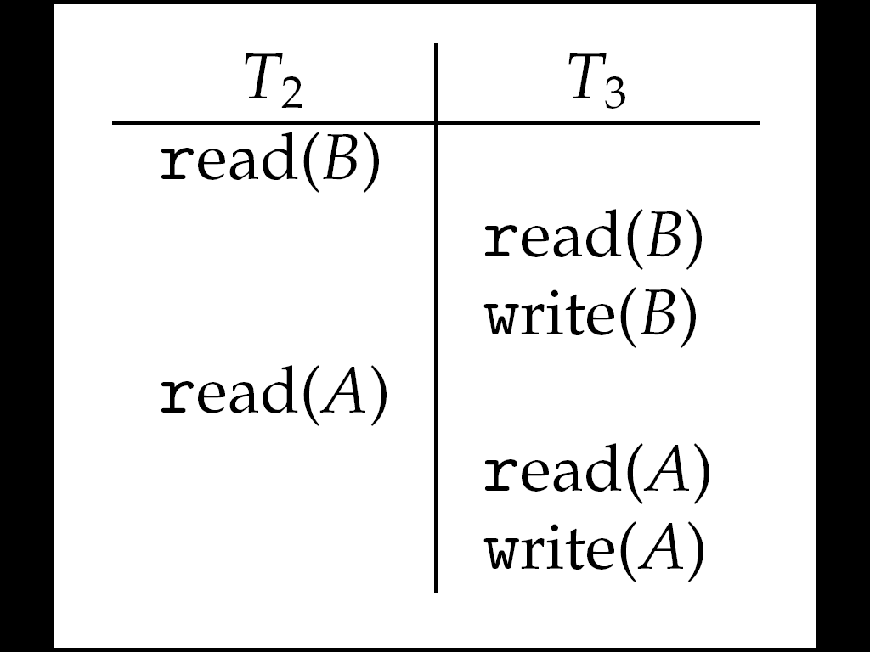
Schedule Possible Under Timestamp Protocol

Slide 74
End of Chapter 5

