Slide 1
Chapter 4: Threads

Slide 2
Layout
Multicore Programming
Multithreading Models
Thread Libraries
Implicit Threading
Threading Issues
Operating System Examples

Slide 3
Objectives
To introduce the notion of a thread
  a fundamental unit of CPU utilization that forms the basis of multithreaded computer systems
To discuss the APIs for
  the Pthreads
  Windows, and
  Java thread libraries
To explore several strategies that provide implicit threading
To examine issues related to multithreaded programming
To cover OS support for threads
  Windows
  Linux

Slide 4
Motivation
Simple and efficient
Thread creation is light-weight
  Process creation is heavy-weight
Multiple tasks can be implemented by separate threads
  Update display
  Fetch data
  Spell checking
  Answer a network request
Most modern applications are multithreaded
  OS Kernels

Slide 5
Multithreaded Server Architecture

Slide 6
Benefits
Responsiveness
  allow continued execution if part of process is blocked
Resource Sharing
  threads share resources of process
Economy
  cheaper than process creation
  thread switching lower overhead than context switching
Scalability
  process can take advantage of multiprocessor architectures

Slide 7
Multicore Programming
Challenges
  Putting pressure on programmers
  Dividing activities
  Balance
  Data splitting
  Data dependency
  Testing and debugging
Parallelism
  implies a system can perform more than one task simultaneously
  Data parallelism-distribute data across m-cores
  Task parallelism-distribute threads across cores
Concurrency
  supports more than one task making progress
  Single processor / core, scheduler providing concurrency

Slide 8
Concurrency vs. Parallelism
Concurrent execution on single-core system:
Parallelism on a multi-core system:

Slide 9
Single and Multithreaded Processes

Slide 10
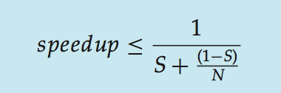
Amdahl’s Law
Identifies performance gains
  adding additional cores to an application that has both serial and parallel components
  S is serial portion
  N processing cores
Example
  if application is 75% parallel / 25% serial, moving from 1 to 2 cores results in speedup of 1.6 times

Slide 11
User Threads and Kernel Threads
User threads
  management done by user-level threads library
  Three primary thread libraries:
    POSIX Pthreads
    Win32 threads
    Java threads
Kernel threads
  Supported by the Kernel
  Examples
    Windows
    Solaris
    Linux
    Tru64 UNIX
    Mac OS X

Slide 12
Multithreading Models
Many-to-One
One-to-One
Many-to-Many

Slide 13
Many-to-One
Many user-level threads →single kernel thread
One thread blocking causes all to block
Multiple threads may not run in parallel on muticore system
  because only one may be in kernel at a time
Few system uses it
Examples:
  Solaris Green Threads
  GNU Portable Threads

Slide 14
One-to-One
Each user-level thread →kernel thread
Creating a user-level thread creates a kernel thread
More concurrency than many-to-one
# threads per process sometimes restricted due to overhead
Examples
  Windows NT/XP/2000
  Linux
  Solaris 9 and later

Slide 15
Many-to-Many Model
many user level threads →many kernel threads
OS creates a sufficient number of kernel threads
Example
  Solaris prior to version 9
  Windows NT/2000 with the ThreadFiber package

Slide 16
Two-level Model
Similar to M:M
  except that it allows a user thread to be bound to kernel thread
Examples
  IRIX
  HP-UX
  Tru64 UNIX
  Solaris 8 and earlier

Slide 17
Thread Libraries
Provides programmer with API
  creating and managing threads
Two primary ways of implementing
  Library entirely in user space
  Kernel-level library supported by the OS

Slide 18
Pthreads
May be provided either as user-level or kernel-level
A POSIX standard (IEEE 1003.1c) API
  thread creation and synchronization
  Specification, not implementation
  specifies behavior of the thread library
  implementation is up to development of the library
  Common in UNIX operating systems
    Solaris
    Linux
    Mac OS X

Slide 19
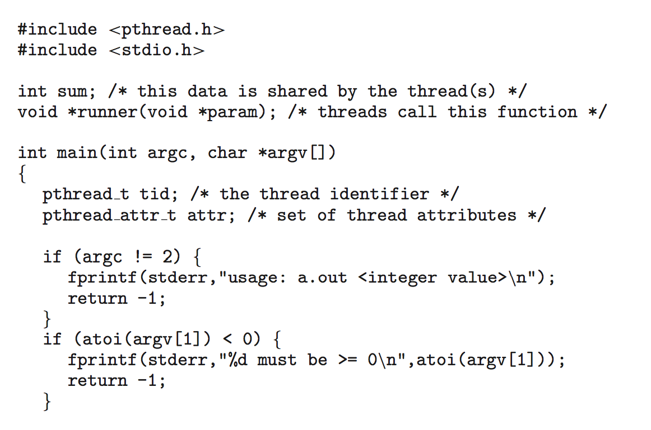
Pthreads Example

Slide 20
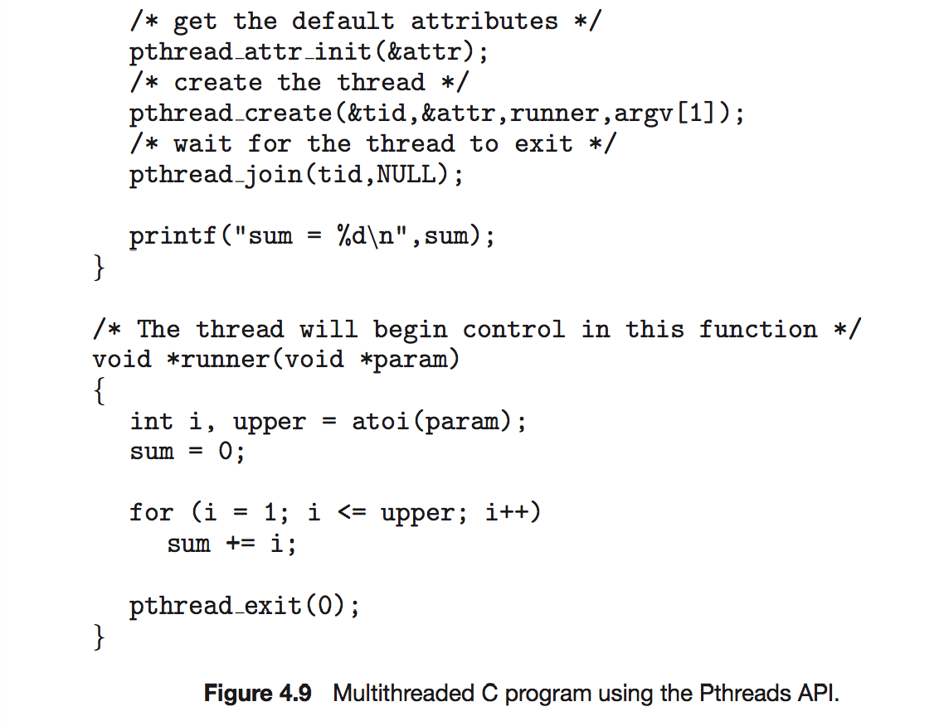
Pthreads Example (Cont.)

Slide 21
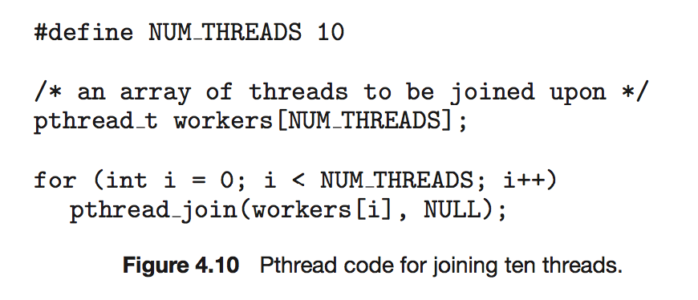
Pthreads Code for Joining 10 Threads

Slide 22
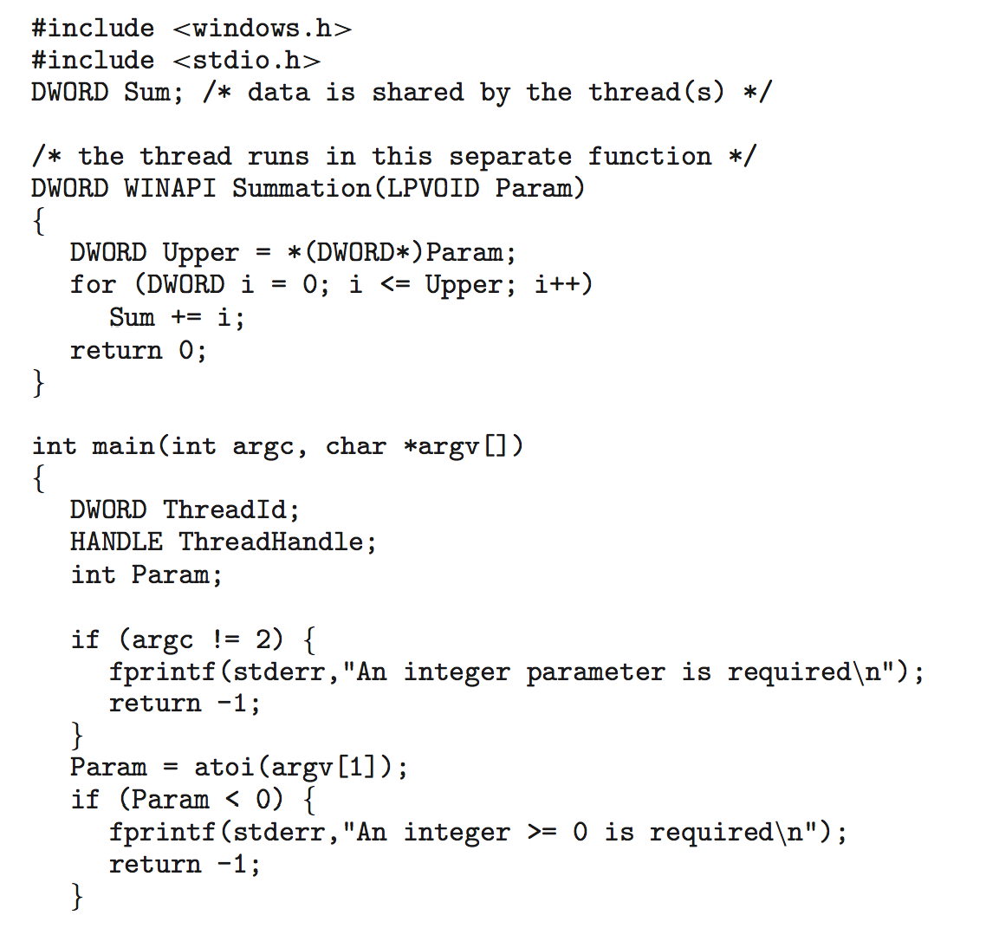
Win32 API Multithreaded C Program

Slide 23
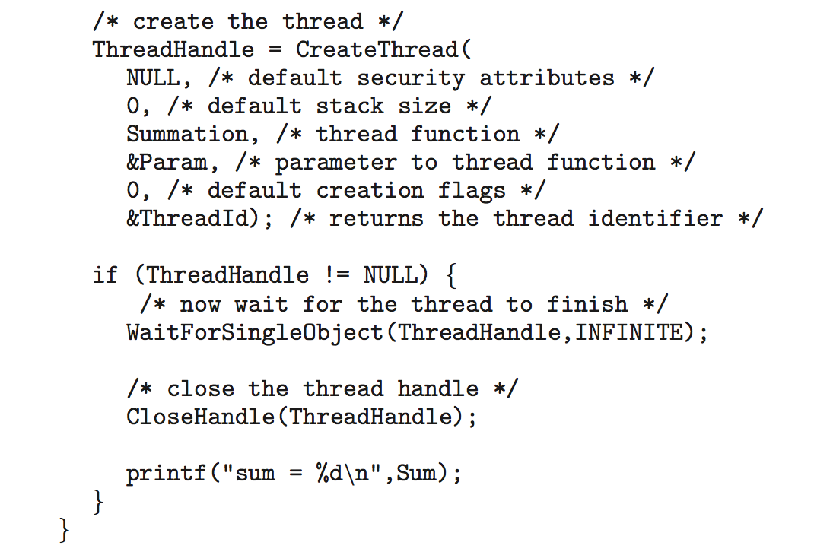
Win32 API Multithreaded C Program (Cont.)

Slide 24
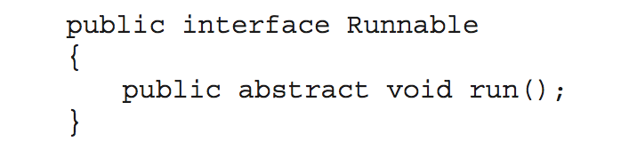
Java Threads
Managed by the JVM
Typically implemented
  using the threads model provided by underlying OS
May be created by:
  Extending Thread class
  Implementing the Runnable interface

Slide 25
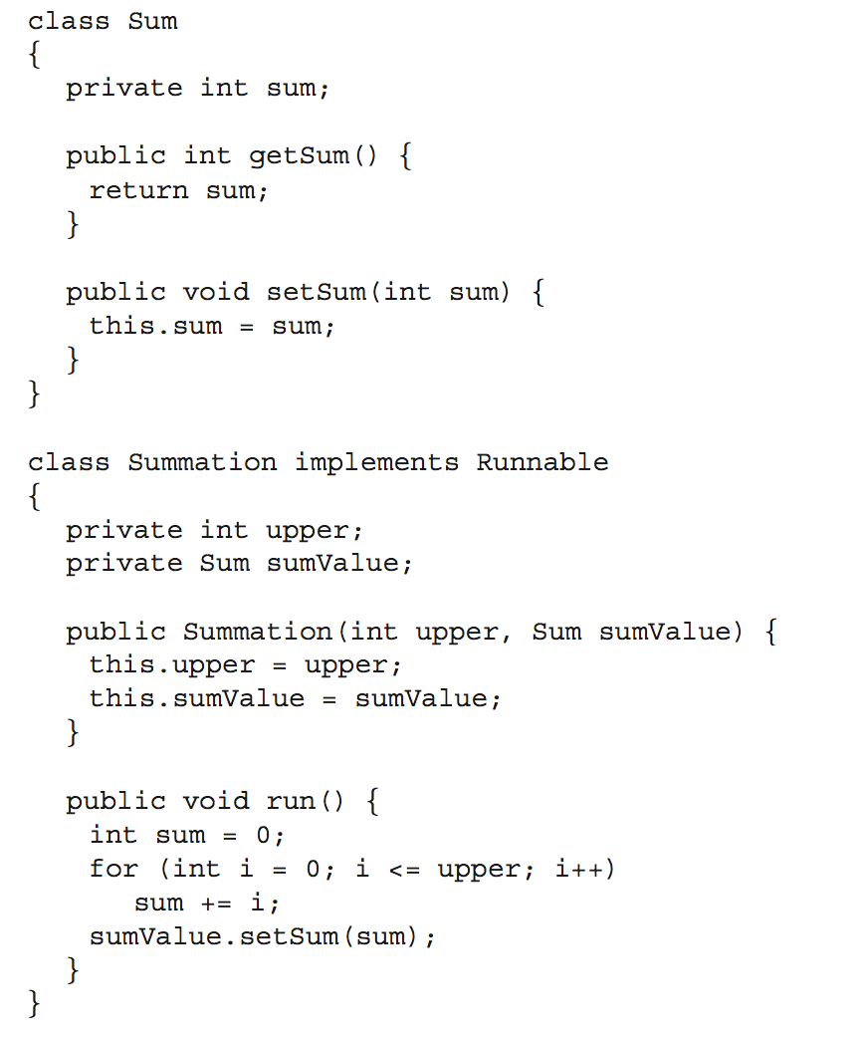
Java Multithreaded Program

Slide 26
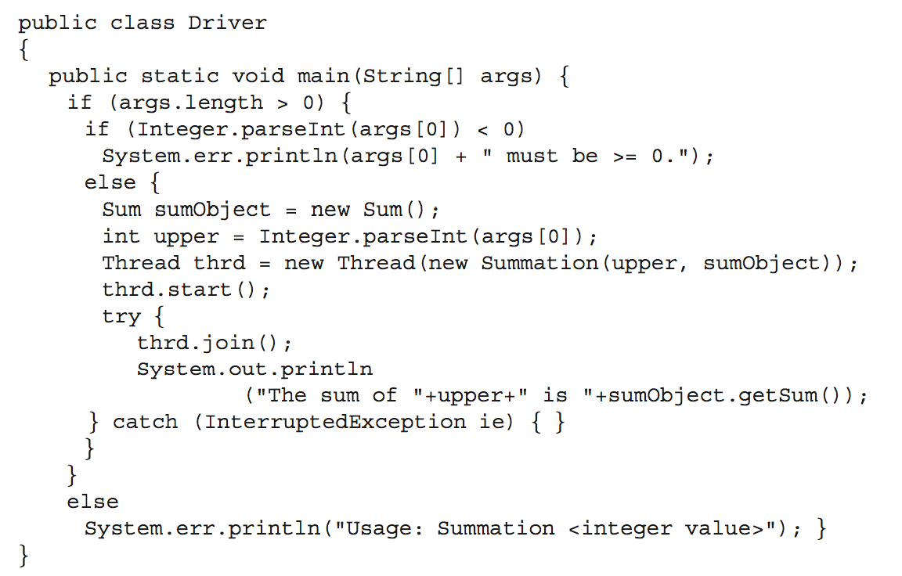
Java Multithreaded Program (Cont.)

Slide 27
Implicit Threading
Created and managed by compilers and run-time libraries
  rather than programmers
Three methods explored
  Thread Pools
  OpenMP
  Grand Central Dispatch
Other methods include
  Microsoft Threading Building Blocks (TBB)
  java.util.concurrent package

Slide 28
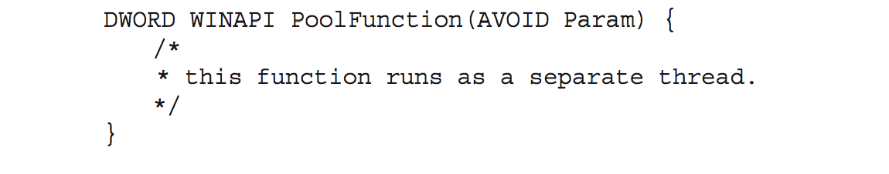
Thread Pools
Threads waiting to work
Advantages:
  faster than create a new thread
  Bind the number of threads in the application(s) to the size of the pool
  Allows different strategies for running task
Windows API supports thread pools:

Slide 29
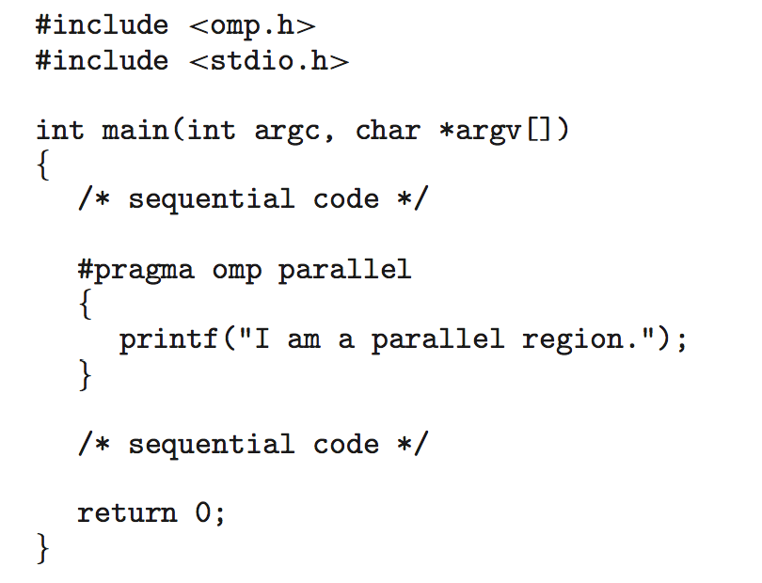
OpenMP
An API
  C, C++, FORTRAN
Parallel programming
Example
#pragma omp parallel
Create as many threads as there are cores
#pragma omp parallel for for(i=0;i<N;i++) {
c[i] = a[i] + b[i];
}
Run for loop in parallel

Slide 30
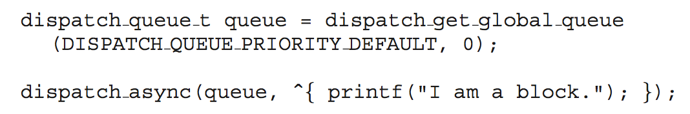
Grand Central Dispatch
Apple technology
Extensions to C, C++ languages, API, and run-time library
Allows identification of parallel sections
Block
  in “^{ }” - ˆ{ printf("I am a block"); }
Blocks placed in dispatch queue
  Assigned to available thread in thread pool when removed from queue
Two types
  serial – blocks removed in FIFO order, queue is per process, called main queue
    Programmers can create additional serial queues within program
  concurrent – removed in FIFO order but several may be removed at a time
    Three system wide queues with priorities low, default, high

Slide 31
Threading Issues
Semantics of fork() and exec() system calls
Signal handling
  Synchronous and asynchronous
Thread cancellation of target thread
  Asynchronous or deferred
Thread-local storage
Scheduler Activations

Slide 32
Semantics of fork() and exec()
Does fork()duplicate only the calling thread or all threads?
  Some UNIXes have two versions of fork
Exec() usually works as normal
  replace the running process including all threads

Slide 33
Signal Handling
Signals
  used in UNIX systems to notify a process that a particular event has occurred
A signal handler
  used to process signals generated by particular event or delivered to a process
  Type
    Default—kernel runs
    user-defined
  User-defined signal handler can override default
  For single-threaded, signal is delivered to process
  For multi-threaded
    Deliver the signal to the thread to which the signal applies
    Deliver the signal to every thread in the process
    Deliver the signal to certain threads in the process
    Assign a specific thread to receive all signals for the process

Slide 34
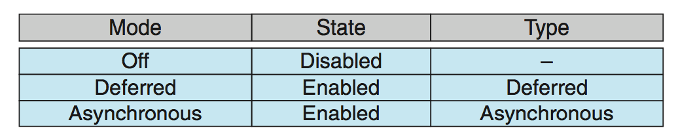
Thread Cancellation (Cont.)
Actual cancellation depends on thread state
If cancellation disabled
  cancellation remains pending until thread enables it
Default type is deferred
For Linux systems
  thread cancellation is handled through signals

Slide 35
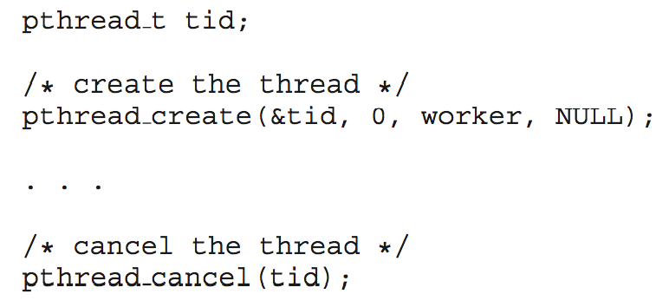
Thread Cancellation
Asynchronous cancellation
  terminates the target thread immediately
Deferred cancellation
  allows the target thread to periodically check if it should be cancelled
Example
  Pthread code to create and cancel a thread:

Slide 36
Thread-Local Storage (TLS)
Each thread has its own copy of data
  Useful when you do not have control over the thread creation process
TLS vs. local variables
  Local variables visible only during single function invocation
  TLS is visible across function invocations
  TLS is unique to each thread

Slide 37
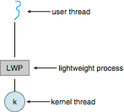
Scheduler Activations
Lightweight process (LWP)
  an intermediate data structure between user and kernel threads
  Appears to be a virtual processor on which process can schedule user thread to run
  Each LWP attached to kernel thread
  How many LWPs to create?
Scheduler activations
  provide upcalls
  a communication mechanism from the kernel to the upcall handler in the thread library
  This communication allows an application to maintain the correct number kernel threads

Slide 38
Operating System Examples
Windows XP Threads
Linux Thread
Notes:
38

Slide 39
Windows Threads
One-to-one mapping, kernel-level
Each thread contains
  A thread id
  Register set representing state of processor
  Separate user and kernel stacks when thread runs in user mode or kernel mode
  Private data storage area used by run-time libraries and dynamic link libraries (DLLs)
Context of a thread
  The register set, stacks, and private storage area
The primary data structures
  ETHREAD (executive thread block)
    includes pointer to process to which thread belongs and to KTHREAD, in kernel space
  KTHREAD (kernel thread block)
    scheduling and synchronization info, kernel-mode stack, pointer to TEB, in kernel space
  TEB (thread environment block)
    thread id, user-mode stack, thread-local storage, in user space

Slide 40
Windows XP Threads Data Structures

Slide 41
Linux Threads
Called tasks rather than threads
creation
  through clone() system call
clone()
  allows a child task to share the address space of the parent task (process)
struct task_struct
  points to process data structures (shared or unique)

Slide 42
End of Chapter 4

