Slide 1
Chapter 3: Processes

Slide 2
Chapter 3: Processes
Concept
Scheduling
Operations
Interprocess Communication (IPC)
Examples of IPC Systems
Communication
  Client-Server Systems

Slide 3
Objectives
To introduce the notion of a process
To describe the various features of processes
  scheduling
  creation
  termination, and
  communication
To explore interprocess communication
  shared memory
  message passing
To describe communication in client-server systems

Slide 4
Process Concept
Process
  a program in execution
  job
Multiple parts in a Process
  Code section
  Program counter, processor registers
  Stack
  Data section
  Heap
    containing memory dynamically allocated during run time
Program and Process
  Passive and active
  One to one or one to many

Slide 5
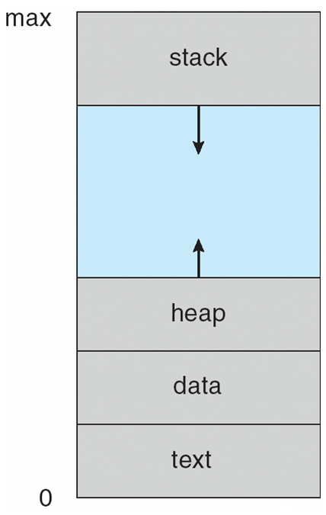
Process in Memory

Slide 6
Process State
Changes during execution
  new
    The process is being created
  running
    Instructions are being executed
  waiting
    The process is waiting for some event to occur
  ready
    The process is waiting to be assigned to a processor
  terminated
    The process has finished execution

Slide 7
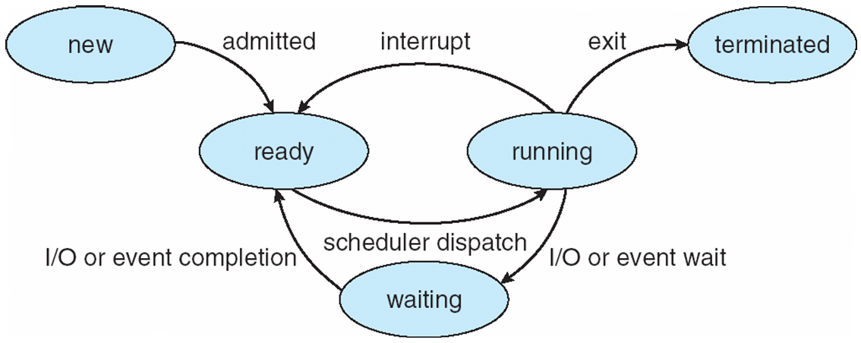
Diagram of Process State

Slide 8
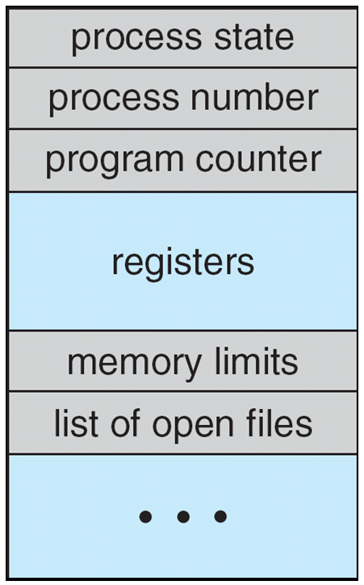
Process Control Block (PCB)
Process state
  running, waiting, etc
Program counter
  location of instruction to next execute
CPU registers
  contents of all process-centric registers
CPU scheduling information
  priorities, scheduling queue pointers
Memory management information
  memory allocated to the process
Accounting information
  CPU used, clock time elapsed since start, time limits
I/O status information
  I/O devices allocated to process, list of open files

Slide 9
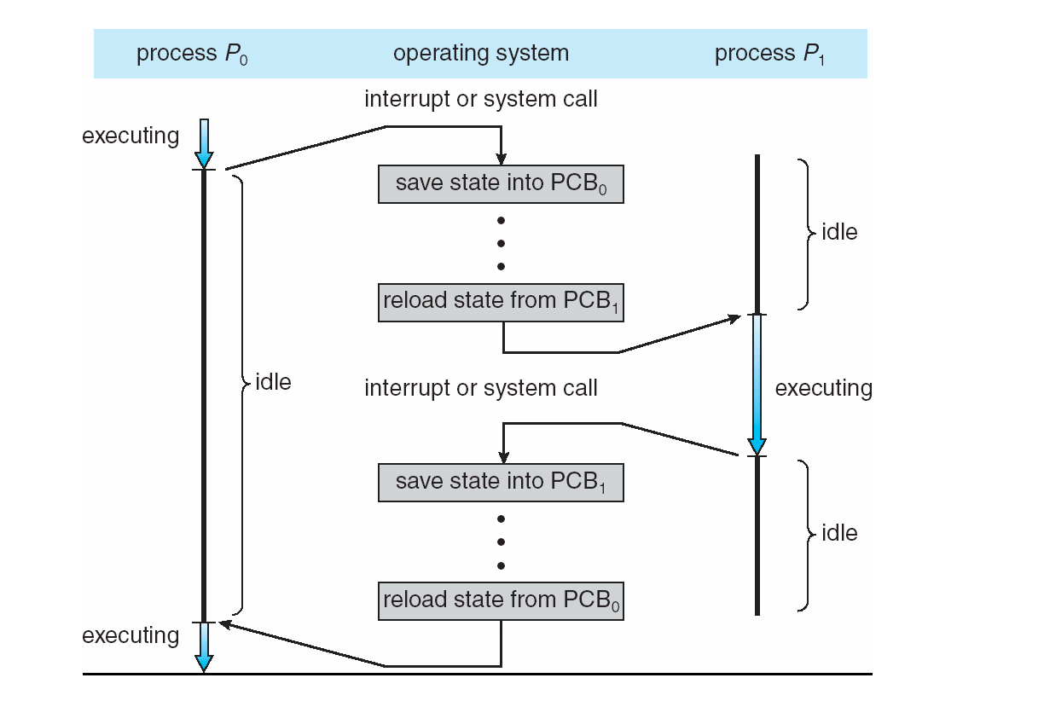
CPU Switch From Process to Process

Slide 10
Threads
Each process may have one or more threads
See next chapter

Slide 11
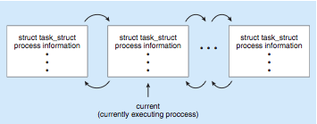
Process Representation in Linux
Represented by the C structure task_struct
pid t pid; /* process identifier */
long state; /* state of the process */
unsigned int time slice /* scheduling information */
struct task struct *parent; /* this process’s parent */
struct list head children; /* this process’s children */
struct files struct *files; /* list of open files */
struct mm struct *mm; /* address space of this process */

Slide 12
Process Scheduling
Purpose
  Maximize CPU usage
Process scheduler
  selects among available processes for next execution on CPU
  Maintains scheduling queues of processes
    Job queue
      set of all processes in the system
    Ready queue
      set of all processes residing in main memory, ready and waiting to execute
    Device queues
      set of processes waiting for an I/O device
Processes migrate among the various queues

Slide 13
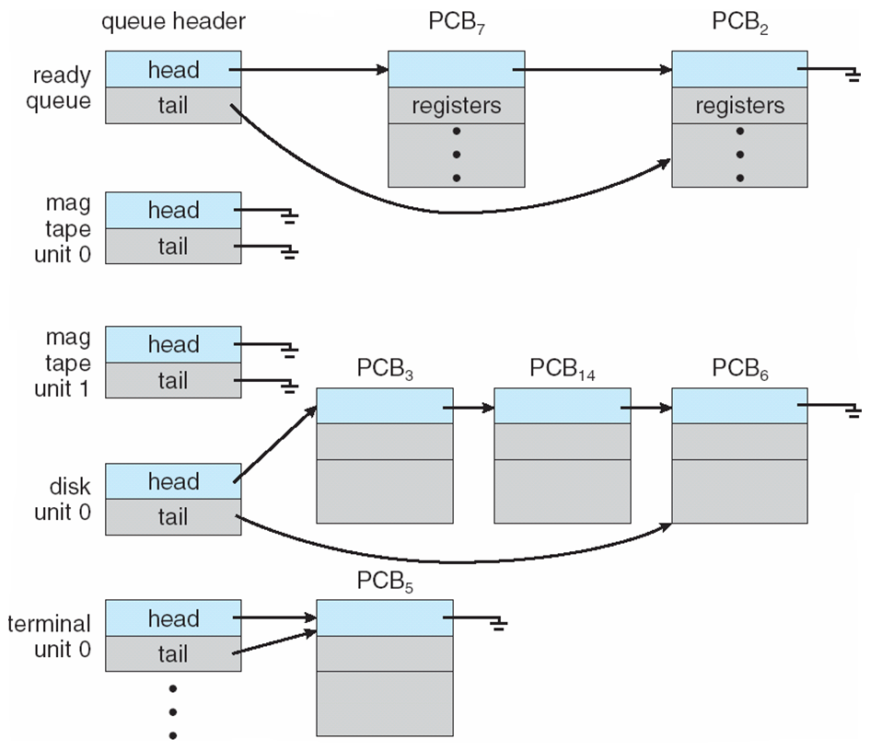
Ready Queue And Various
I/O Device Queues

Slide 14
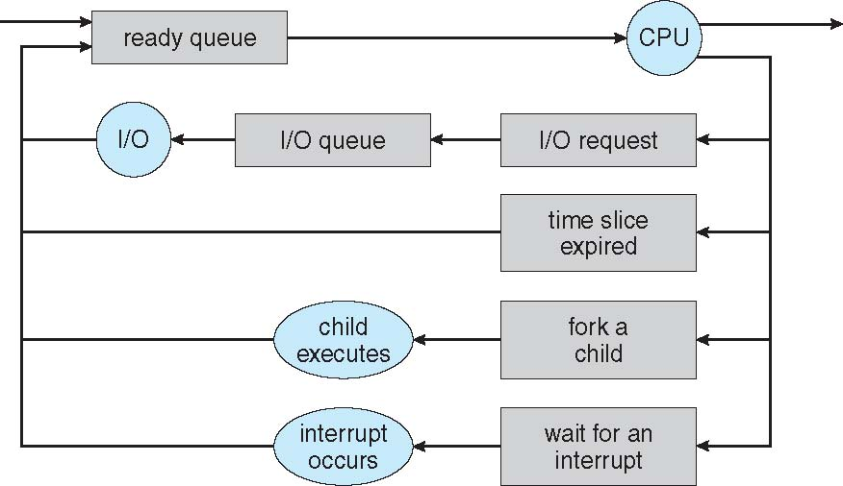
Representation of Process Scheduling
Queuing diagram represents queues, resources, flows

Slide 15
Schedulers
Long-term scheduler
  Job scheduler
  Determine process to be brought into the ready queue
  Invoked in seconds/minutes
  Controls the degree of multiprogramming
Short-term scheduler
  CPU scheduler
  Determines the process to be executed next
  Sometimes the only scheduler in a system
  Invoked in milliseconds-very fast
I/O-bound process
  Spends more time doing I/O than computations
  many short CPU bursts
CPU-bound process
  Spends more time doing computations
  few very long CPU bursts

Slide 16
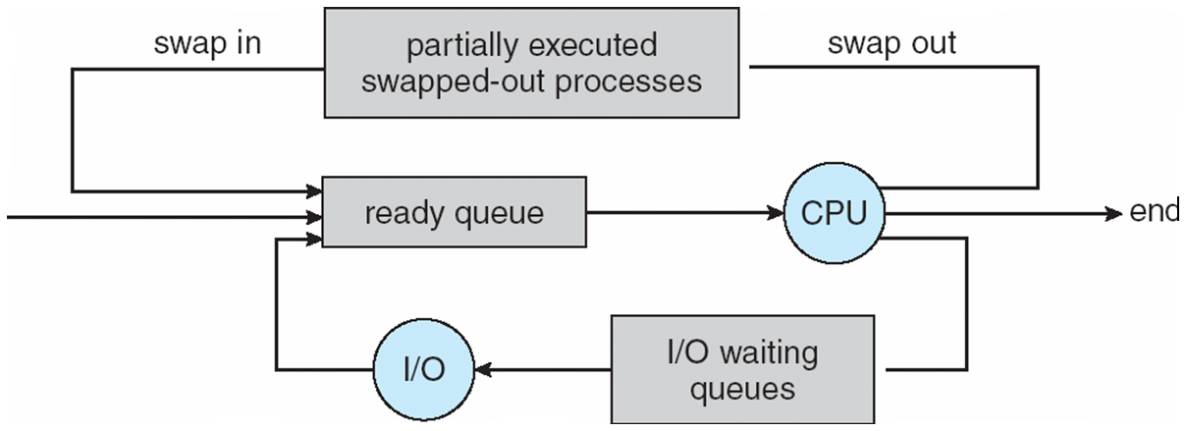
Addition of Medium Term Scheduling
Medium-term scheduler
  Applicable only if degree of multiple programming needs to decrease
  Remove process from memory
  store on disk
  bring back in from disk to continue execution: swapping

Slide 17
Multitasking in Mobile Systems
Some systems / early systems
  allow only one process to run, others suspended
Android allows multitasking
  Run foreground and background, with fewer limits
  Background process uses a service to perform tasks
  Service can keep running even if background process is suspended
  Service has no user interface, small memory use

Slide 18
Context Switch
CPU switch to another process
  Save the current state
  Load the saved state
  Context
  represented in the PCB
Context-switch time
  Overhead → the system does no useful work while switching
  The more complex the OS and the PCB → longer the context switch
  Dependent on hardware support
    multiple sets of registers per CPU → multiple contexts loaded at once

Slide 19
Operations on Processes
System must provide mechanisms
  process creation
  Termination
  ….

Slide 20
Process Creation
Process creation can cause a tree of processes
PID is used to identify and manage the Process.
Resource sharing
  Parent and children share all resources
  Children share subset of parent’s resources
  Parent and child share no resources
Execution
  Parent and children execute concurrently
  Parent waits until children terminate

Slide 21
A Tree of Processes in Linux

Slide 22
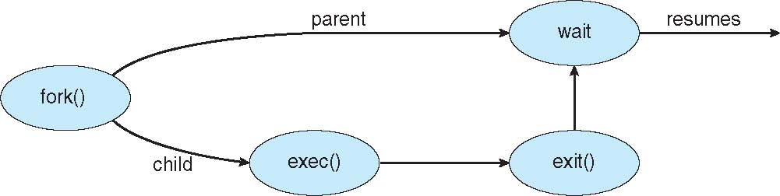
Process Creation (Cont.)
Address space
  Child duplicate of parent
  Child has a program loaded into it
UNIX examples
  fork() system call creates new process
  exec() system call used after a fork() to replace the process’ memory space with a new program

Slide 23
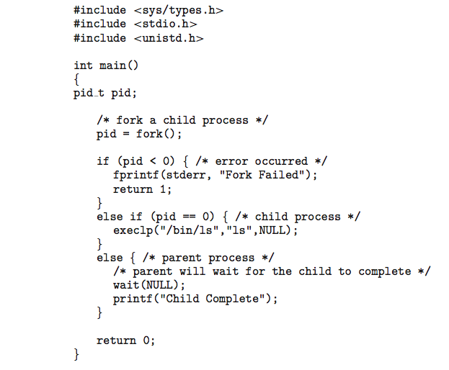
C Program forking Separate Process

Slide 24
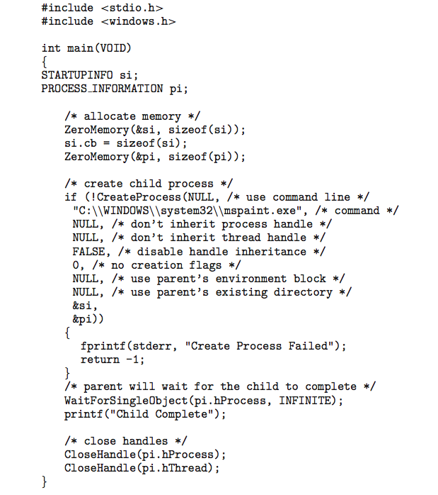
Creating a Separate Process via Windows API

Slide 25
Process Termination
Process executes last statement and asks the operating system to delete it (exit())
  Output data from child to parent (via wait())
  Process’ resources are deallocated by operating system
Parent may terminate execution of children processes (abort())
  Child has exceeded allocated resources
  Task assigned to child is no longer required
  If parent is exiting
    Some operating systems do not allow child to continue if its parent terminates
      All children terminated - cascading termination
Wait for termination, returning the pid:
pid t pid; int status;
pid = wait(&status);
If no parent waiting, then terminated process is a zombie
If parent terminated, processes are orphans

Slide 26
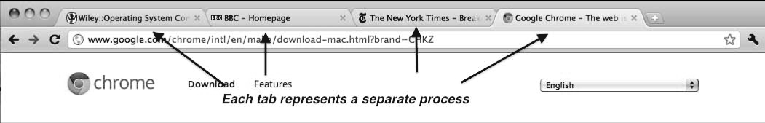
Multiprocess Architecture – Chrome Browser
Many web browsers ran as single process (some still do)
  If one web site causes trouble, entire browser can hang or crash
Google Chrome Browser is multiprocess with 3 categories
  Browser process manages user interface, disk and network I/O
  Renderer process renders web pages, deals with HTML, Javascript, new one for each website opened
    Runs in sandbox restricting disk and network I/O, minimizing effect of security exploits
  Plug-in process for each type of plug-in

Slide 27
Interprocess Communication
Processes within a system may be independent or cooperating
Cooperating process can affect or be affected by other processes, including sharing data
Reasons for cooperating processes:
  Information sharing
  Computation speedup
  Modularity
  Convenience
Cooperating processes need interprocess communication (IPC)
Two models of IPC
  Shared memory
  Message passing

Slide 28
Communications Models

Slide 29
Cooperating Processes
Independent process cannot affect or be affected by the execution of another process
Cooperating process can affect or be affected by the execution of another process
Advantages of process cooperation
  Information sharing
  Computation speed-up
  Modularity
  Convenience

Slide 30
Producer-Consumer Problem
Paradigm for cooperating processes, producer process produces information that is consumed by a consumer process
  unbounded-buffer places no practical limit on the size of the buffer
  bounded-buffer assumes that there is a fixed buffer size

Slide 31
Bounded-Buffer – Shared-Memory Solution
Shared data
      #define BUFFER_SIZE 10
      typedef struct {
      . . .
      } item;
      item buffer[BUFFER_SIZE];
      int in = 0;
      int out = 0;
Solution is correct, but can only use BUFFER_SIZE-1 elements

Slide 32
Bounded-Buffer – Producer
item next produced;
while (true) {
/* produce an item in next produced */
while (((in + 1) % BUFFER SIZE) == out)
; /* do nothing */
buffer[in] = next produced;
in = (in + 1) % BUFFER SIZE;
}

Slide 33
Bounded Buffer – Consumer
item next consumed;
while (true) {
while (in == out)
; /* do nothing */
next consumed = buffer[out];
out = (out + 1) % BUFFER SIZE;
/* consume the item in next consumed */
}

Slide 34
Interprocess Communication – Message Passing
Mechanism for processes to communicate and to synchronize their actions
Message system – processes communicate with each other without resorting to shared variables
IPC facility provides two operations:
  send(message) – message size fixed or variable
  receive(message)
If P and Q wish to communicate, they need to:
  establish a communication link between them
  exchange messages via send/receive
Implementation of communication link
  physical (e.g., shared memory, hardware bus)
  logical (e.g., direct or indirect, synchronous or asynchronous, automatic or explicit buffering)

Slide 35
Implementation Questions
How are links established?
Can a link be associated with more than two processes?
How many links can there be between every pair of communicating processes?
What is the capacity of a link?
Is the size of a message that the link can accommodate fixed or variable?
Is a link unidirectional or bi-directional?

Slide 36
Direct Communication
Processes must name each other explicitly:
  send (P, message) – send a message to process P
  receive(Q, message) – receive a message from process Q
Properties of communication link
  Links are established automatically
  A link is associated with exactly one pair of communicating processes
  Between each pair there exists exactly one link
  The link may be unidirectional, but is usually bi-directional

Slide 37
Indirect Communication
Messages are directed and received from mailboxes (also referred to as ports)
  Each mailbox has a unique id
  Processes can communicate only if they share a mailbox
Properties of communication link
  Link established only if processes share a common mailbox
  A link may be associated with many processes
  Each pair of processes may share several communication links
  Link may be unidirectional or bi-directional

Slide 38
Indirect Communication
Operations
  create a new mailbox
  send and receive messages through mailbox
  destroy a mailbox
Primitives are defined as:
send(A, message) – send a message to mailbox A
receive(A, message) – receive a message from mailbox A

Slide 39
Indirect Communication
Mailbox sharing
  P₁, P₂, and P₃ share mailbox A
  P₁, sends; P₂ and P₃ receive
  Who gets the message?
Solutions
  Allow a link to be associated with at most two processes
  Allow only one process at a time to execute a receive operation
  Allow the system to select arbitrarily the receiver. Sender is notified who the receiver was.

Slide 40
Synchronization
Message passing may be either blocking or non-blocking
Blocking is considered synchronous
  Blocking send has the sender block until the message is received
  Blocking receive has the receiver block until a message is available
Non-blocking is considered asynchronous
  Non-blocking send has the sender send the message and continue
  Non-blocking receive has the receiver receive a valid message or null
}

Slide 41
Synchronization (Cont.)
Different combinations possible
  If both send and receive are blocking, we have a rendezvous
Producer-consumer becomes trivial
message next produced;
while (true) {
/* produce an item in next produced */
send(next produced);
}
message next consumed;
while (true) {
receive(next consumed);
/* consume the item in next consumed */
}

Slide 42
Buffering
Queue of messages attached to the link; implemented in one of three ways
  1. Zero capacity – 0 messages
  Sender must wait for receiver (rendezvous)
  2. Bounded capacity – finite length of n messages
  Sender must wait if link full
  3. Unbounded capacity – infinite length
  Sender never waits

Slide 43
Examples of IPC Systems - POSIX
POSIX Shared Memory
  Process first creates shared memory segment
  shm_fd = shm_open(name, O CREAT | O RDRW, 0666);
  Also used to open an existing segment to share it
  Set the size of the object
ftruncate(shm fd, 4096);
  Now the process could write to the shared memory
  sprintf(shared memory, "Writing to shared memory");

Slide 44
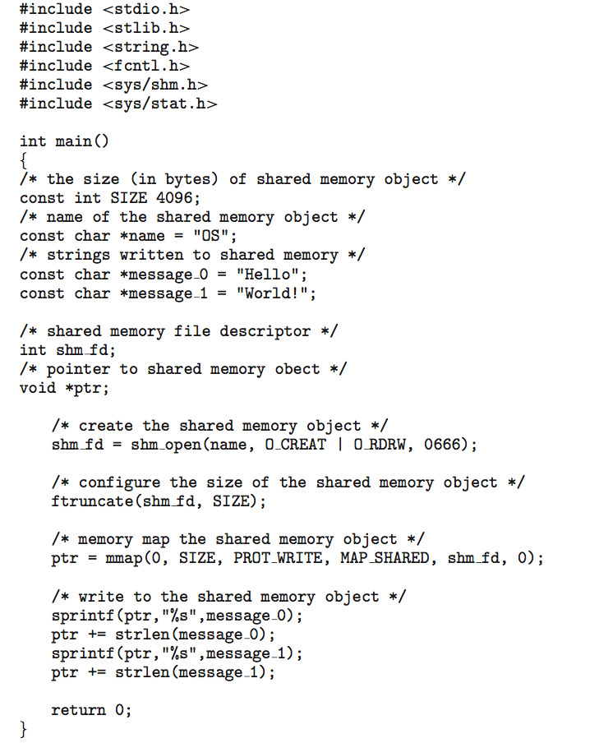
IPC POSIX Producer

Slide 45
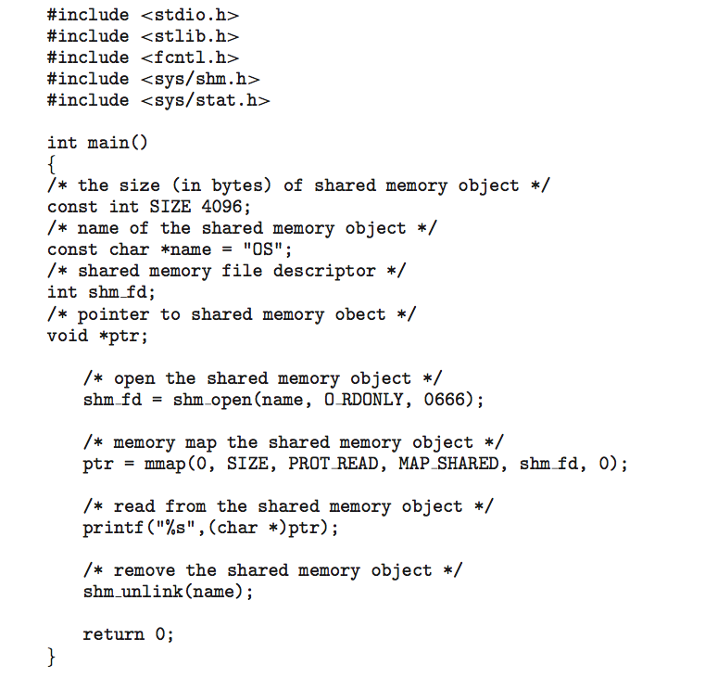
IPC POSIX Consumer

Slide 46
Examples of IPC Systems - Mach
Mach communication is message based
  Even system calls are messages
  Each task gets two mailboxes at creation- Kernel and Notify
  Only three system calls needed for message transfer
  msg_send(), msg_receive(), msg_rpc()
  Mailboxes needed for commuication, created via
  port_allocate()
  Send and receive are flexible, for example four options if mailbox full:
    Wait indefinitely
    Wait at most n milliseconds
    Return immediately
    Temporarily cache a message

Slide 47
Examples of IPC Systems – Windows
Message-passing centric via advanced local procedure call (LPC) facility
  Only works between processes on the same system
  Uses ports (like mailboxes) to establish and maintain communication channels
  Communication works as follows:
    The client opens a handle to the subsystem’s connection port object.
    The client sends a connection request.
    The server creates two private communication ports and returns the handle to one of them to the client.
    The client and server use the corresponding port handle to send messages or callbacks and to listen for replies.

Slide 48
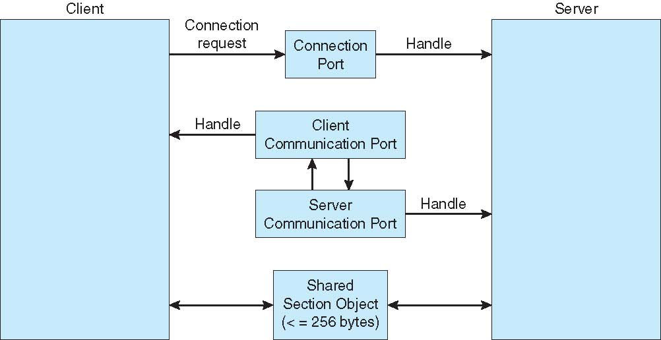
Local Procedure Calls in Windows XP

Slide 49
Communications in Client-Server Systems
Sockets
Remote Procedure Calls
Pipes
Remote Method Invocation (Java)

Slide 50
Sockets
A socket is defined as an endpoint for communication
Concatenation of IP address and port – a number included at start of message packet to differentiate network services on a host
The socket 161.25.19.8:1625 refers to port 1625 on host 161.25.19.8
Communication consists between a pair of sockets
All ports below 1024 are well known, used for standard services
Special IP address 127.0.0.1 (loopback) to refer to system on which process is running

Slide 51
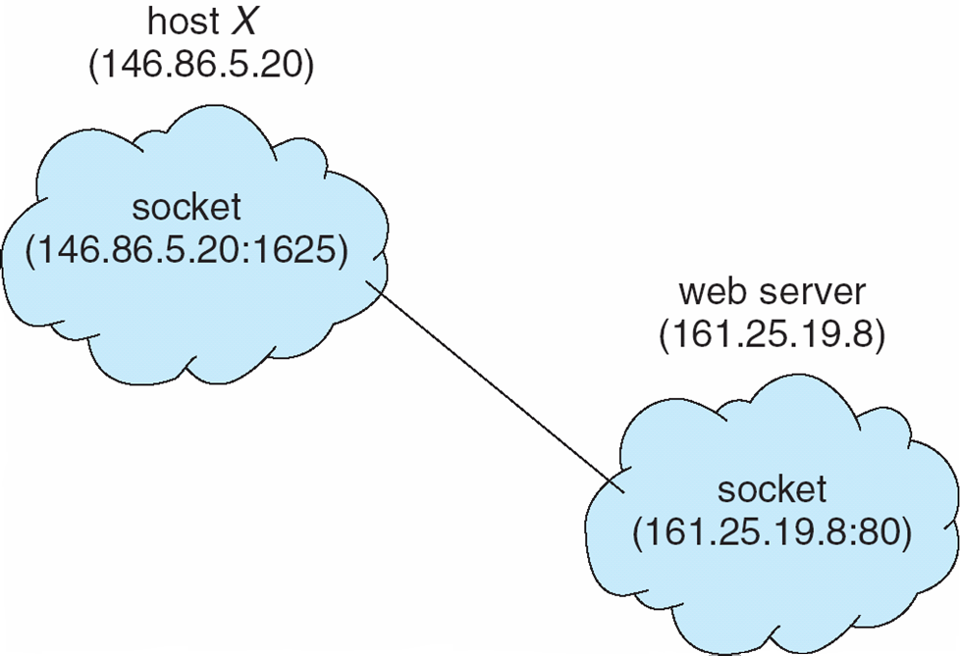
Socket Communication

Slide 52
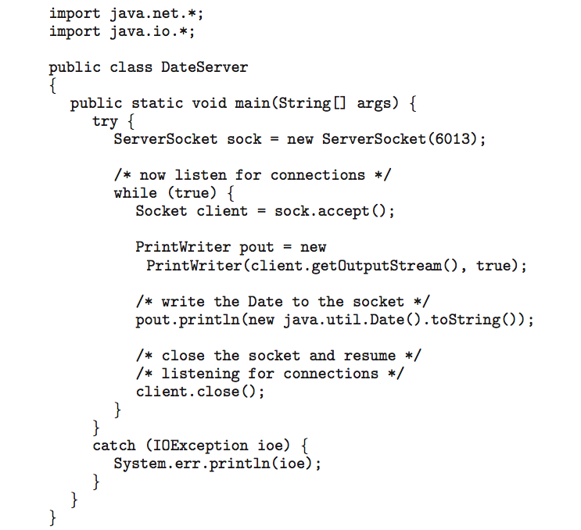
Sockets in Java
Three types of sockets
  Connection-oriented (TCP)
  Connectionless (UDP)
  MulticastSocket class– data can be sent to multiple recipients
Consider this “Date” server:

Slide 53
Remote Procedure Calls
Remote procedure call (RPC) abstracts procedure calls between processes on networked systems
  Again uses ports for service differentiation
Stubs – client-side proxy for the actual procedure on the server
The client-side stub locates the server and marshalls the parameters
The server-side stub receives this message, unpacks the marshalled parameters, and performs the procedure on the server
On Windows, stub code compile from specification written in Microsoft Interface Definition Language (MIDL)
Data representation handled via External Data Representation (XDL) format to account for different architectures
  Big-endian and little-endian
Remote communication has more failure scenarios than local
  Messages can be delivered exactly once rather than at most once
OS typically provides a rendezvous (or matchmaker) service to connect client and server

Slide 54
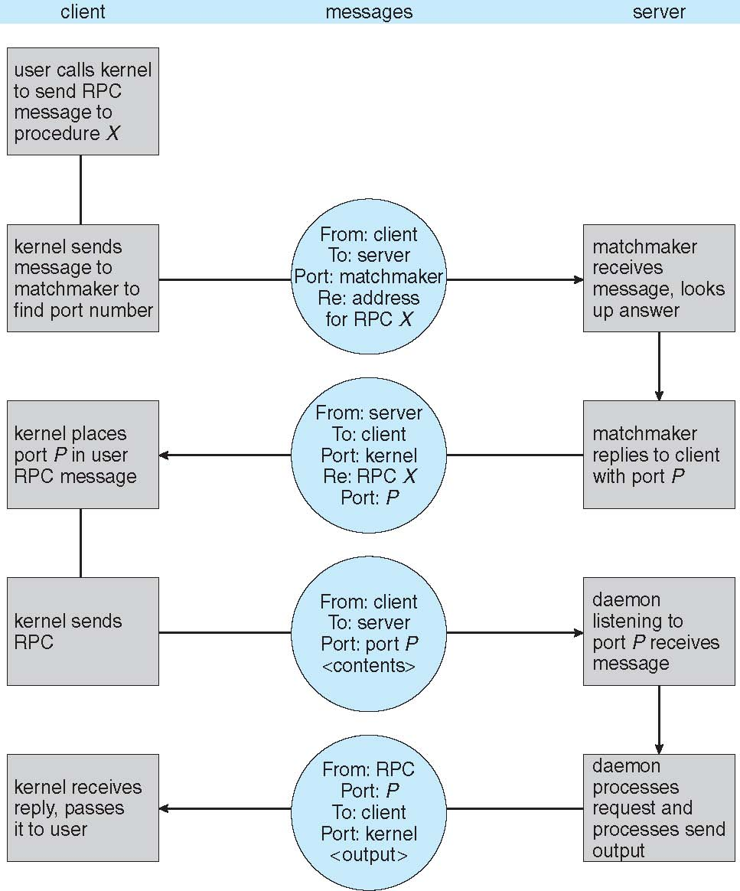
Execution of RPC

Slide 55
Pipes
Acts as a conduit allowing two processes to communicate
Issues
  Is communication unidirectional or bidirectional?
  In the case of two-way communication, is it half or full-duplex?
  Must there exist a relationship (i.e. parent-child) between the communicating processes?
  Can the pipes be used over a network?

Slide 56
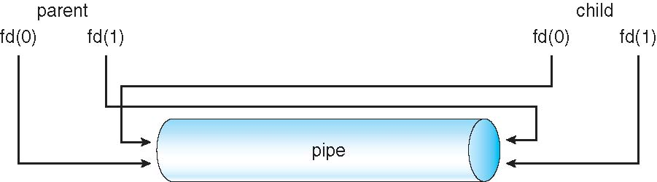
Ordinary Pipes
Ordinary Pipes allow communication in standard producer-consumer style
Producer writes to one end (the write-end of the pipe)
Consumer reads from the other end (the read-end of the pipe)
Ordinary pipes are therefore unidirectional
Require parent-child relationship between communicating processes
Windows calls these anonymous pipes
See Unix and Windows code samples in textbook

Slide 57
Named Pipes
Named Pipes are more powerful than ordinary pipes
Communication is bidirectional
No parent-child relationship is necessary between the communicating processes
Several processes can use the named pipe for communication
Provided on both UNIX and Windows systems

Slide 58
End of Chapter 3

