Slide 1
Chapter 2: Operating-System Structures

Slide 2
Chapter 2: Operating-System Structures
Services
User Interface
System Calls
Types of System Calls
System Programs
Design and Implementation
Structure
Debugging
Generation
System Boot

Slide 3
Objectives
the services
  to users
  To processes, and
  To other systems
How to structure an OS
OS
  Installation
  Customization
  Booting

Slide 4
Operating System Services
User interface
  CLI
  GUI
  Batch
Program execution
I/O operations
  a file, or
  an I/O device
File-system manipulation

Slide 5
Operating System Services (Cont.)
  Process Communications
    over a network
    shared memory
    message passing
  Error detection and handling
    CPU
    Memory
    I/O devices
    File operations

Slide 6
Operating System Services (Cont.)
Resource allocation
Accounting
Protection and security
  Protection
    involves ensuring that all access to system resources is controlled
  Security
    Authentication
    Defending external I/O devices from invalid access attempts

Slide 7
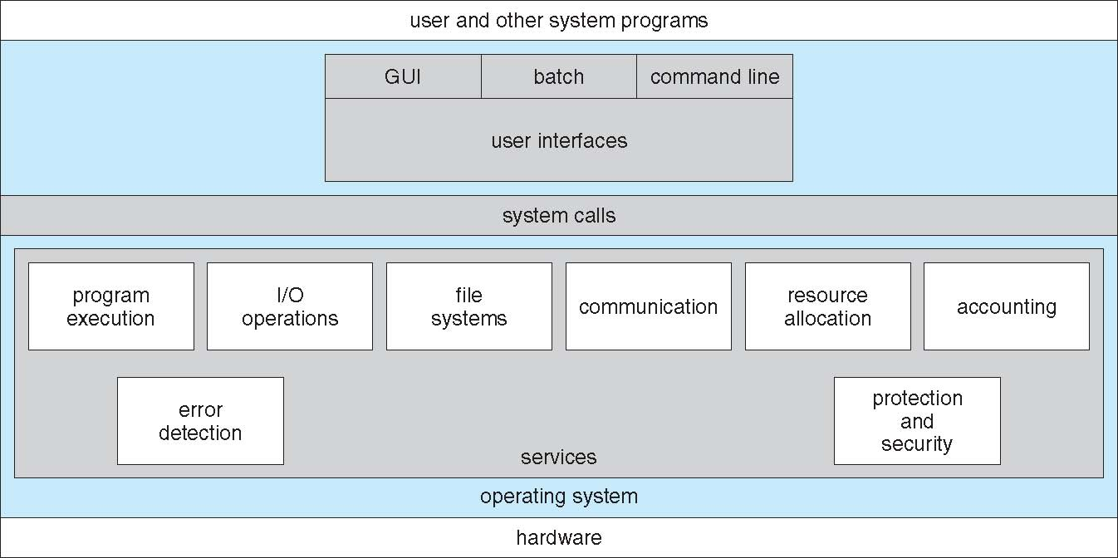
A View of Operating System Services

Slide 8
CLI
allows direct command entry
  Kernel
  systems program
  shells

Slide 9
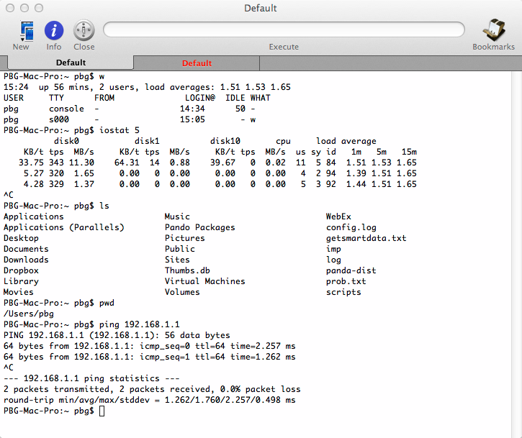
CLI example-Bourne Shell

Slide 10
GUI
User-friendly
  Usually mouse, keyboard, and monitor
  Icons represent files, programs, actions, etc
  Invented at Xerox PARC
Hybrid system (GUI and CLI)
  MS Windows
  Apple Mac OS
  Unix and Linux

Slide 11
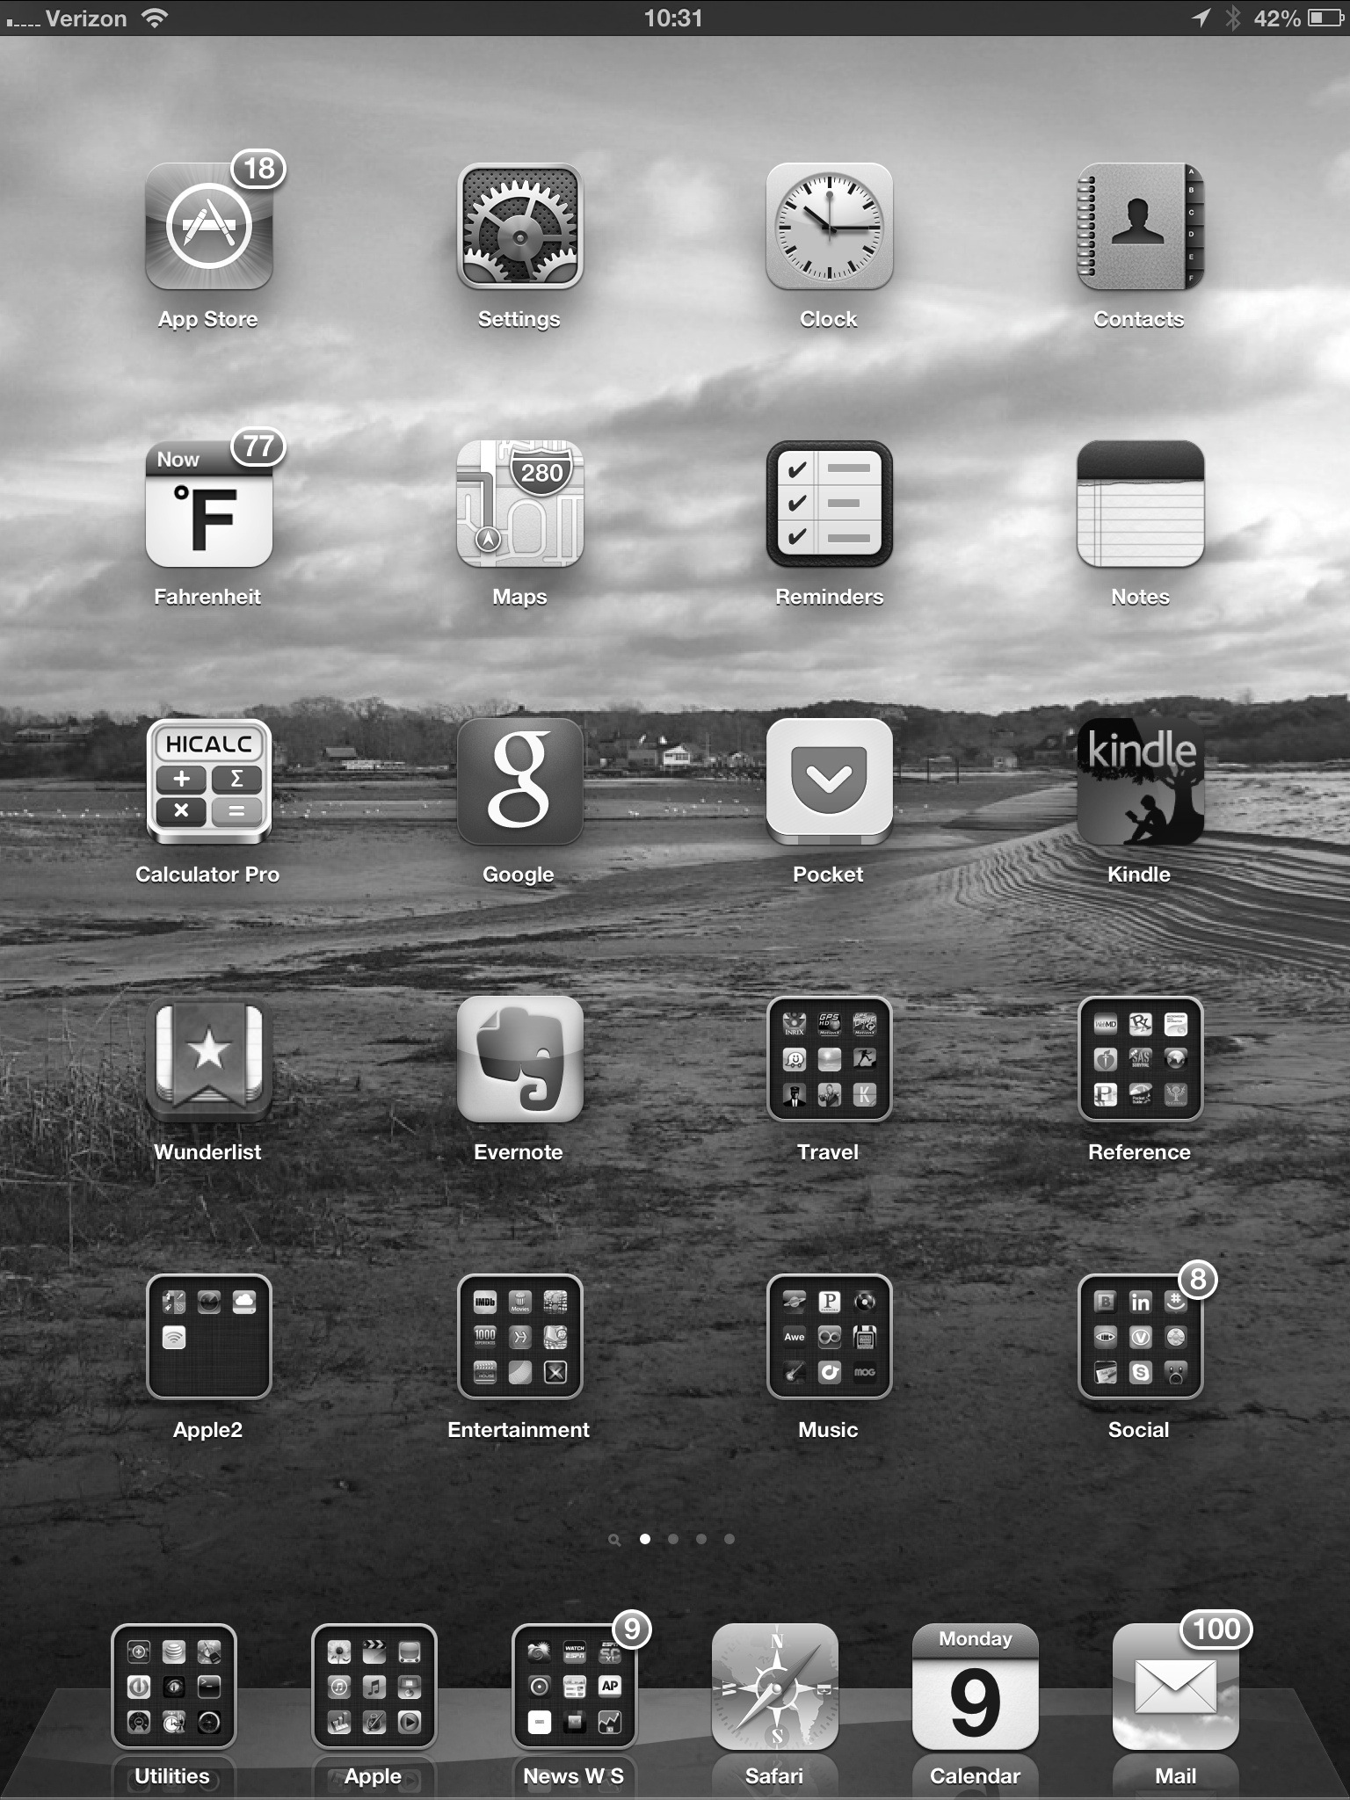
Touchscreen Interfaces
New interfaces
  Mouse not possible or not desired
  Actions and selection based on gestures
  Virtual keyboard for text entry

Slide 12
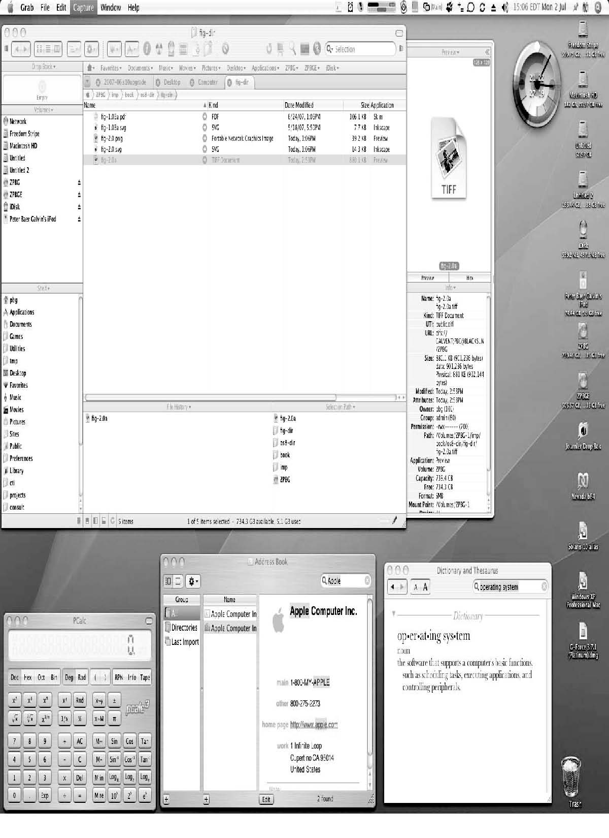
The Mac OS X GUI

Slide 13
System Calls
Programming interface
  to the services provided by the OS
Written in C or C++
Mostly accessed via API
  Win32 API
  POSIX API
  Java API
Why use APIs rather than system calls?

Slide 14
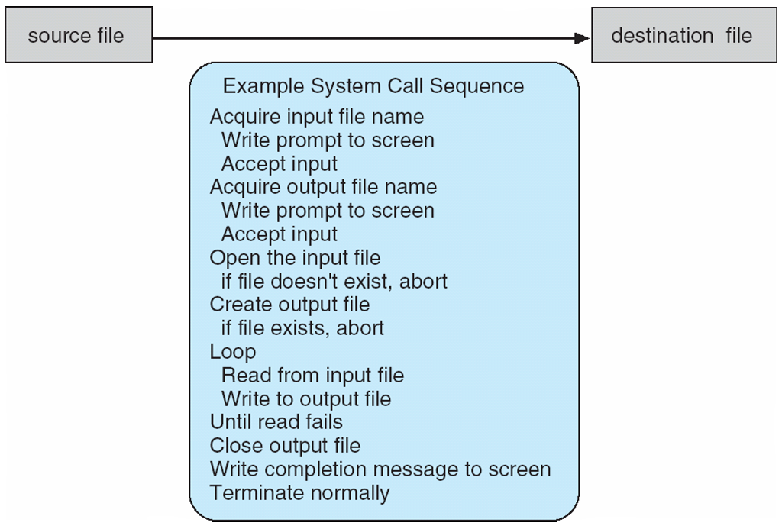
Example of System Calls
System call sequence
  copy the contents of one file to another file

Slide 15
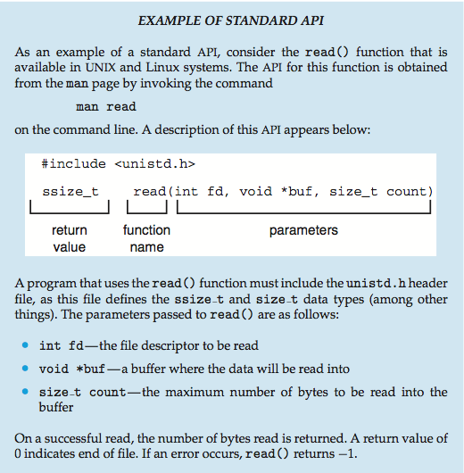
Example of Standard API

Slide 16
System Call Implementation
System-call interface
  A number is associated with a system call
  Maintains a table indexed according to these numbers
  Invokes intended system call in OS kernel, and
  Returns status of the system call and any return values
The caller
  Needs know nothing about the implementation
  Needs to obey API
  Understands what OS will do as a result call
  Most details of OS interface hidden from programmer by API
    Static library
    Run-time library (DLL)

Slide 17
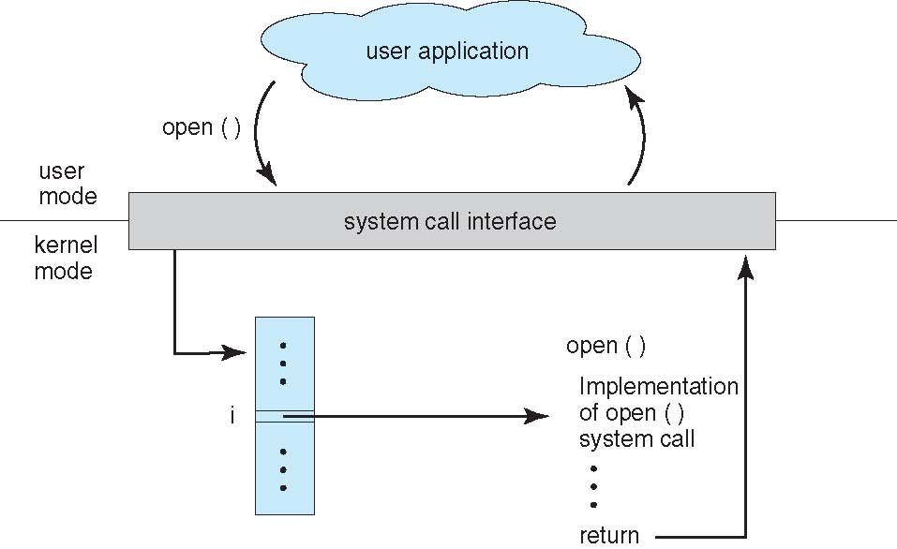
API – System Call – OS Relationship

Slide 18
Passing Parameters from SC to OS
Three Ways
  Register-value
  Register-address
  Stack

Slide 19
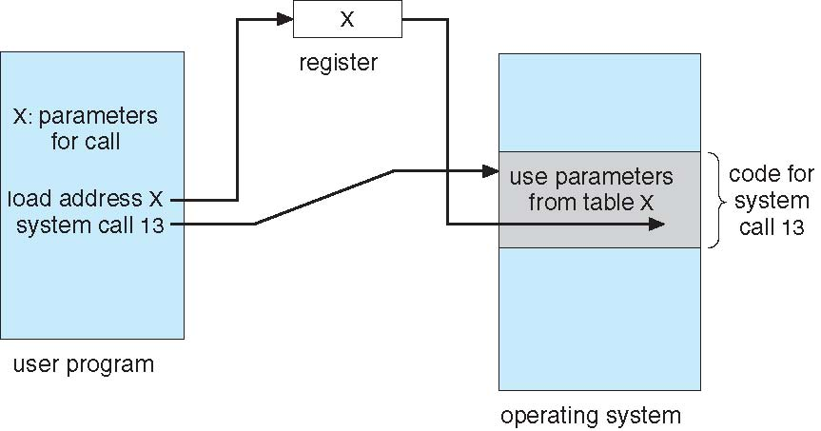
Parameter Passing via Register

Slide 20
Types of System Calls
Process control
  end, abort
  load, execute
  create process, terminate process
  get process attributes, set process attributes
  wait for time
  wait event, signal event
  allocate and free memory
  Dump memory if error
  Debugger for determining bugs, single step execution
  Locks for managing access to shared data between processes

Slide 21
Types of System Calls
File management
  create file, delete file
  open, close file
  read, write, reposition
  get and set file attributes
Device management
  request device, release device
  read, write, reposition
  get device attributes, set device attributes
  logically attach or detach devices

Slide 22
Types of System Calls (Cont.)
Information maintenance
  get time or date, set time or date
  get system data, set system data
  get and set process, file, or device attributes
Communications
  create, delete communication connection
  send, receive messages if message passing model to host name or process name
    From client to server
  Shared-memory model create and gain access to memory regions
  transfer status information
  attach and detach remote devices

Slide 23
Types of System Calls (Cont.)
Protection
  Control access to resources
  Get and set permissions
  Allow and deny user access

Slide 24
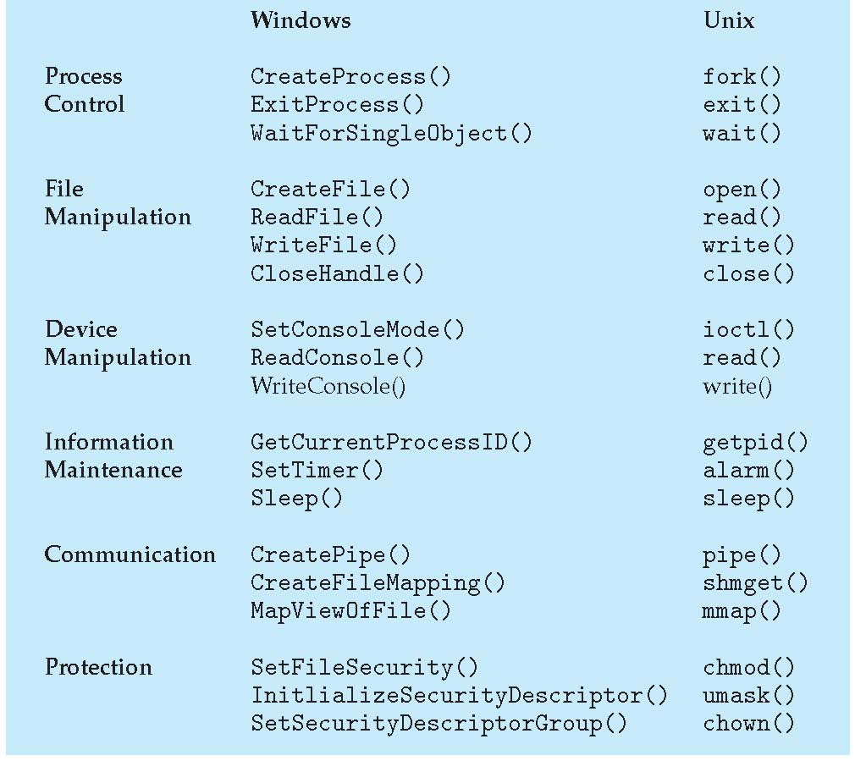
Examples of Windows and
Unix System Calls

Slide 25
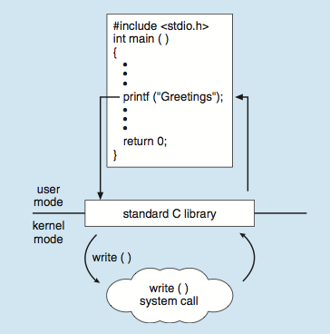
Standard C Library Example
printf() library
  calls write() system call

Slide 26
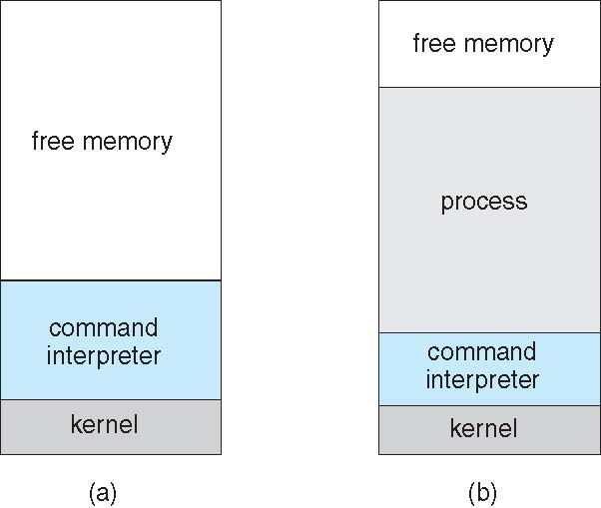
Example: MS-DOS
Single-tasking
Shell invoked when system booted
Single memory space
Simple method to run program
  No process created
  Load into memory
  Overwrite all but the kernel
(a) At system startup (b) running a program

Slide 27
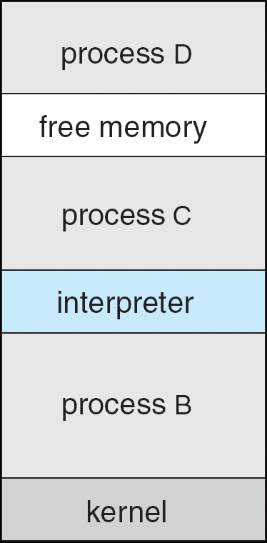
Example: FreeBSD
Unix variant
Multitasking
User login
  invoke user’s choice of shell
Shell
  executes fork() system call to create process
  Executes exec() to load program into process
  Shell waits for process to terminate or continues with user commands
Process exits
  with code of 0 – no error, or
  > 0 – error code

Slide 28
System Programs
Provide
  a convenient environment for program development and execution.
Categories
  File manipulation
  Status information sometimes stored in a File modification
  Programming language support
  Program loading and execution
  Communications
  Background services
  Application programs

Slide 29
Different System Programs
File management
  Create, delete, copy, rename, print, dump, list, and generally manipulate files and directories
Status information
  System info
  Performance, logging, and debugging information
  Format info
  Configuration information

Slide 30
System Programs (Cont.)
File modification
  Edit
  Search
  Conversion
Programming-language support
Program loading and execution
Communications

Slide 31
System Programs (Cont.)
Background Services
  Launch at boot time
  disk checking
  process scheduling
  error logging, printing
  Run in user context not kernel context
  Known as services, subsystems, daemons
Application programs
  Don’t pertain to system
  Run by users
  Not typically considered part of OS
  Launched by command line, mouse click, finger poke

Slide 32
OS Design and Implementation
No universal approach, but some guidelines
Internal structure of different OSs can vary widely
Start by defining goals and specifications
  User goals
    Convenience and efficiency
    Easy to learn
    Reliable
    Safe
  System goals
    Easy to design, implement, and maintain
    Flexible, reliable, error-free, and efficient
  Choice of hardware

Slide 33
Cont.
Specifying and designing OS
  highly creative task of software engineering
Distinguish Policy and Mechanism
  Policy: What will be done?
  Mechanism: How to do it?

Slide 34
Implementation
Variation history
  Early OSes in assembly language
  Then like Algol, PL/1
  Now C, C++
Actually a mix of languages
  Lowest levels in assembly
  Main body in C
  Systems programs in C, C++
  Even some script languages
port to other hardware
  With more high-level language
  But slower
Emulation
  allow an OS to run on non-native hardware

Slide 35
Operating System Structure
General-purpose OS
  very large program
Various ways to structure one as follows

Slide 36
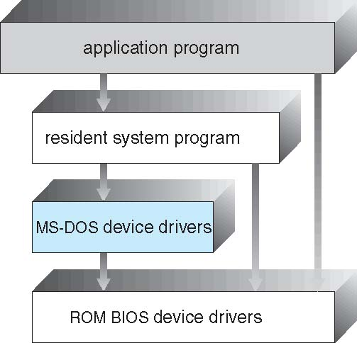
Simple Structure
MS-DOS
  Provides the most functionality in the least space
  Not divided into modules
  Its interfaces and levels of functionality are not well separated

Slide 37
UNIX
UNIX
  limited by hardware functionality
  the original UNIX operating system had limited structuring
Two separable parts
  Systems programs
  The kernel
    a large number of functions for one level
    everything below the system-call interface and above the physical hardware
    file system
    CPU scheduling
    memory management, and
    other operating-system functions

Slide 38
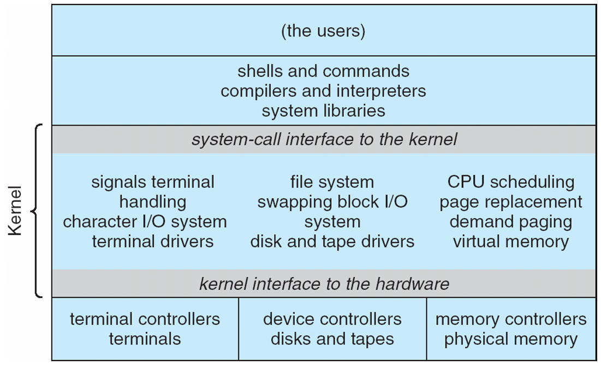
Traditional UNIX System Structure
Beyond simple but not fully layered

Slide 39
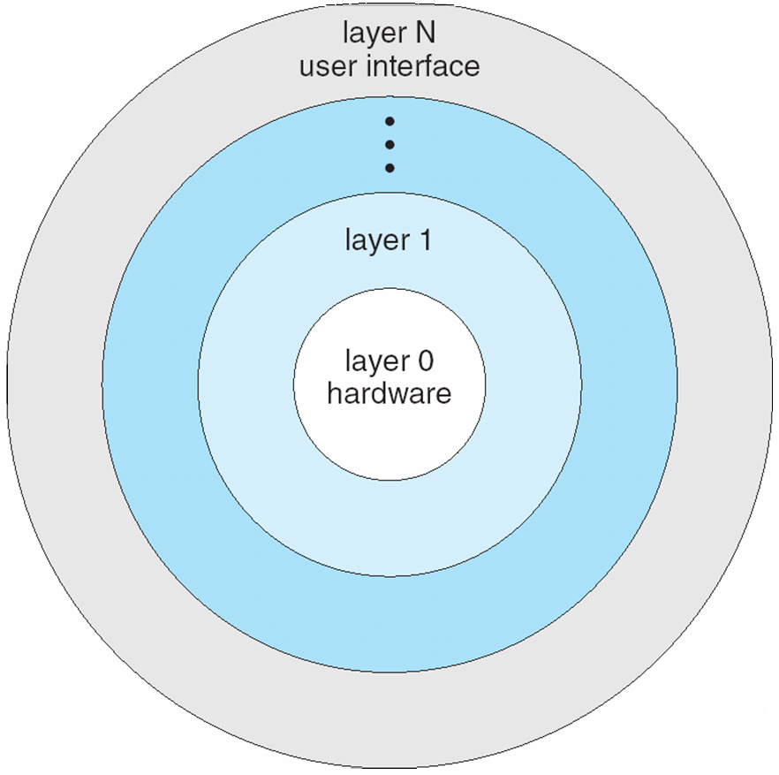
Layered Approach
The operating system is divided into a number of layers (levels), each built on top of lower layers. The bottom layer (layer 0), is the hardware; the highest (layer N) is the user interface.
With modularity, layers are selected such that each uses functions (operations) and services of only lower-level layers

Slide 40
Microkernel System Structure
Moves as much from the kernel into user space
Mach
  example of microkernel
  Mac OS X kernel (Darwin) partly based on Mach
Communication
  takes place between user modules using message passing
Benefits:
  Easier to extend a microkernel
  Easier to port the operating system to new architectures
  More reliable (less code is running in kernel mode)
  More secure
Disadvantage
  Performance overhead of user space to kernel space communication

Slide 41
Microkernel System Structure

Slide 42
Module approach
Most modern operating systems
  Implement loadable kernel modules
  Uses object-oriented approach
  Each core component is separate
  Each talks to the others over known interfaces
  Each is loadable as needed within the kernel
Overall, similar to layers but with more flexible
  Linux, Solaris, etc

Slide 43
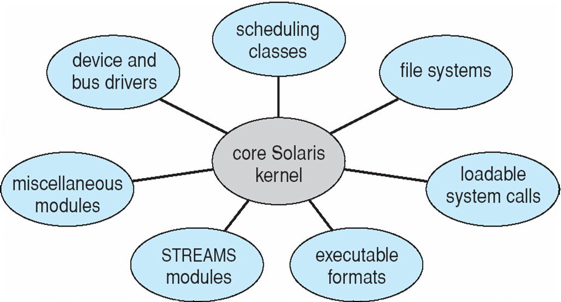
Solaris Modular Approach

Slide 44
Hybrid Systems
Most modern operating systems actually not one pure model
  Hybrid combines multiple approaches to address performance, security, usability needs
  Linux and Solaris kernels in kernel address space, so monolithic, plus modular for dynamic loading of functionality
  Windows mostly monolithic, plus microkernel for different subsystem personalities
Apple Mac OS X hybrid, layered, Aqua UI plus Cocoa programming environment
  Below is kernel consisting of Mach microkernel and BSD Unix parts, plus I/O kit and dynamically loadable modules (called kernel extensions)

Slide 45
Mac OS X Structure

Slide 46
iOS
Apple mobile OS for iPhone, iPad
  Structured on Mac OS X, added functionality
  Does not run OS X applications natively
    Also runs on different CPU architecture (ARM vs. Intel)
  Cocoa Touch
    Objective-C API for developing apps
  Media services
    layer for graphics, audio, video
  Core services
    provides cloud computing, databases
  Core operating system
    based on Mac OS X kernel

Slide 47
Android
Developed by Google
  Open Source
Similar stack to IOS
Based on Linux kernel but modified
  Provides process, memory, device-driver management
  Adds power management
Runtime environment
  includes core set of libraries and Dalvik virtual machine
  Apps developed in Java plus Android API
    Java class files compiled to Java bytecode
    then translated to executable than runs in Dalvik VM
Libraries include frameworks for
  web browser (webkit)
  database (SQLite)
  multimedia
  smaller libc

Slide 48
Android Architecture

Slide 49
Operating-System Debugging
Debugging is finding and fixing errors, or bugs
OSes generate log files containing error information
Failure of an application can generate core dump file capturing memory of the process
Operating system failure can generate crash dump file containing kernel memory
Beyond crashes, performance tuning can optimize system performance
  Sometimes using trace listings of activities, recorded for analysis
  Profiling is periodic sampling of instruction pointer to look for statistical trends
Kernighan’s Law: “Debugging is twice as hard as writing the code in the first place. Therefore, if you write the code as cleverly as possible, you are, by definition, not smart enough to debug it.”

Slide 50
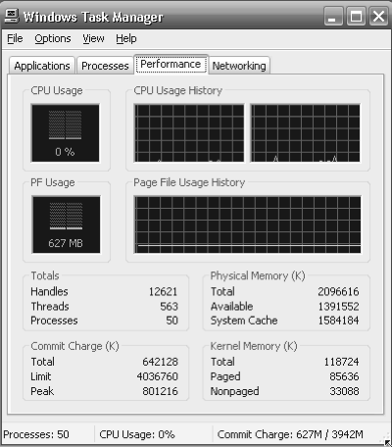
Performance Tuning
Improve performance by removing bottlenecks
OS must provide means of computing and displaying measures of system behavior
For example, “top” program or Windows Task Manager

Slide 51
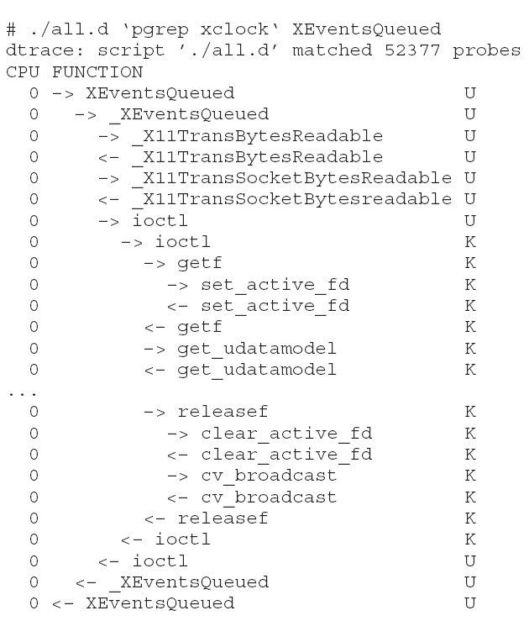
DTrace
DTrace tool in Solaris, FreeBSD, Mac OS X allows live instrumentation on production systems
  Probes fire when code is executed within a provider, capturing state data and sending it to consumers of those probes
Example of following XEventsQueued system call move from libc library to kernel and back

Slide 52
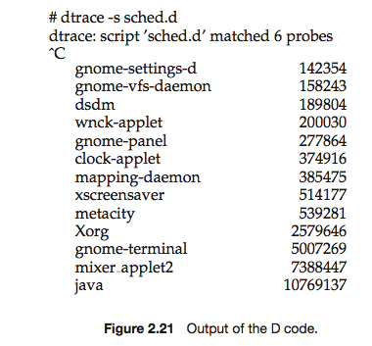
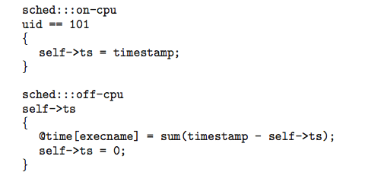
DTrace
DTrace code to record amount of time each process with UserID 101 is in running mode (on CPU) in nanoseconds

Slide 53
Operating System Generation
Operating systems are designed to run on any of a class of machines; the system must be configured for each specific computer site
SYSGEN program obtains information concerning the specific configuration of the hardware system
  Used to build system-specific compiled kernel or system-tuned
  Can general more efficient code than one general kernel

Slide 54
System Boot
When power initialized on system, execution starts at a fixed memory location
  Firmware ROM used to hold initial boot code
Operating system must be made available to hardware so hardware can start it
  Small piece of code – bootstrap loader, stored in ROM or EEPROM locates the kernel, loads it into memory, and starts it
  Sometimes two-step process where boot block at fixed location loaded by ROM code, which loads bootstrap loader from disk
Common bootstrap loader, GRUB, allows selection of kernel from multiple disks, versions, kernel options
Kernel loads and system is then running

Slide 55
End of Chapter 2

