Slide 1
Chapter 1: Introduction

Slide 2
Chapter 1: Introduction
What Operating Systems Do
Computer-System Organization
Computer-System Architecture
Operating-System Structure
Operating-System Operations
Process Management
Memory Management
Storage Management
Protection and Security
Kernel Data Structures
Computing Environments
Open-Source Operating Systems

Slide 3
Objectives
To describe the basic organization of computer systems
To provide a grand tour of the major components of operating systems
To give an overview of the many types of computing environments
To explore several open-source operating systems

Slide 4
What is an Operating System?
A program
  that acts as an intermediary between a user of a computer and the computer hardware
Goals:
  Execute user programs and make solving user problems easier
  Make the computer system convenient to use
  Use the computer hardware in an efficient manner

Slide 5
Computer System Structure
Consists of four components:
  Hardware
    provides basic computing resources
      CPU, memory, I/O devices
  OS
    Controls and coordinates use of hardware among various applications and users
  AP
    define the ways in which the system resources are used to solve the computing problems of the users
      Word processors, compilers, web browsers, database systems, video games
  Users
    People, machines, other computers

Slide 6
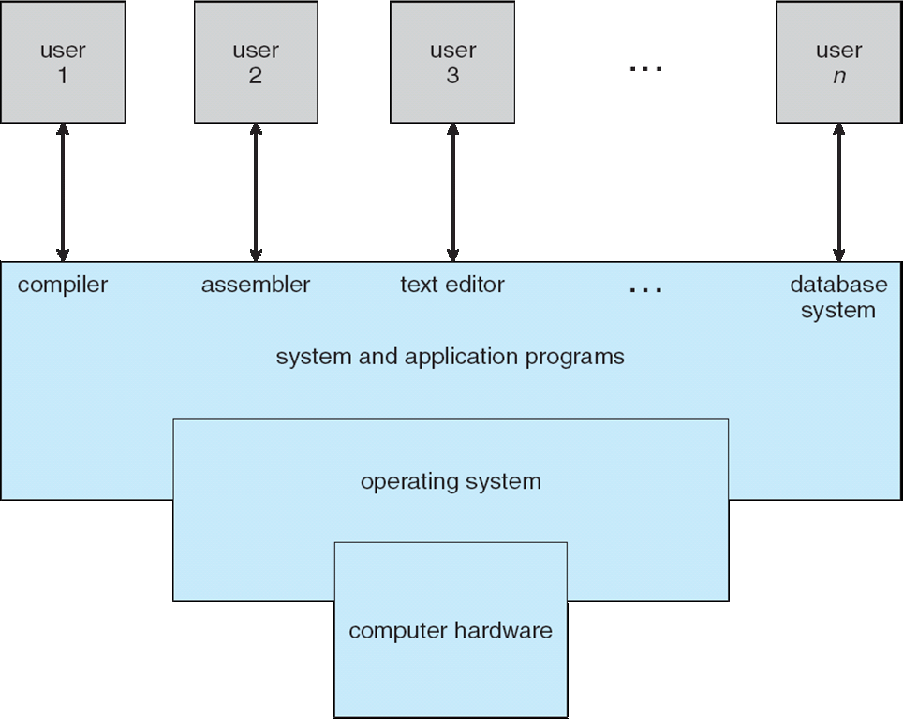
Four Components of a Computer System

Slide 7
What OS Does
Depends on the point of view
Users
  want convenience, ease of use
  Don’t care about resource utilization
Shared computer
  such as mainframe or minicomputer must keep all users happy
Dedicate systems
  such as workstations have dedicated resources
  but frequently use shared resources from servers
Handheld computers
  resource poor
  optimized for usability and battery life
Embedded computers
  have little or no user interface
  such as embedded computers in devices and automobiles

Slide 8
OS Definition
Resource allocator
  Manages all resources
  Decides between conflicting requests for efficient and fair resource use
Control program
  Controls execution of programs
  Prevents errors and improper use of the computer

Slide 9
OS Definition (Cont.)
No universally accepted definition
Varies wildly
Kernel
  The program running at all times on the computer
system programs
Application programs

Slide 10
Computer Startup
Bootstrap Program
  Firmware—ROM or EPROM
  loaded at power-up or reboot
  Initializes all aspects of system
  Loads operating system kernel from HD
  Starts kernel execution

Slide 11
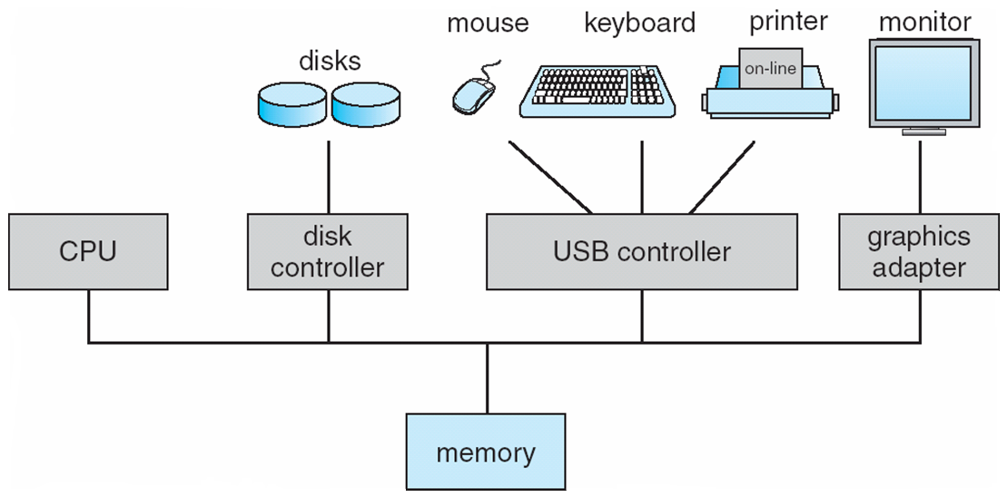
Computer System Organization
Computer-system operation
  One or more CPUs, device controllers connect through common bus providing access to shared memory
  Concurrent execution of CPUs and devices competing for memory cycles

Slide 12
Computer-System Operation
I/O management
  I/O devices and the CPU can execute concurrently
  Each device controller is in charge of a particular device type
  Each device controller has a local buffer
CPU management
  CPU moves data from/to main memory to/from local buffers
  Interruption
    Device controller informs CPU that it has finished its operation by causing an interrupt
Memory Management

Slide 13
Common Functions of Interrupts
Call Interrupt service routine
  Pointed by interrupt vector which contains all routine address
A trap or exception
  a software-generated interrupt caused either by an error or a user request
OS
  interrupt driven

Slide 14
Interrupt Handling
Context saving
  The OS preserves the state of the CPU by storing registers and the program counter
Type Determination
  polling
  vectored interrupt system
Take action
  Separate segments of code determine what action should be taken for each type of interrupt

Slide 15
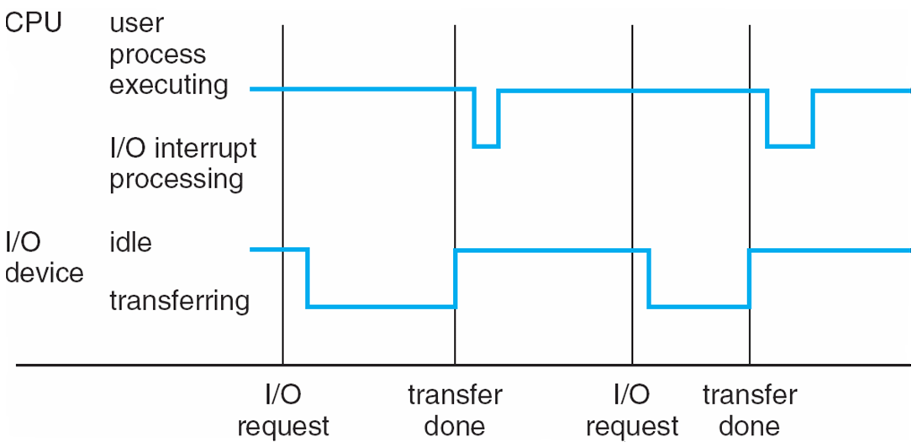
Interrupt Timeline

Slide 16
How control returns?
Waiting
  After I/O starts, control returns to user program only upon I/O completion
  Wait instruction idles the CPU until the next interrupt
  Wait loop (contention for memory access)
  At most one I/O request is outstanding at a time, no simultaneous I/O processing
Not Waiting
  After I/O starts, control returns to user program without waiting for I/O completion
  System call – request to the OS to allow user to wait for I/O completion
  Device-status table contains entry for each I/O device indicating its type, address, and state
  OS indexes into I/O device table to determine device status and to modify table entry to include interrupt

Slide 17
Storage Definitions and Notation Review
The basic unit of computer storage is the bit. A bit can contain one of two values, 0 and 1. All other storage in a computer is based on collections of bits. Given enough bits, it is amazing how many things a computer can represent: numbers, letters, images, movies, sounds, documents, and programs, to name a few. A byte is 8 bits, and on most computers it is the smallest convenient chunk of storage. For example, most computers don’t have an instruction to move a bit but do have one to move a byte. A less common term is word, which is a given computer architecture’s native unit of data. A word is made up of one or more bytes. For example, a computer that has 64-bit registers and 64-bit memory addressing typically has 64-bit (8-byte) words. A computer executes many operations in its native word size rather than a byte at a time.
Computer storage, along with most computer throughput, is generally measured and manipulated in bytes and collections of bytes. A kilobyte, or KB, is 1,024 bytes; a megabyte, or MB, is 1,0242 bytes; a gigabyte, or GB, is 1,0243 bytes; a terabyte, or TB, is 1,0244 bytes; and a petabyte, or PB, is 1,0245 bytes. Computer manufacturers often round off these numbers and say that a megabyte is 1 million bytes and a gigabyte is 1 billion bytes. Networking measurements are an exception to this general rule; they are given in bits (because networks move data a bit at a time).

Slide 18
DMA
Used for high-speed I/O devices
I/O buffer ←> main memory
  Transfer data from buffer directly to main memory without CPU intervention
Only one interrupt is generated per block

Slide 19
Storage Structure
Main memory
  Random access
  Typically volatile
Secondary storage
  Nonvolatile
  Large capacity
  Examples
    Magnetic disks
    Solid-state disks

Slide 20
Storage Hierarchy
Storage systems organized in hierarchy
  Speed
  Cost
  Volatility
Caching
  copying information into faster storage system
  main memory can be viewed as a cache for secondary storage
Device Driver
  for each device controller to manage I/O
  Provides uniform interface between controller and kernel

Slide 21
Storage-Device Hierarchy

Slide 22
Caching
What is Caching idea?
Faster and temporary storage
Usage
  Improve OS performance
  Cache hitting rate
Cache size and replacement

Slide 23
Computer-System Architecture
Single processor system
  General purpose
  Special purpose
Multiprocessor system
  parallel systems, tightly-coupled systems
  Advantages include:
    Increased throughput
    Economy of scale
    Increased reliability – graceful degradation or fault tolerance
  Two types:
    Asymmetric Multiprocessing
    Symmetric Multiprocessing

Slide 24
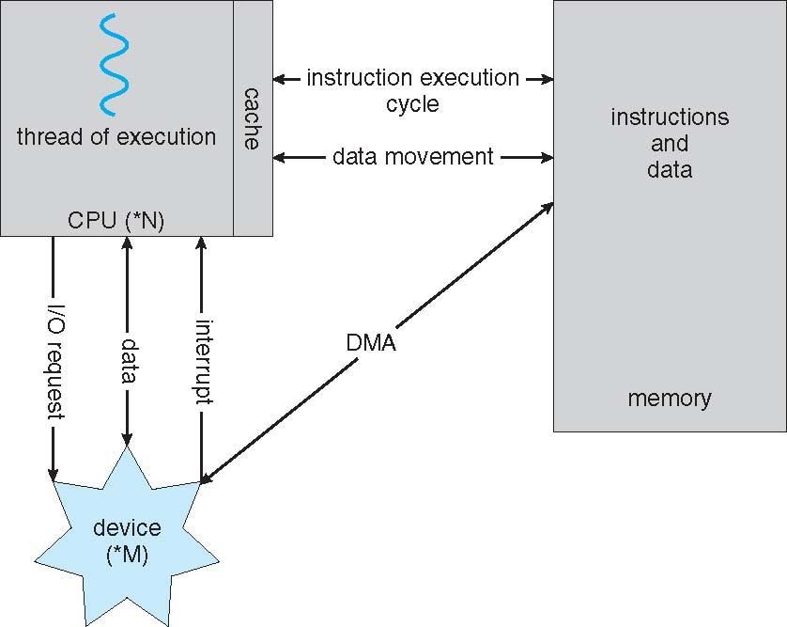
How a Modern Computer Works
A von Neumann architecture

Slide 25
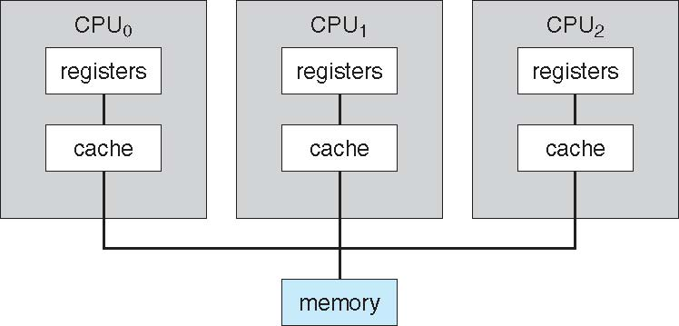
Symmetric Multiprocessing Architecture

Slide 26
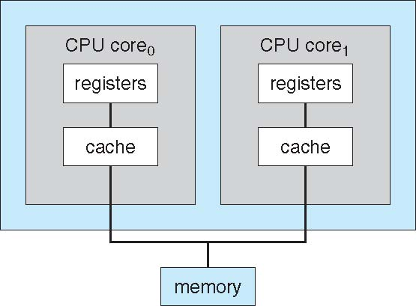
A Dual-Core Design
UMA and NUMA architecture variations
Multi-chip and multicore
Systems containing all chips vs. blade servers
  Chassis containing multiple separate systems

Slide 27
Clustered Systems
Multiple systems working together
  Usually sharing storage via a storage-area network (SAN)
  Provides a high-availability service which survives failures
    Asymmetric clustering
      has one machine in hot-standby mode
    Symmetric clustering
      has multiple nodes running applications, monitoring each other
  Some clusters are for high-performance computing (HPC)
    Applications must be written to use parallelization
  Some have distributed lock manager (DLM) to avoid conflicting operations

Slide 28
Clustered Systems

Slide 29
OS Structure
Multiprogramming
  Single user cannot keep CPU and I/O devices busy at all times
  Multiprogramming organizes jobs (code and data) so CPU always has one to execute
  A subset of total jobs in system is kept in memory
  One job selected and run via job scheduling
  When it has to wait (for I/O for example), OS switches to another job
Timesharing (multitasking)
  logical extension in which CPU switches jobs so frequently that users can interact with each job while it is running, creating interactive computing
  Response time should be < 1 second
  Each user has at least one program executing in memory process
  If several jobs ready to run at the same time  CPU scheduling
  If processes don’t fit in memory, swapping moves them in and out to run
  Virtual memory allows execution of processes not completely in memory

Slide 30
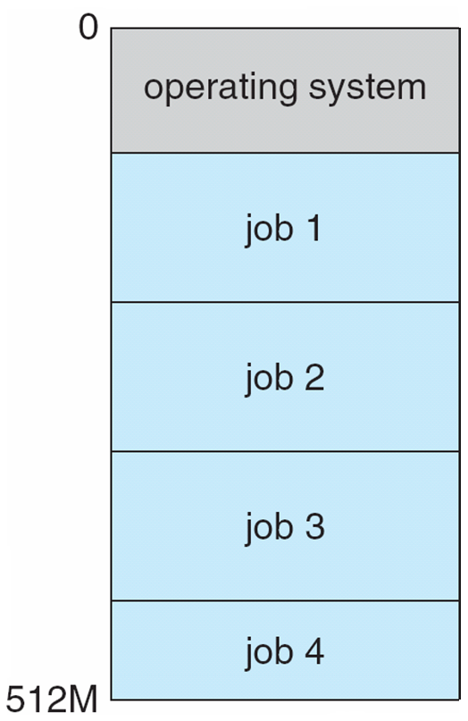
Memory Layout for Multiprogrammed System

Slide 31
Operating-System Operations
Interrupt driven by hardware
Software error or request creates exception or trap
  Division by zero, request for operating system service
Other process problems
  include infinite loop, processes modifying each other or the operating system
Dual-mode operation
  allows OS to protect itself and other system components
  User mode and kernel mode
  Mode bit provided by hardware
    Provides ability to distinguish when system is running user code or kernel code
    Some instructions designated as privileged, only executable in kernel mode
    System call changes mode to kernel, return from call resets it to user
Increasingly CPUs support multi-mode operations
  i.e. virtual machine manager (VMM) mode for guest VMs

Slide 32
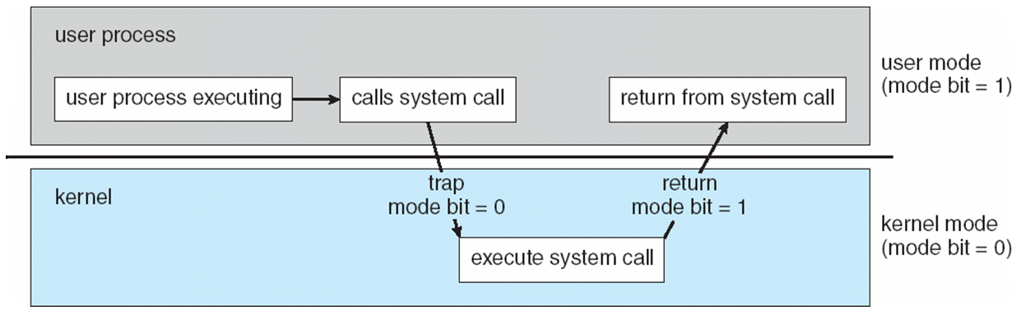
Mode transition and infinite loop prevention
Timer
  prevent infinite loop / process hogging resources
  Set interrupt after specific period
  Operating system decrements counter
  Generate an interrupt when counter zero
  Set up before scheduling process to regain control or terminate program that exceeds allotted time

Slide 33
Process Management
A program in execution
Resources for a process
  CPU, memory, I/O, files
  Initialization data
Single-threaded process
  one program counter specifying location of next instruction to execute
  Process executes instructions sequentially, one at a time, until completion
Multi-threaded process
  one program counter per thread
Typically system has many processes
  some user, some operating system running concurrently on one or more CPUs
  Concurrency by multiplexing the CPUs among the processes / threads

Slide 34
Process Management Activities
Creating and deleting
Suspending and resuming
Synchronization
Communication
Deadlock handling

Slide 35
Memory Management
Data management
Instructions (code) management
Optimizing CPU utilization
Optimizing computer response to users
Memory management activities
  Keeping track of which parts of memory are currently being used and by whom
  Deciding which processes and data to move into and out of memory
  Allocating and de-Allocating memory space as needed

Slide 36
Storage Management
Mapping
  Logical unit to physical medium
File-System management
  File
  Directory
  Access control
  OS activities include
    Creating and deleting files and directories
    Primitives to manipulate File and Dir
    Mapping files onto secondary storage
    Backup files onto stable (non-volatile) storage media

Slide 37
Mass-Storage Management
Magnetic and Optical Disk, Tape, SSD
OS activities
  Free-space management
  Storage allocation
  Disk scheduling

Slide 38
Performance of Various Levels of Storage
Movement between levels of storage hierarchy can be explicit or implicit

Slide 39
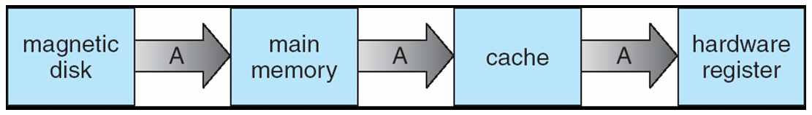
Migration of Integer A from Disk to Register
Multitasking environments
Multiprocessor environment
  must provide cache coherency in hardware such that all CPUs have the most recent value in their cache
Distributed environment
  even more complex
  Several copies of a datum can exist
  Various solutions covered in Chapter 17

Slide 40
I/O Subsystem
Responsible for
  Memory management of I/O including
    buffering
    caching
    spooling
  General device-driver interface
  Drivers for specific hardware devices

Slide 41
Protection and Security
Protection
  mechanism for controlling access of processes or
  users to resources defined by the OS
Security
  defense of the system against internal and external attacks
  denial-of-service, worms, viruses, identity theft, theft of service
Mechanism
  User identities
  User ID then associated with resources
  Group identifier (group ID)
  Privilege escalation
    allows user to change to effective ID with more rights

Slide 42
Kernel Data Structures
Many similar to standard programming data structures
Singly linked list
Doubly linked list
Circular linked list

Slide 43
Kernel Data Structures
Binary search tree
left <= right
  Search performance is O(n)
  Balanced binary search tree is O(lg n)

Slide 44
Kernel Data Structures
Hash function can create a hash map
Bitmap
  string of n binary digits representing the status of n items
Linux data structures
  defined in include files
    <linux/list.h>, <linux/kfifo.h>, <linux/rbtree.h>

Slide 45
Computing Environments - Traditional
Stand-alone general purpose machines
Network computers (thin clients)
  Wired
  wireless
Ubiquitous computing

Slide 46
Computing Environments - Mobile
Handheld smartphones, tablets, etc
What is the functional difference between them and a “traditional” laptop?
Extra feature – more OS features (GPS, gyroscope)
Allows new types of apps like augmented reality
Use IEEE 802.11 wireless, or cellular data networks for connectivity
Leaders are Apple iOS and Google Android

Slide 47
Computing Environments – Distributed
Distributed
  Collection of separate, possibly heterogeneous, systems networked together
    Network is a communications path, TCP/IP most common
      Local Area Network (LAN)
      Wide Area Network (WAN)
      Metropolitan Area Network (MAN)
      Personal Area Network (PAN)
  Network Operating System
    provides features between systems across network
    Communication scheme allows systems to exchange messages
    Illusion of a single system

Slide 48
Computing Environments – Client-Server
Client-Server Computing
  Dumb terminals supplanted by smart PCs
  Many systems now servers, responding to requests generated by clients
    Compute-server system provides an interface to client to request services (i.e., database)
    File-server system provides interface for clients to store and retrieve files

Slide 49
Computing Environments - Peer-to-Peer
Another model of distributed system
P2P does not distinguish clients and servers
  Instead all nodes are considered peers
  May each act as client, server or both
  Node must join P2P network
    Registers its service with central lookup service on network, or
    Broadcast request for service and respond to requests for service via discovery protocol
  Examples include Napster and Gnutella, Voice over IP (VoIP) such as Skype

Slide 50
Computing Environments - Virtualization
Allows operating systems to run applications within other OSes
  Vast and growing industry
Emulation
  used when source CPU type different from target type (i.e. PowerPC to Intel x86)
  Generally slowest method
  When computer language not compiled to native code – Interpretation
Virtualization
  OS natively compiled for CPU, running guest OSes also natively compiled
  Consider VMware running WinXP guests, each running applications, all on native WinXP host OS
  VMM provides virtualization services

Slide 51
Computing Environments - Virtualization
Use cases involve laptops and desktops running multiple OSes for exploration or compatibility
  Apple laptop running Mac OS X host, Windows as a guest
  Developing apps for multiple OSes without having multiple systems
  QA testing applications without having multiple systems
  Executing and managing compute environments within data centers
VMM can run natively, in which case they are also the host
  There is no general purpose host then (VMware ESX and Citrix XenServer)

Slide 52
Computing Environments - Virtualization

Slide 53
Computing Environments – Cloud Computing
Delivers computing, storage, even apps as a service across a network
Logical extension of virtualization as based on virtualization
Many types
  Public cloud
    available via Internet to anyone willing to pay
  Private cloud
    run by a company for the company’s own use
  Hybrid cloud
    includes both public and private cloud components
  Software as a Service (SaaS)
    one or more applications available via the Internet (i.e. word processor)
  Platform as a Service (PaaS)
    software stack ready for application use via the Internet (i.e a database server)
  Infrastructure as a Service (IaaS)
    servers or storage available over Internet (i.e. storage available for backup use)

Slide 54
Computing Environments – Cloud Computing
Cloud compute environments
  composed of traditional OSes, plus VMMs, plus cloud management tools
  Internet connectivity requires security like firewalls
  Load balancers spread traffic across multiple applications

Slide 55
Computing Environments – Real-Time Embedded Systems
Real-time embedded systems most prevalent form of computers
  Vary considerable, special purpose, limited purpose OS, real-time OS
  Use expanding
Many other special computing environments as well
  Some have OSes, some perform tasks without an OS
Real-time OS has well-defined fixed time constraints
  Processing must be done within constraint
  Correct operation only if constraints met

Slide 56
Open-Source Operating Systems
Operating systems made available in source-code format rather than just binary closed-source
Counter to the copy protection and Digital Rights Management (DRM) movement
Started by Free Software Foundation (FSF), which has “copyleft” GNU Public License (GPL)
Examples include GNU/Linux and BSD UNIX (including core of Mac OS X), and many more
Can use VMM like VMware Player (Free on Windows), Virtualbox (open source and free on many platforms - http://www.virtualbox.com)
  Use to run guest operating systems for exploration

Slide 57
End of Chapter 1

