Slide 1
10,000 New Computer Science Teachers by 2015 How can we help?
Wayne Summers
TSYS School of Computer Science
Columbus State University
Columbus, GA
November 12, 2010

Slide 2
Need
“Innovations in computing and more broadly, information technology (IT), drive our economy, underlie many new advances in science and engineering, and contribute to our national security. Projected job growth in IT is very strong.”
NSF Computing Education for the 21st Century (CE21) call for proposals, http://www.nsf.gov/pubs/2010/nsf10619/nsf10619.htm

Slide 3
Problem
“Despite these very positive indicators, student interest in computing has declined dramatically over the last decade.
For example, the percentage of college freshmen indicating an intent to major in computing has declined overall by 70% in the last decade; for women, the decline was 80% (HERI, 2000-2009).
Recent data show that student interest in computing majors has fallen behind projected job openings by a factor of five and a half (ACT, 2010).”
ACT: American College Testing Program (2010), The Condition of College and Career Readiness.
Higher Education Research Institute (HERI), College Freshmen Survey, 2000-2009.

Slide 5
Solution
Computing Education for the 21st Century (CE21)
Increase the number and diversity of K-14 students and teachers who develop and practice computational competencies in a variety of contexts
Increase the number and diversity of early postsecondary students who are engaged and have the background in computing necessary to successfully pursue degrees in computing-related and computationally-intensive fields of study
http://www.nsf.gov/pubs/2010/nsf10619/nsf10619.htm

Slide 6
CSU’s Initiatives
Summer Computer Camps for kids
First Lego League Robotics
Teacher Workshops
Computer Science Teacher Endorsement

Slide 7
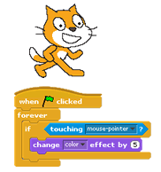
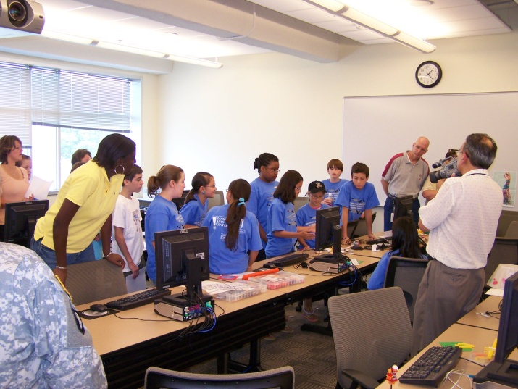
Summer Computer Camps
Activ8 Computing Camps
Computerized Craft Building with Pico Crickets
Create your own adventure - Game and Movie making through programming with Scratch
Web Design
Web Design & Flash® Animation
Animating with Alice
Lego robots
GameMaker
3D Game Art and Design with Blender
Python Programming

Slide 8
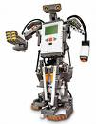
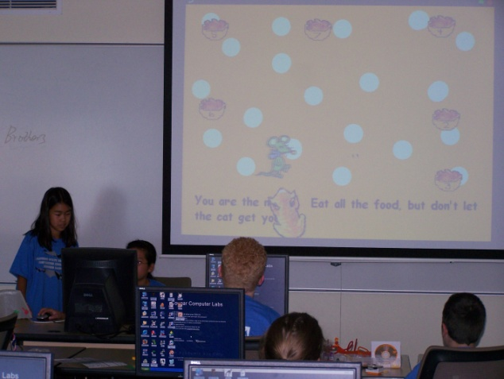
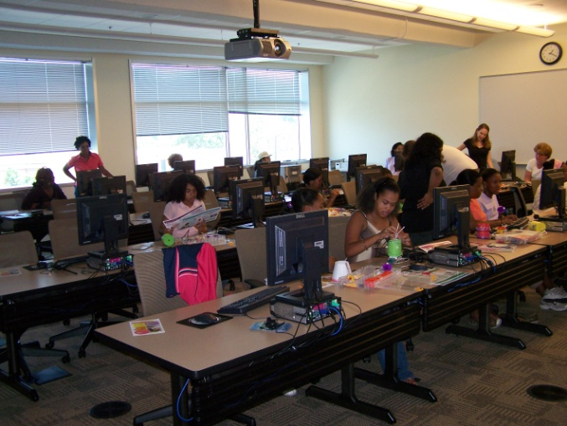
Summer Computer Camps
AGES: 8-11 or 11-14 or high school
2010: 12 camps: : 147 kids [114 boys & 33 girls]
2009: 15 camps: 160 kids [126 boys & 34 girls]
2008: 13 camps: 161 kids [119 boys & 42 girls]
2007: 4 camps: 75 kids [52 boys & 23 girls]
partial funding by GA Computes

Slide 9
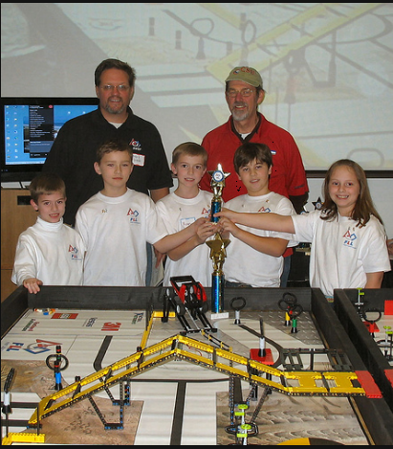
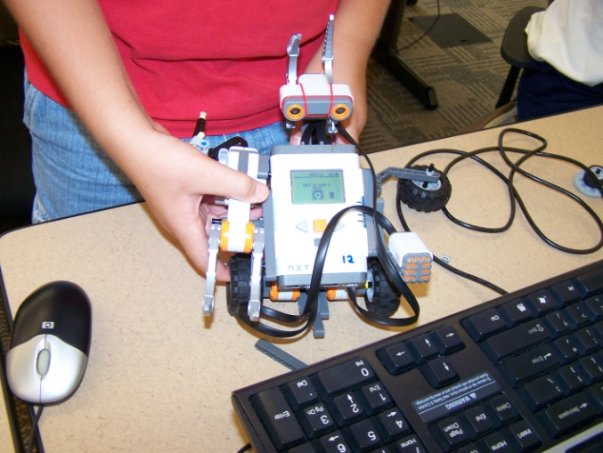
First Lego League Robotics
Dec. 2009 – hosted 10 teams from throughout South GA
Dec. 2010 – plan to host 18 teams

Slide 10
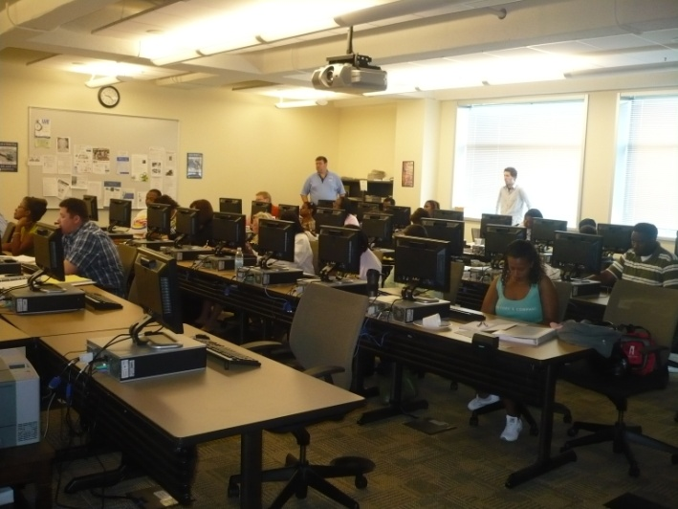
Weekend Teacher Workshops

Slide 11
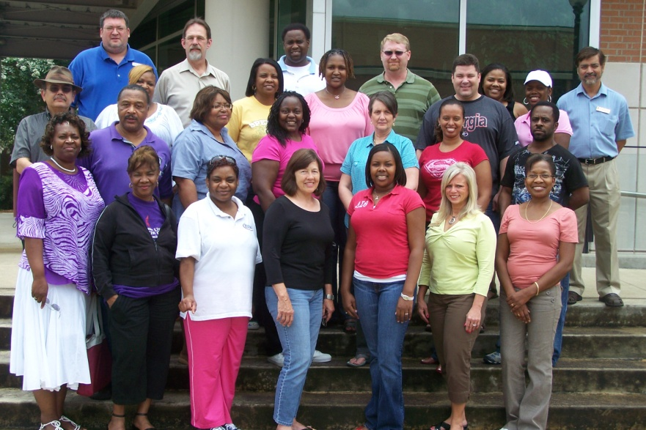
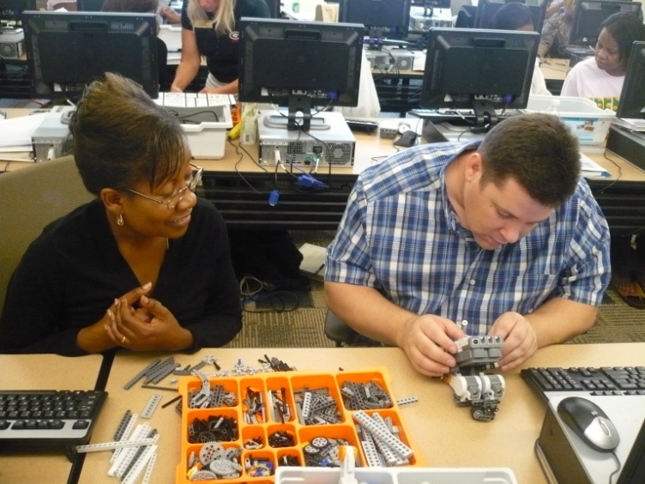
Summer Teacher Workshops
Scratch / CS Unplugged
Alice / CS Unplugged
Lego Robots / CS Unplugged
Programming mobile devices / Web 2.0
Lesson Plans

Slide 12
Computer Science Teacher Endorsement
There are two targets:
people who already have a teaching certificate, who are just looking for an add-on endorsement
students who are currently work on a certification in another field and want to add an endorsement ( there are both undergraduate and graduate options)
Mode of Delivery
the graduate classes will be offered online.
the pre-service undergraduate option will be taught only on campus at this time.

Slide 13
Computer Science Teacher Endorsement
Graduate endorsement
CPSC 6105. Fundamental Principles of Computer Science
CPSC 6106. Fundamentals of Computer Programming and Data Structures
CPSC 5135G. Programming Languages
CPSC 5157G. Computer Networks
EDUT 5125G. Methods of Teaching Computer Science
EDUT 5455G. Practicum in Computer Science
Aligned to the GAPSC Standards (based on ISTE Standards)

Slide 14
Computer Science Teacher Endorsement
Undergraduate endorsement
CPSC 1105. Introduction to Information Technology
CPSC 1301/1301L. Computer Science 1
CPSC 1302. Computer Science 2
CPSC 2105. Computer Organization
CPSC 2108. Data Structures
CPSC 5135G. Programming Languages
CPSC 5157G. Computer Networks
EDUT 5125U. Methods of Teaching Computer Science
EDUT 5455U. Practicum in Computer Science

Slide 15
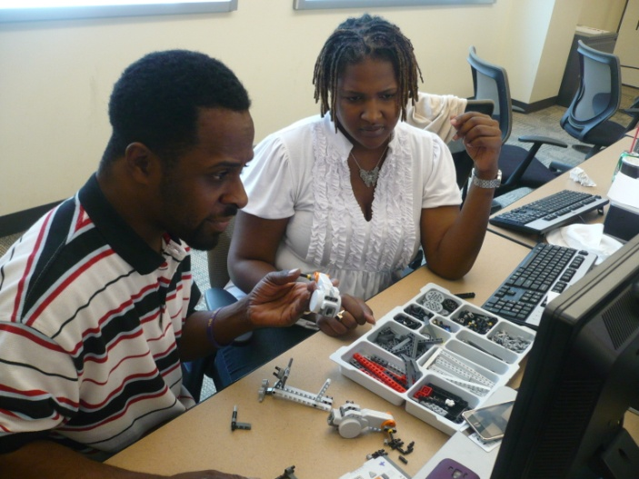
Computer Science Teacher Endorsement
Assessments and Evidence for Meeting Standards
Content GPA (content knowledge)
Professional Portfolio (Field Experiences and Clinical Practice)
Field Experience Evaluation
Dispositions Evaluation
Graduate and Employer Surveys

Slide 16
QUESTIONS?
Wayne Summers
TSYS School of Computer Science Columbus State University
http://cs.colstate.edu
cs@colstate.edu
(706) 568-2410
summers_wayne@colstate.edu

