Slide 1
PRESENTATION to BEIJING INSTITUTE of PETROCHEMICAL TECHNOLOGY
Dr. Wayne Summers
TSYS School of Computer Science
Columbus State University
7 May 2012

Slide 2
AGENDA
Overview of Columbus State University
Q&A
Overview of School of Computer Science
Q&A
Guidelines for BIPT Students

Slide 3
USA

Slide 4
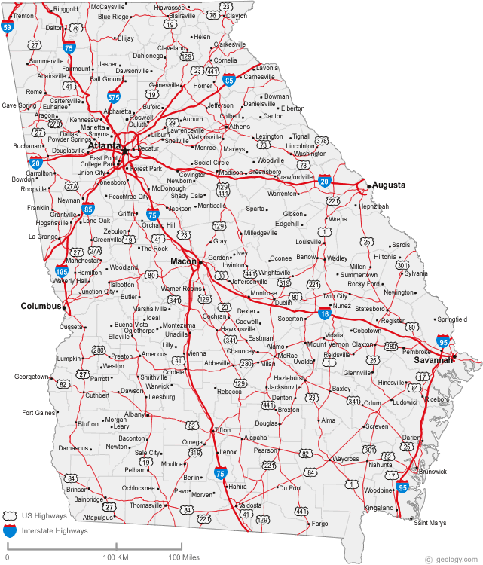
Georgia

Slide 5
The best places to raise a family
1 Honolulu, Hawaii 2 Virginia Beach, Virginia 3 Billings, Montana 4 Columbus, Georgia 5 San Diego, California
Best Life editors used safety, good schools with favorable student-teacher ratios, above-average test scores and respectable budgets. Plenty of museums, parks and pediatricians and data from the U.S. Census Bureau, the National Center for Education Statistics, the FBI, the American Association of Museums, the National Center for Health Statistics and the American Bar Association

Slide 6
Columbus State University

Slide 7
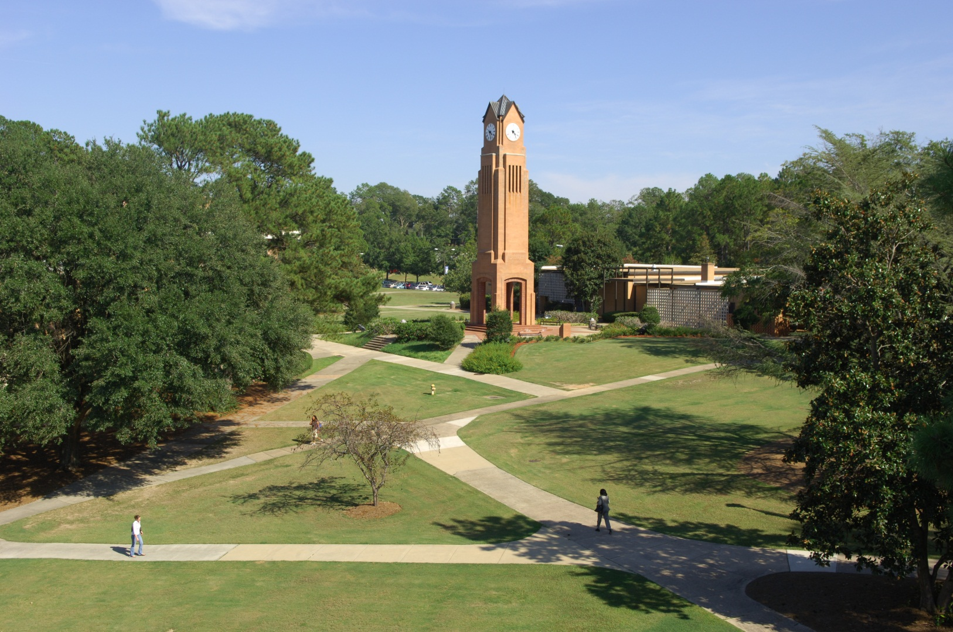
COLUMBUS STATE UNIVERSITY

Slide 8
COLUMBUS STATE UNIVERSITY
Some Quick Facts about CSU
Established in 1958
Public (part of University System of Georgia)
More than 150 acres (910 Mu)
Now serving over 8,300 students (> 7000 UG; 60% female)
Over 300 fulltime instructional faculty (over 2/3 with PhD)
More than 100 different degree and certificate programs
Over one hundred student organizations
Over a dozen competitive sports teams
Downtown, England, Troup County, Fort Benning
174 study-abroad students; >100 international students
Partnership, outreach, Servant Leadership, Honors,
Internships/Co-ops Undergraduate research/Creative projects, Study abroad

Slide 9
CSU Study Abroad programs reach 14 countries. Students also have access through the University System of Georgia to programs that go to 39 countries.

Slide 10
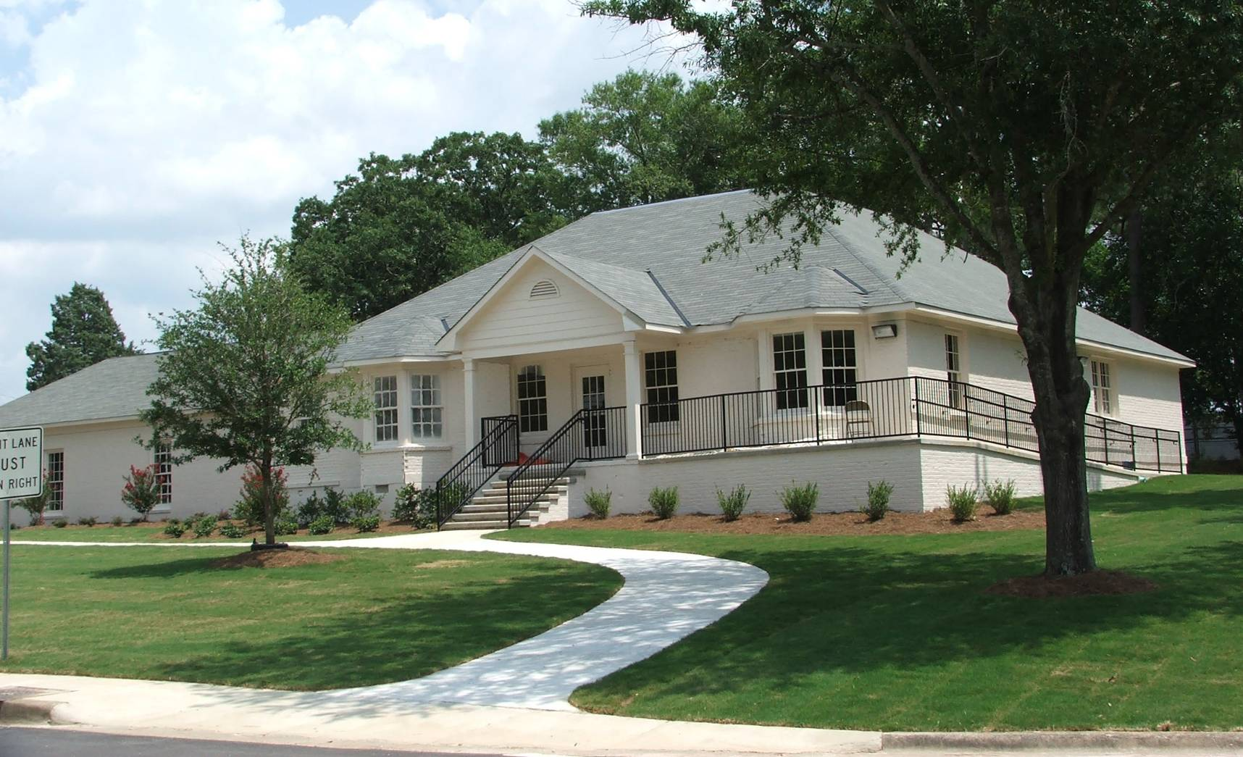
CSU International House

Slide 11
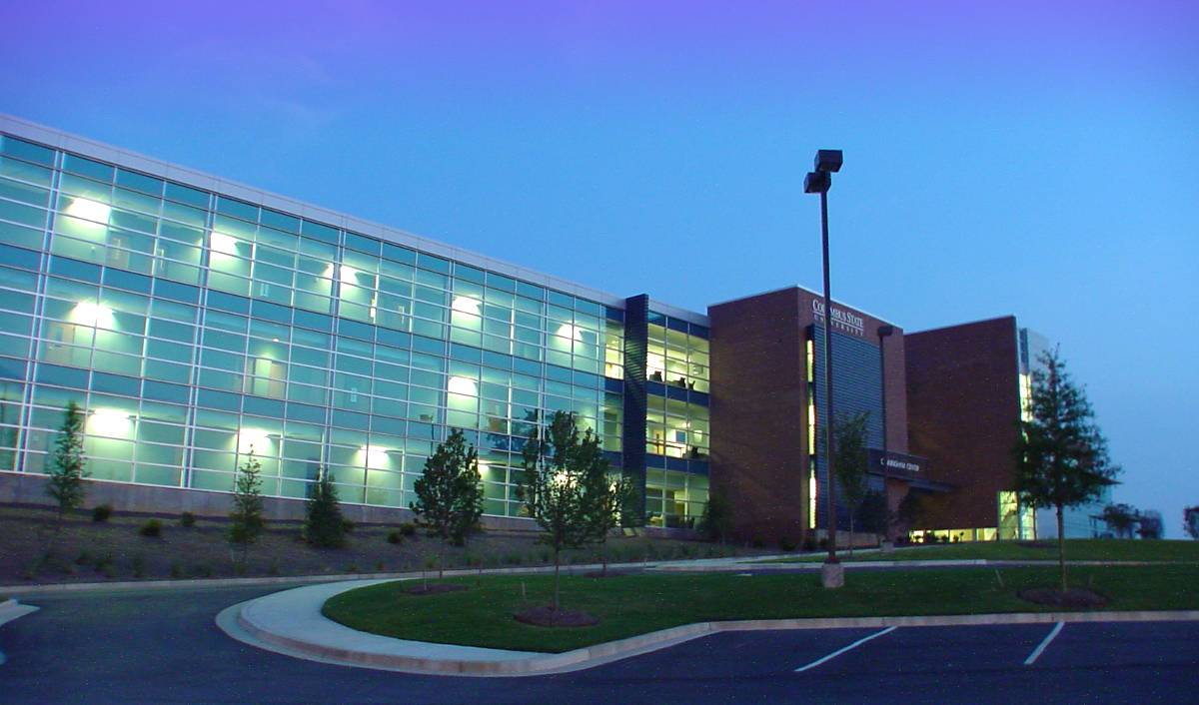
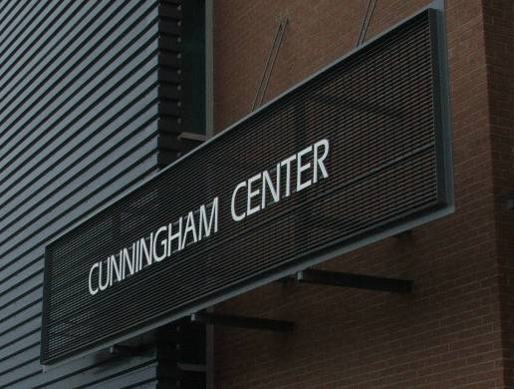
CSU’s Cunningham Center
The 67,500-square foot Cunningham Center for Leadership Development, started with a gift and a bequest to the university from John Cunningham, a lifelong salesman who possessed a true passion for the sales profession.

Slide 12
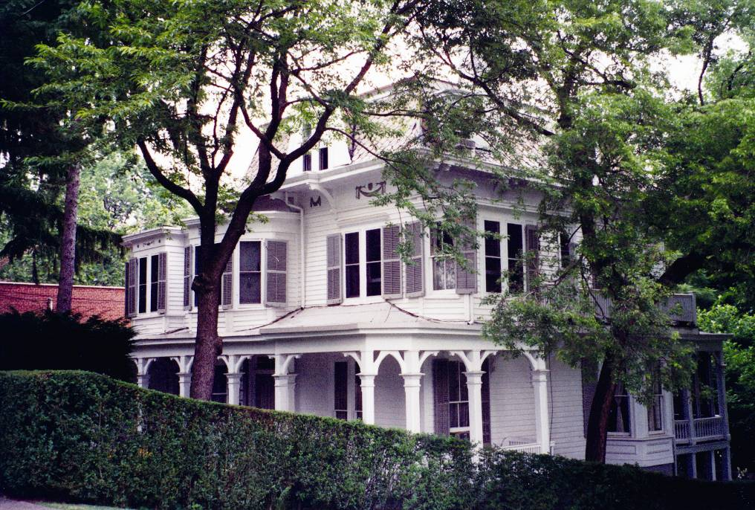
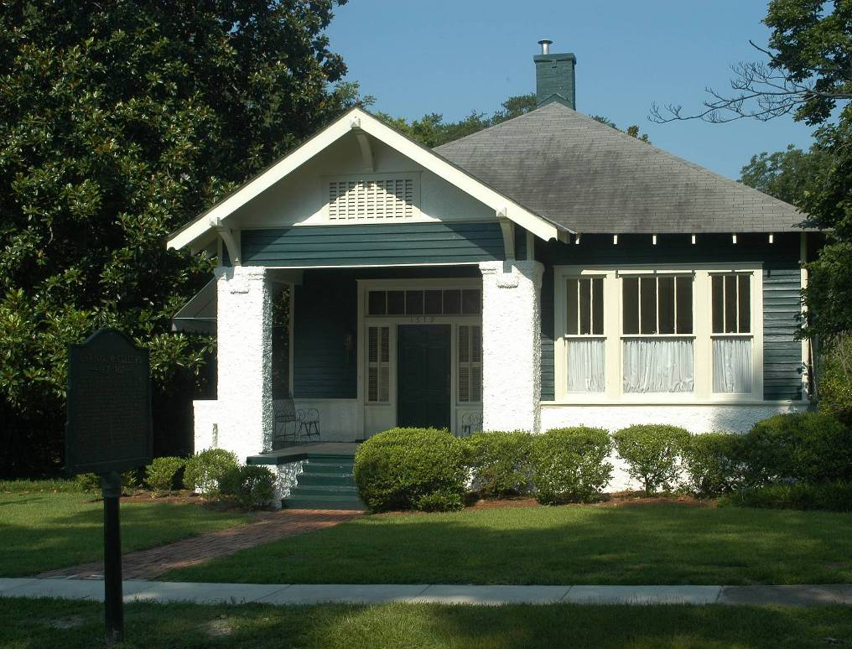
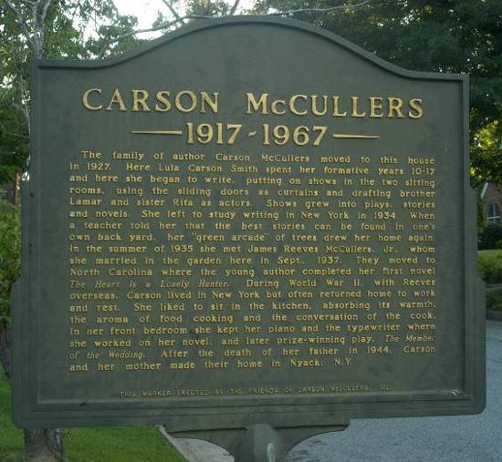
Carson McCullers Center for Writers and Musicians

Slide 13
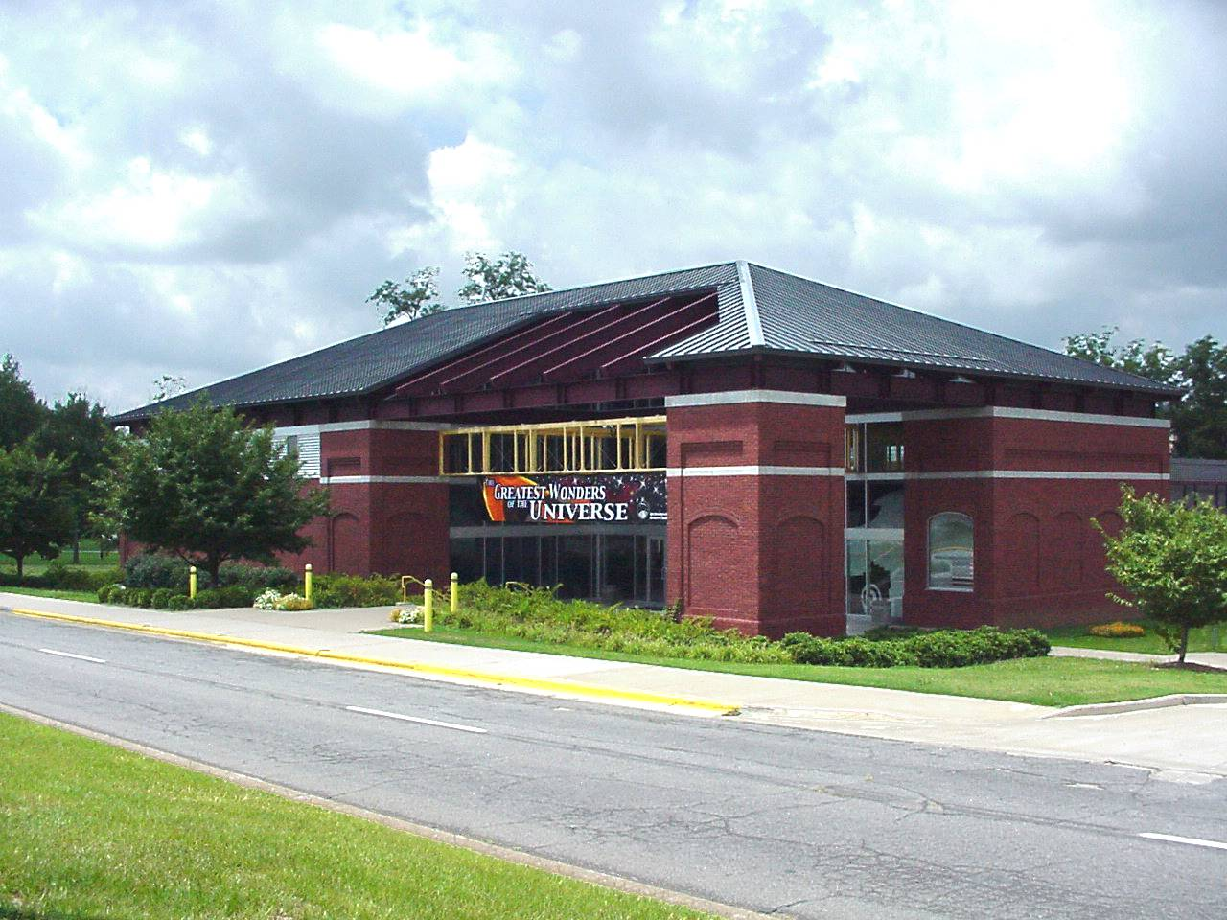

Slide 15
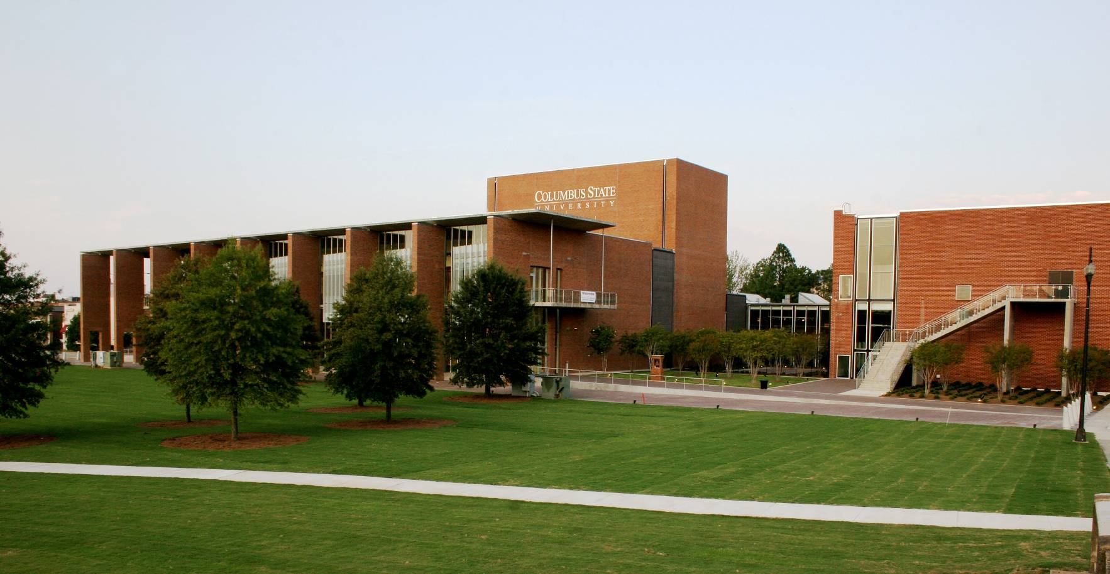
CSU’s RiverPark Art and Theatre Complex

Slide 16
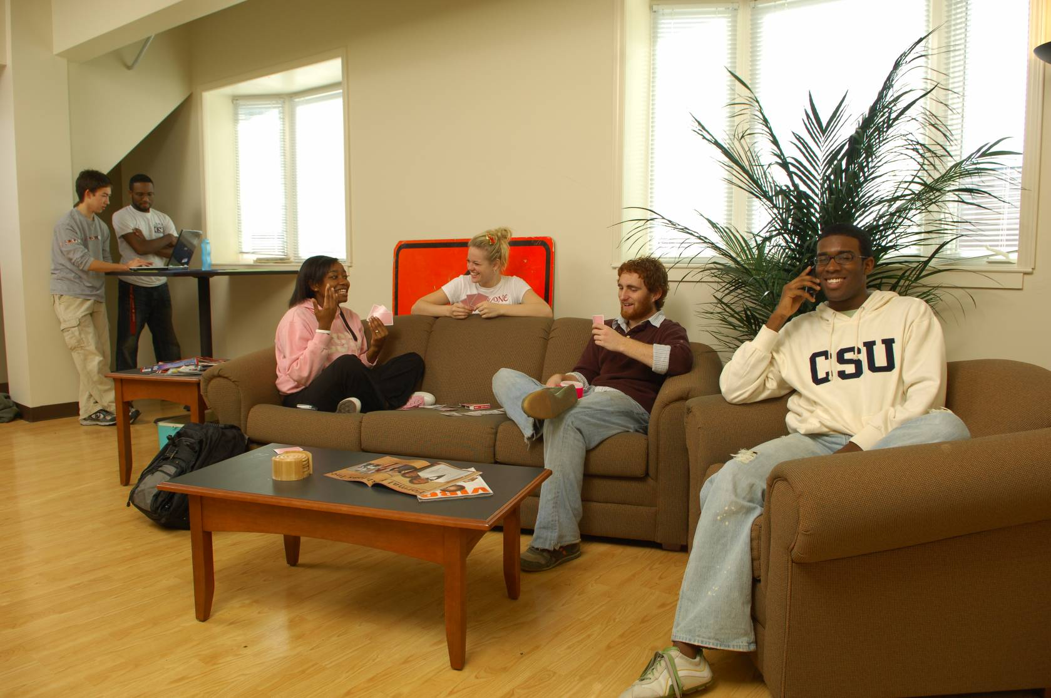
CSU’s RiverPark student apartments

Slide 17
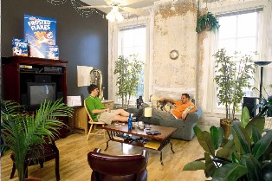
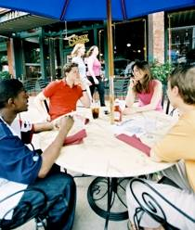
CSU’s RiverPark student apartments

Slide 18
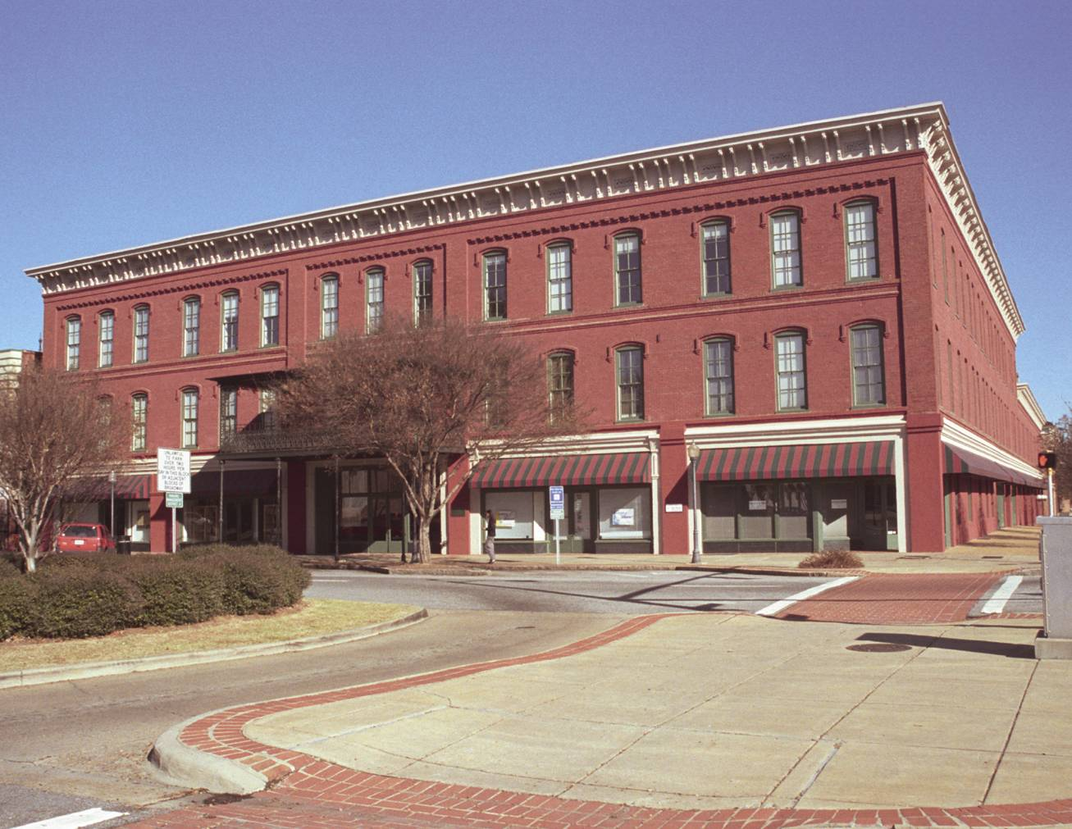

Slide 19
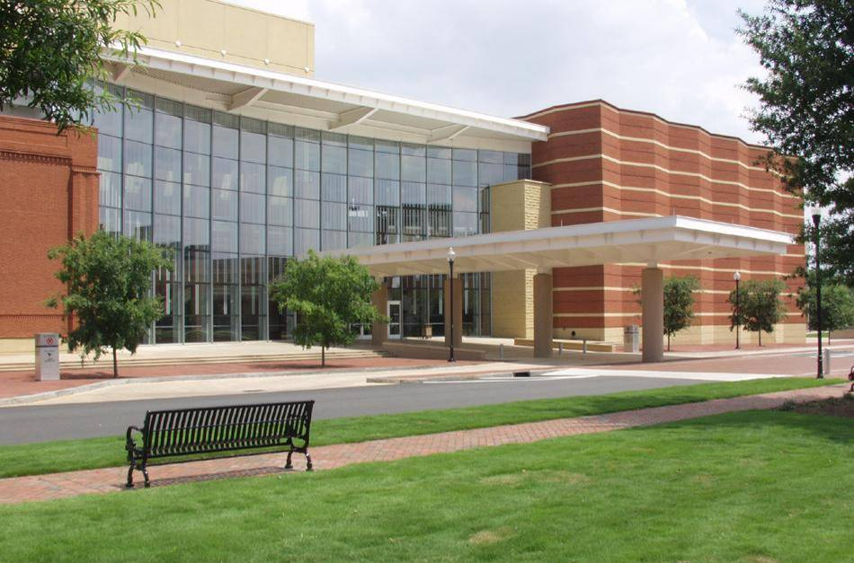

Slide 20
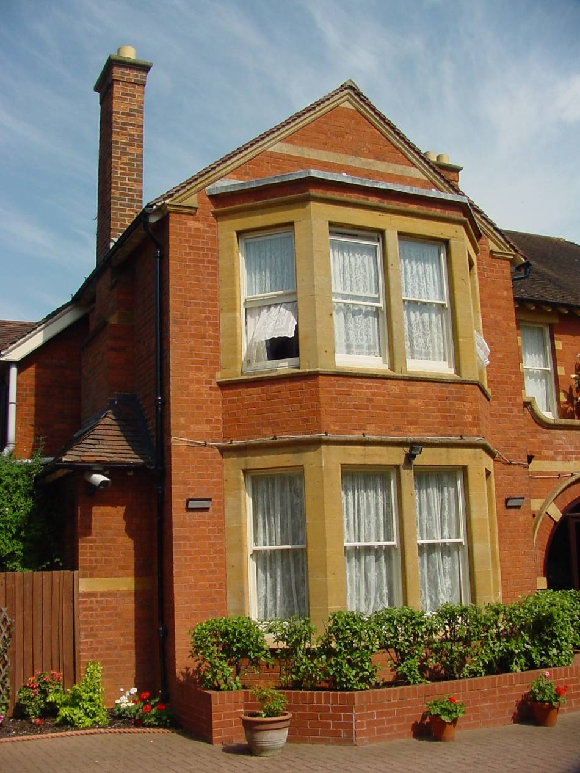
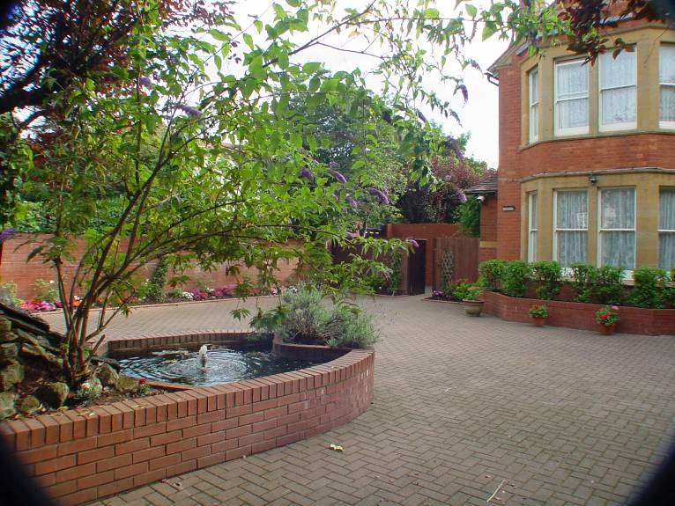
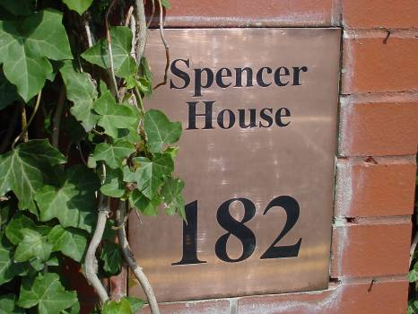
CSU Spencer House In Oxford England

Slide 21
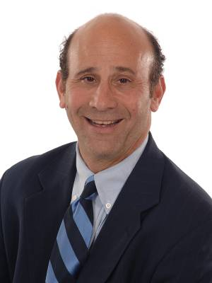
A new president and
a new strategic plan for excellence
Dr. Tim Mescon
CSU’s 4th President
Vision:
Columbus State University provides world-class education and assures student success through creative inquiry and community, regional, and global partnerships.

Slide 22
CSU Organization Chart

Slide 23
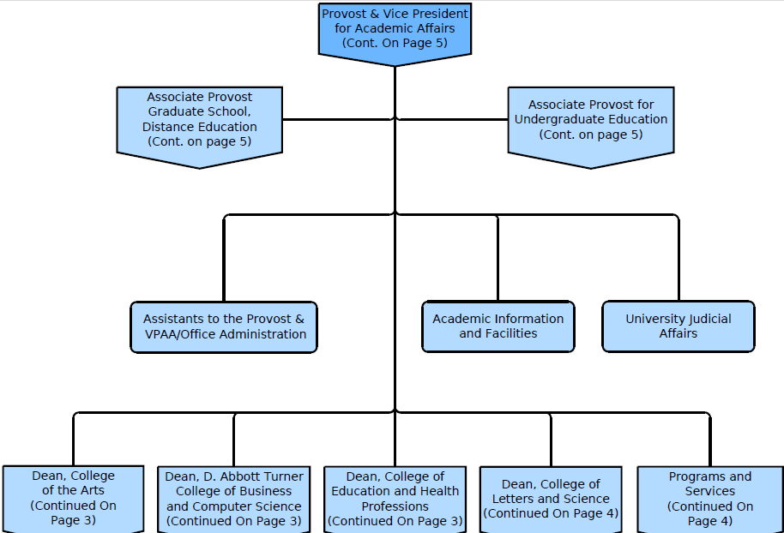
Academic Org. Chart

Slide 24
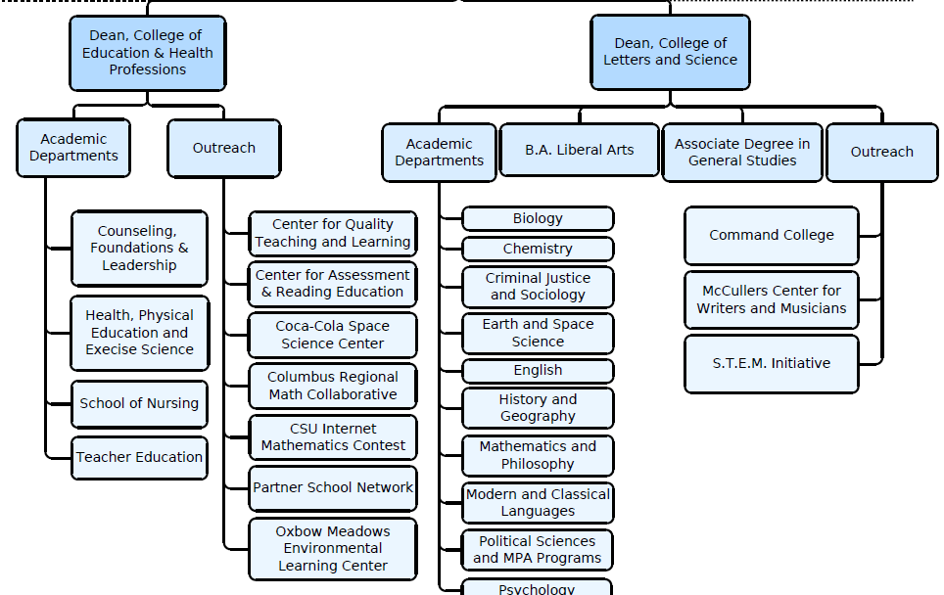

Slide 25
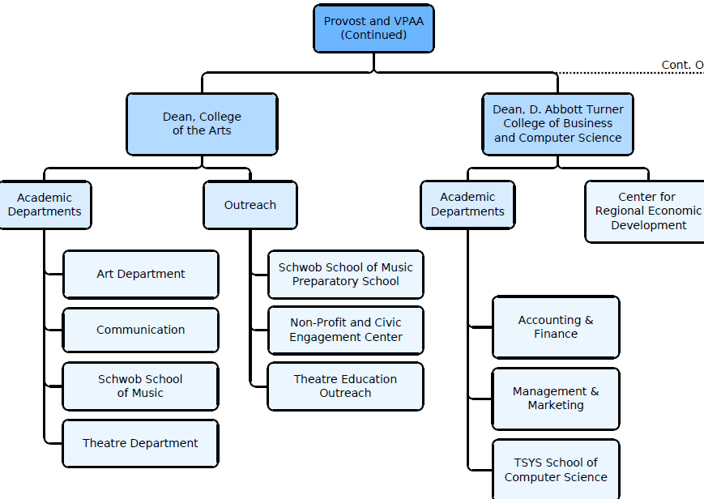

Slide 26
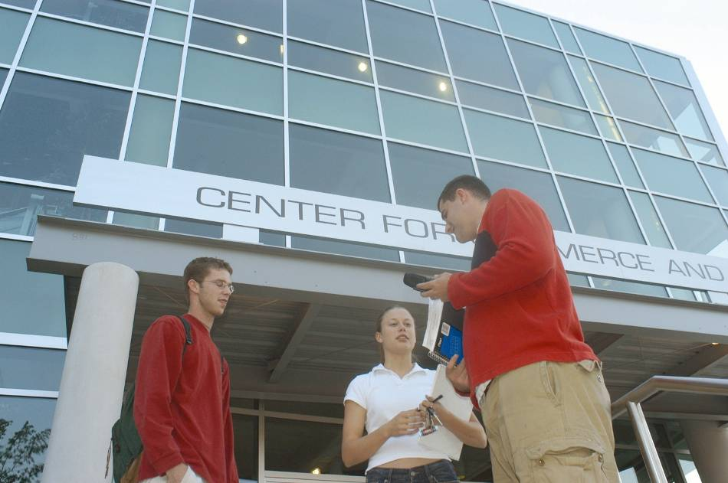
In pursuit of academic excellence
Goal of national accreditation for all eligible academic depts.
CSU’s D. Abbott Turner College of Business: now rated among top 27% of nation’s business schools
(Music, Nursing, Education, Art, Theatre and Counseling also similarly recognized)

Slide 27
In pursuit of academic excellence
Substantially increase online degree options.
Undergraduate online degree now available:
Bachelor of Science in Information Technology
Graduate online degrees now available:
Master of Arts in Teaching Secondary Math and Science
Master of Business Administration
Master of Education in Accomplished Teaching
Master of Education in Education Leadership
Master of Public Administration
Master of Science in Applied Computer Science

Slide 28
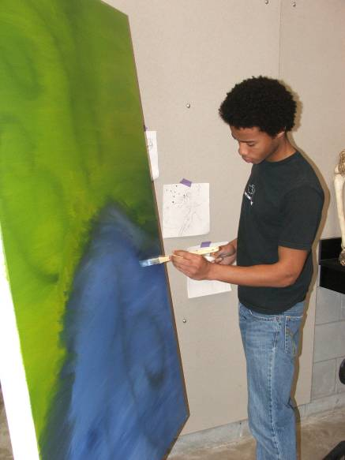
In pursuit of academic excellence
New academic units:
College of the Arts
School of Nursing
Department of Earth and Space Science
TSYS School of Computer Science
Office of the provost

Slide 29
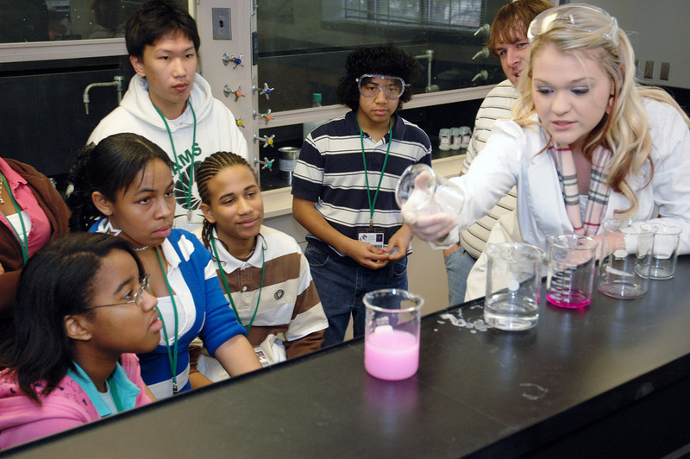
In pursuit of academic excellence
Emphasis on Science, Technology & Math Education

Slide 30
In pursuit of academic excellence
Human resource management program that is Georgia’s first to meet the standards of Society for Human Resource Management

Slide 31
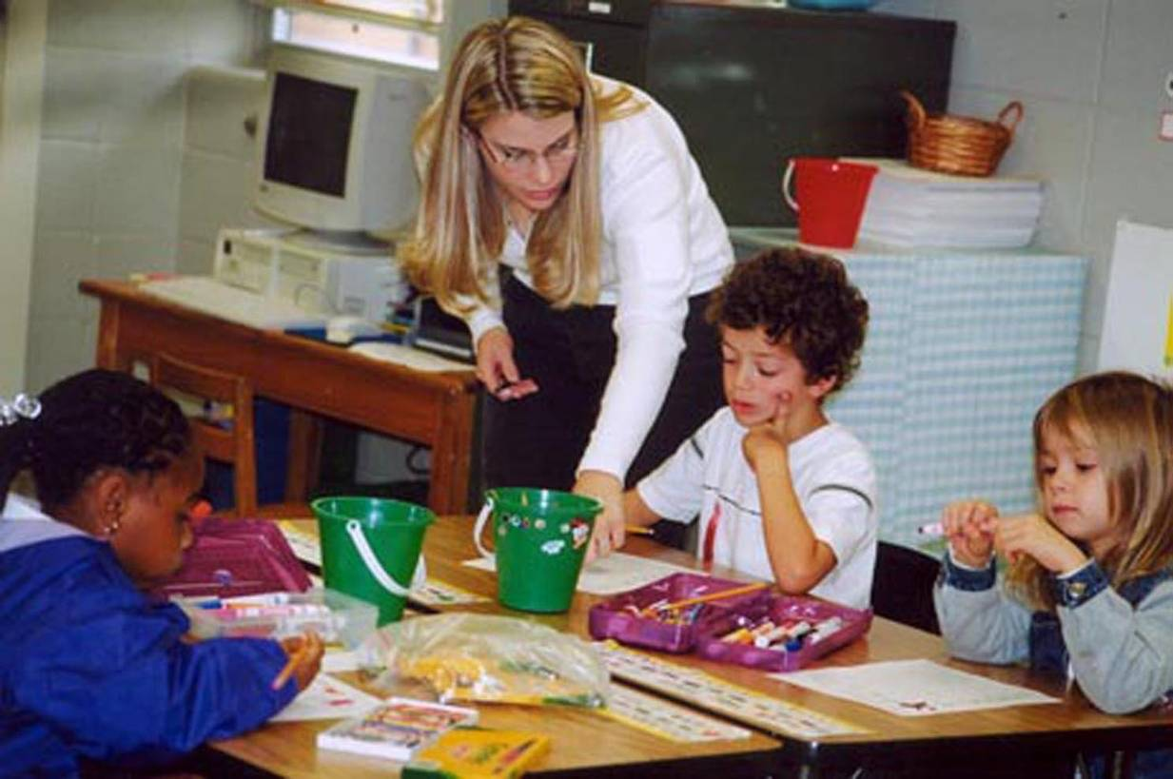
In pursuit of academic excellence
Increase graduate programs
More than 50 percent of local teachers are CSU graduates. Similar numbers for nursing & IT

Slide 32
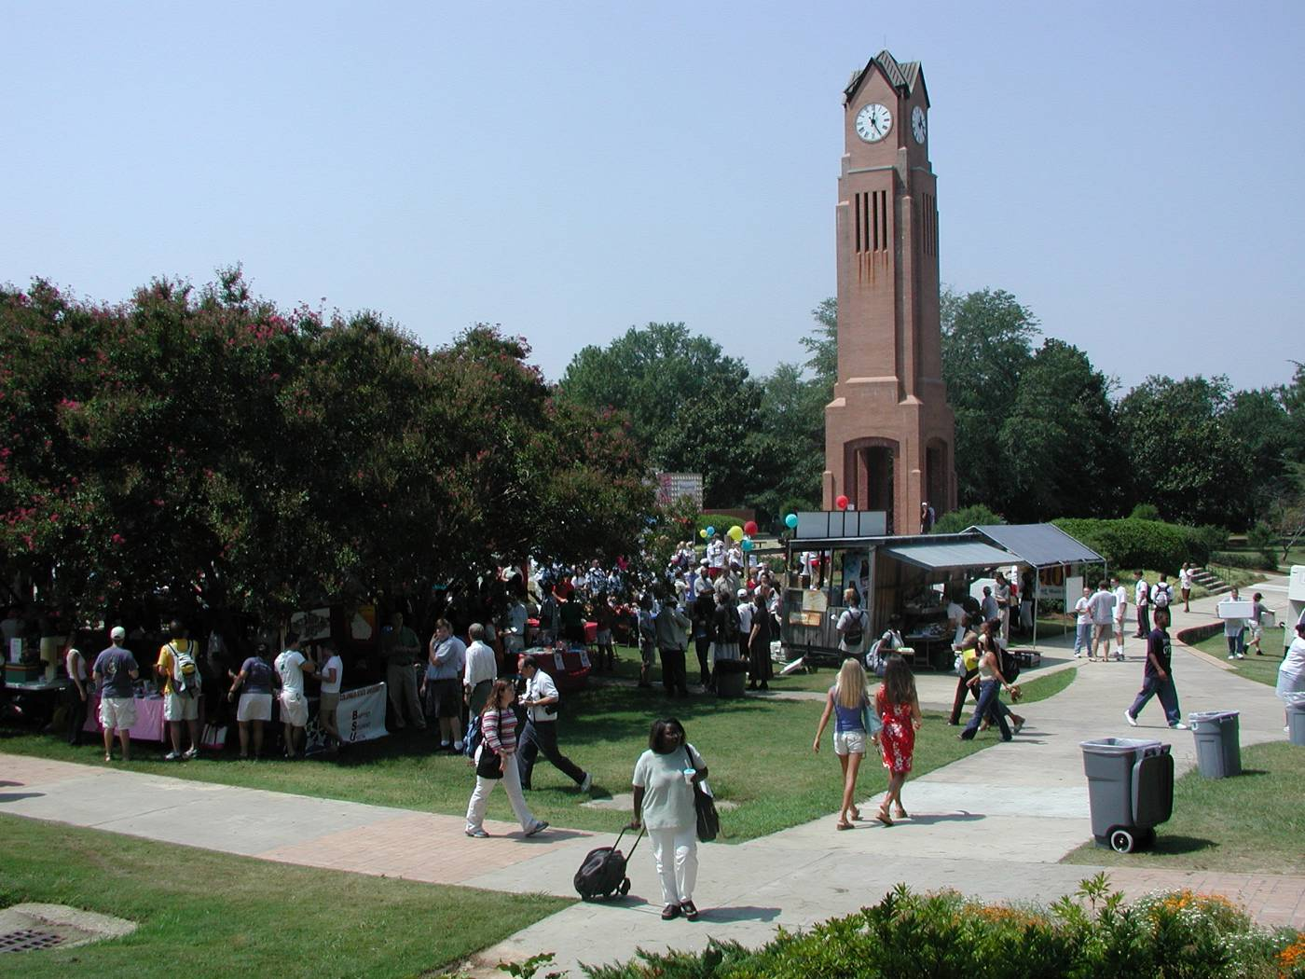
Columbus State University

Slide 33
Columbus State University

Slide 34
Columbus State University
Growth of on-campus housing at CSU

Slide 35
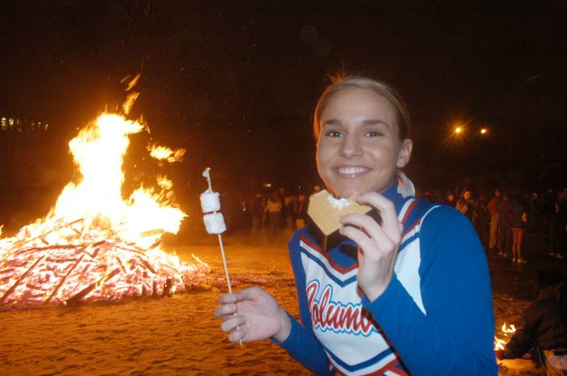
Columbus State University
New emphasis on retention by enhancing the “college experience.”
Mandatory freshman year experience program
Upgrade of campus dining facilities
Adding new collegiate and clubs sports
New bookstore (with Apple store inside) downtown

Slide 36
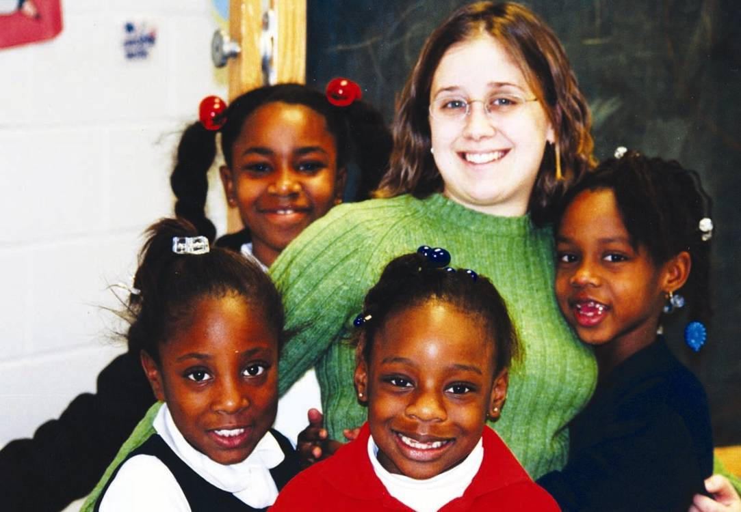
Columbus State University
Expand Honors, Servant Leadership
Students in the Servant Leadership program have contributed more than 76,000 hours of volunteer work to the community.

Slide 37
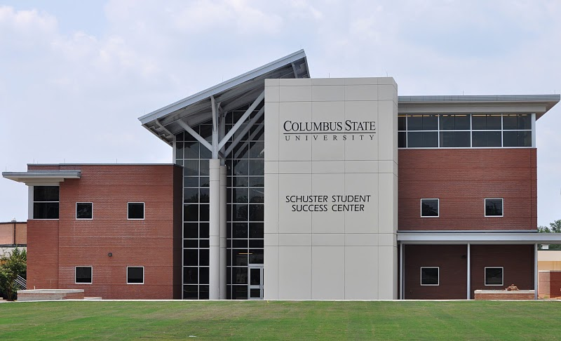
Columbus State University
Schuster Student Success Center

Slide 38
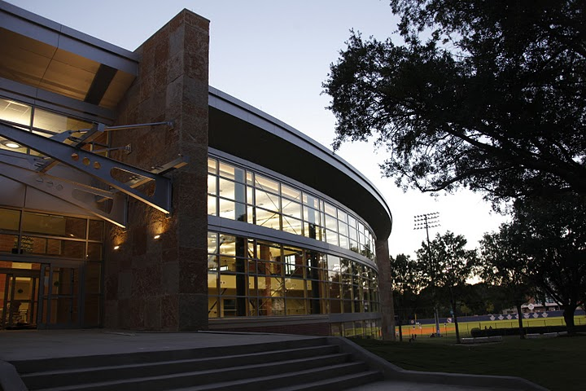
Columbus State University
Student Recreation Center

Slide 39
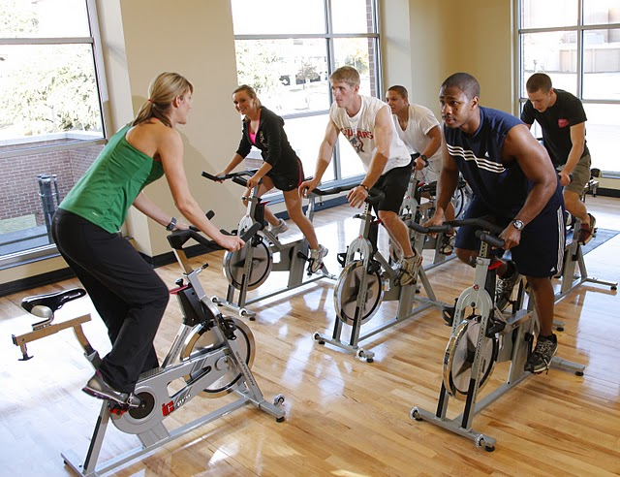
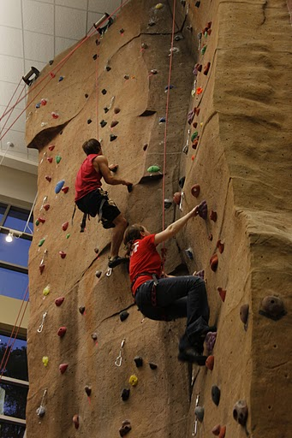
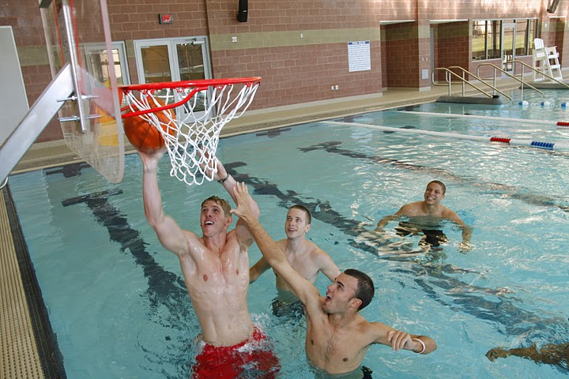
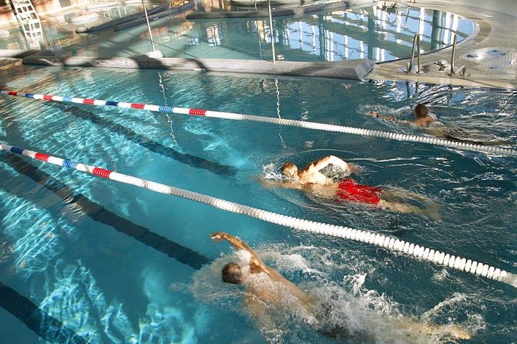
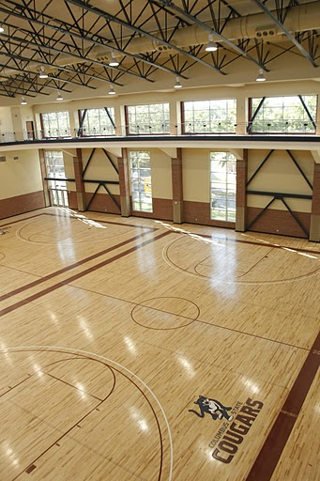
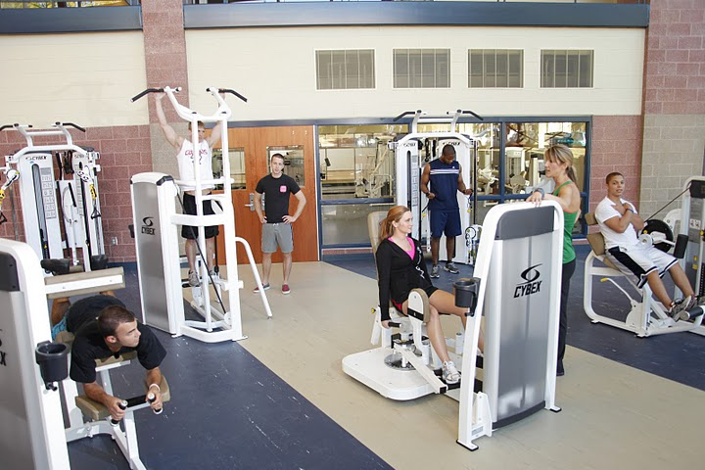
Student Recreation Center

Slide 40
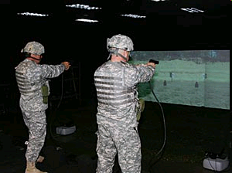
Create more partnerships with academic institutions, government agencies, and businesses consistent with the university’s mission

Slide 41
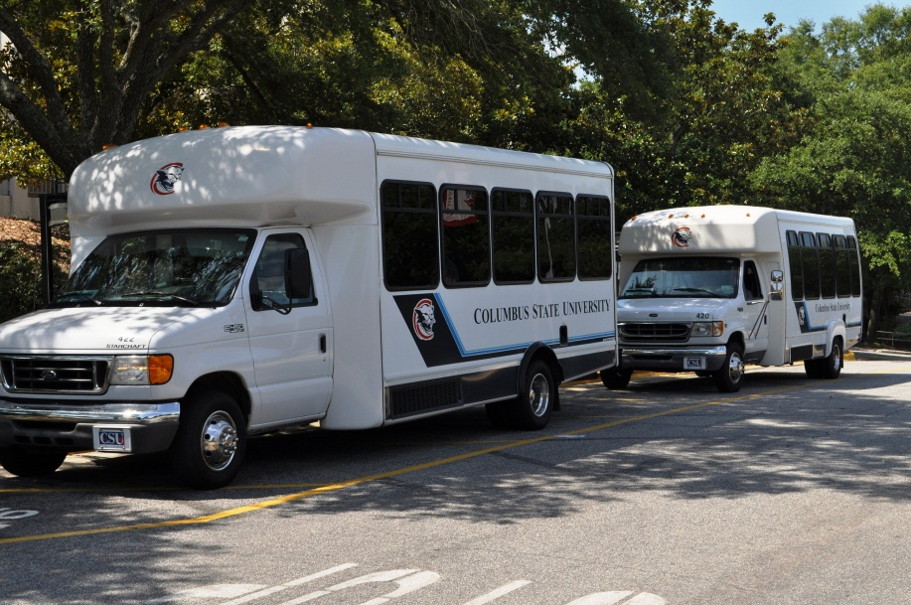
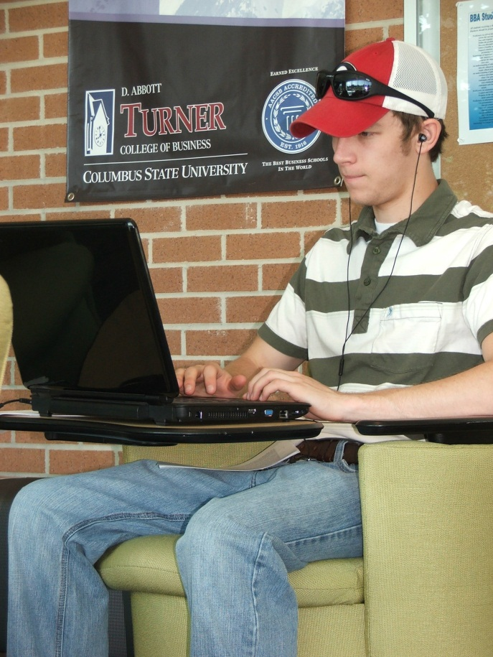
Provide a best-in-class technology platform and information-based services
Wireless service on all buses; throughout campus in 2 years

Slide 42
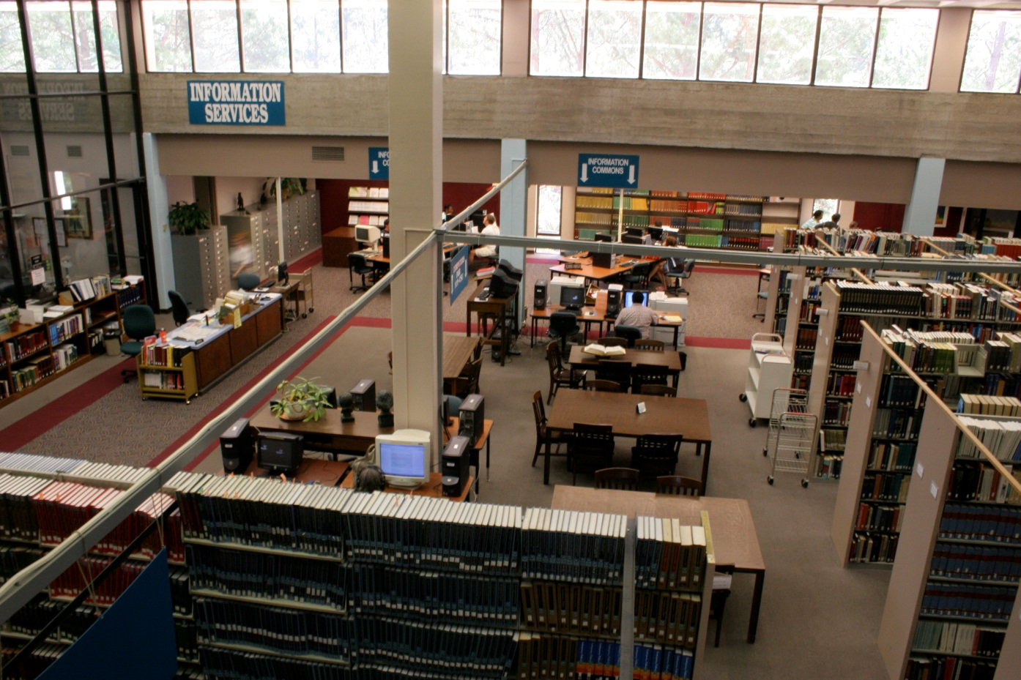
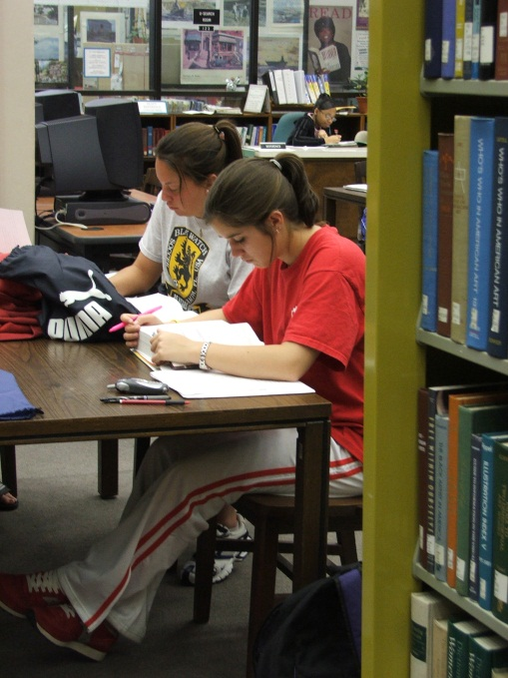
Provide a best-in-class technology platform and information-based services
Upgrade libraries; expand digital information availability

Slide 43
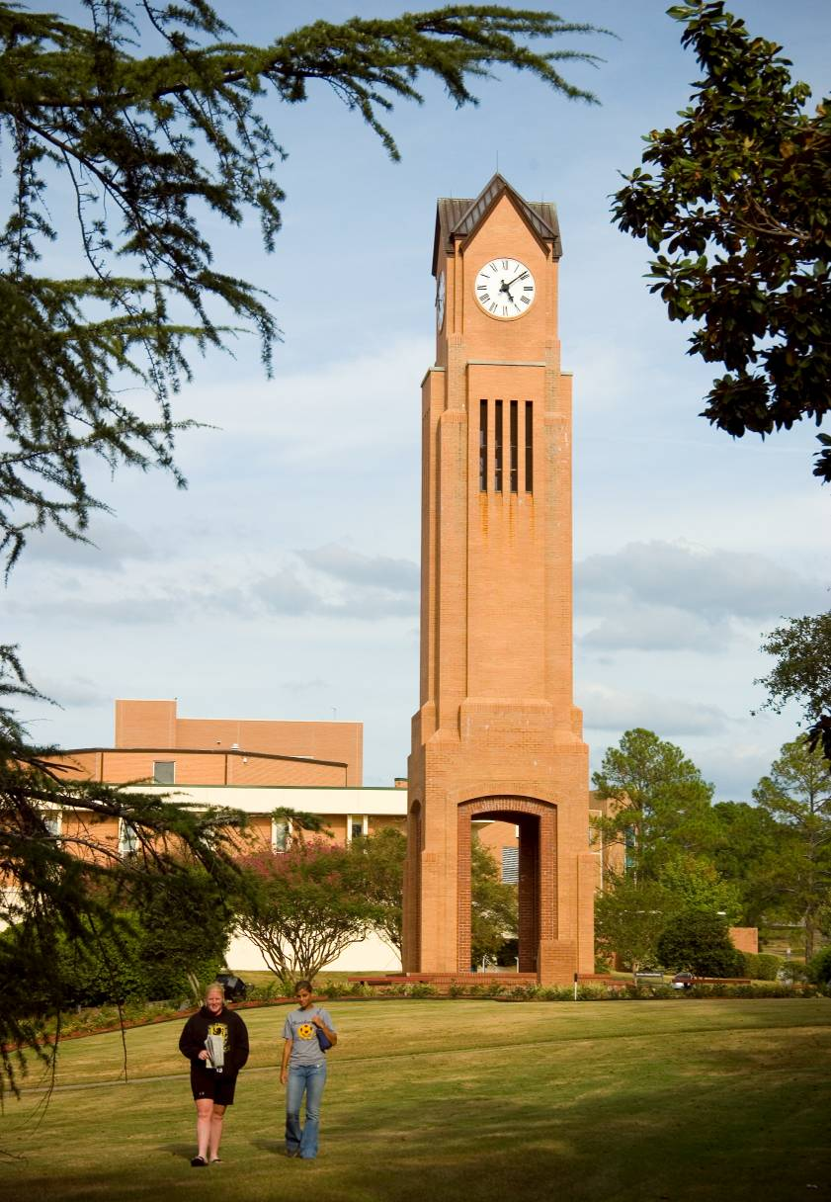
Questions about CSU?

