Slide 1
CSU-BIPT STUDY ABROAD PROGRAM IN CHINA MAY 20 – June 4, 2014
Spend Maymester in China studying China’s contributions in technology

Slide 2
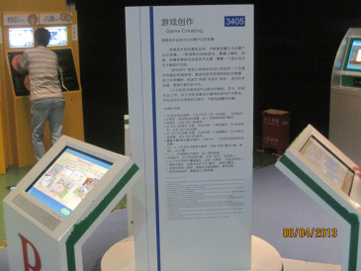
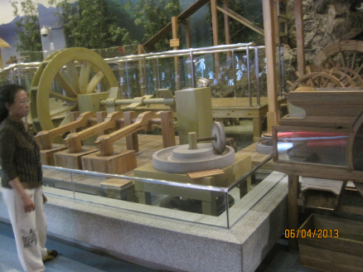
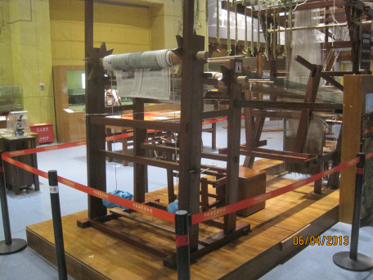
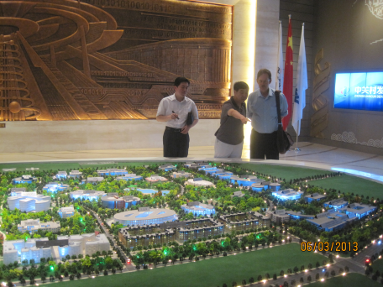
Anime / Robots Computer Games Communications
Experience first-hand China’s contributions to technology by active immersion in the culture and society of China.

Slide 3
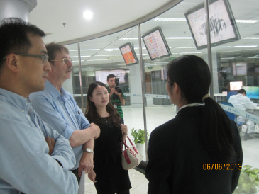
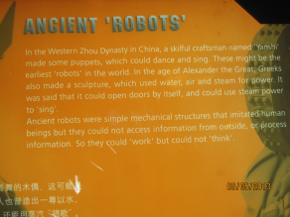
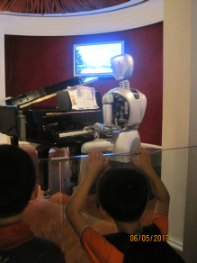
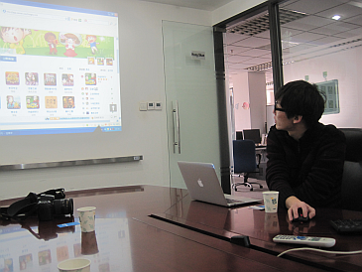
Among the sites you will visit are
China Science & Technology Museum,
Shanghai Science and Technology Museum
Zhongguancun Technology Park , and
Shanghai Supercomputer Center.

Slide 4
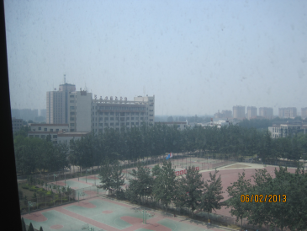
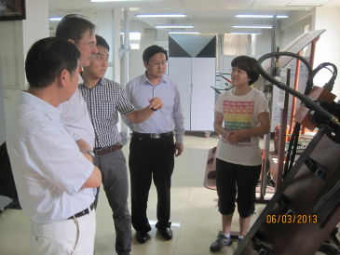
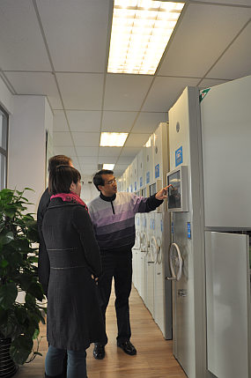
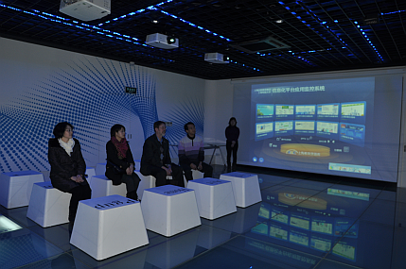
Hosted By BIPT & SOU
Beijing Institute of Petrochemical Technology
Shanghai Open University

Slide 5
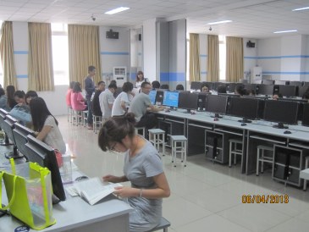
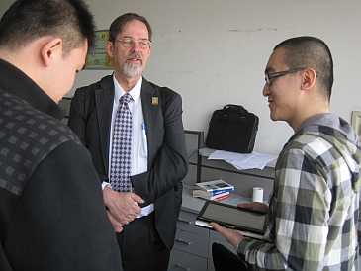
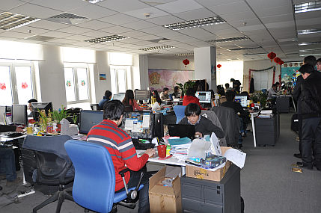
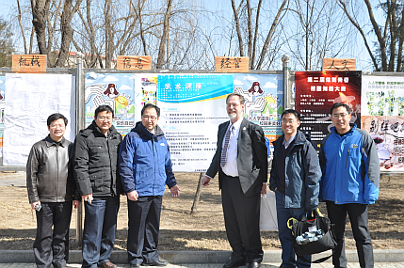
Make New Friends Learn Mandarin Work with Software Engineers to Create a Social Media Game
Computer
Science
Projects
Class
Raytoon Software
Campus Tours

Slide 6
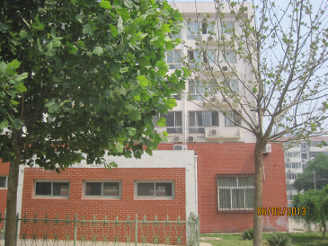
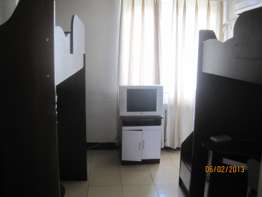
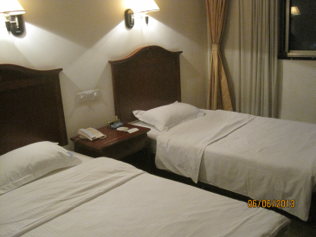
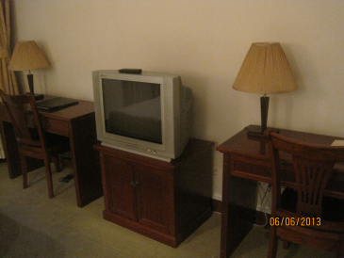
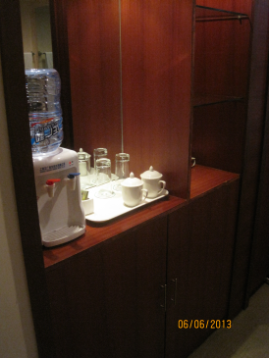
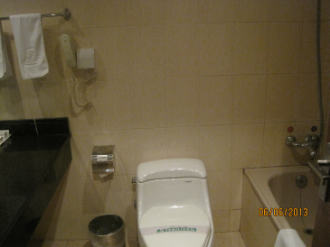
Stay on Campus
Beijing Institute of Petrochemical Technology
Shanghai Open University

Slide 7
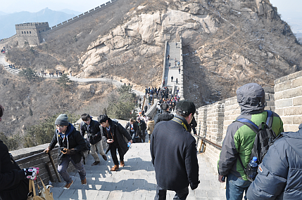
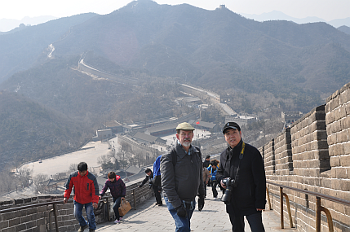
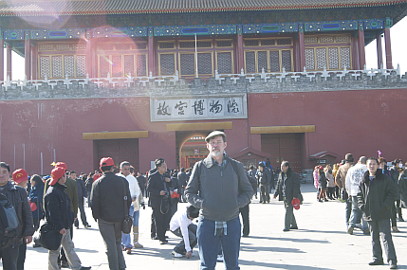
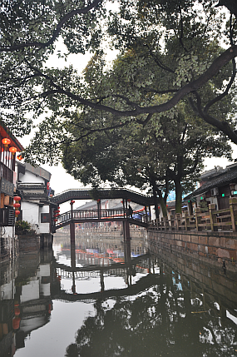
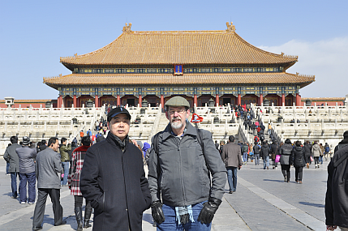
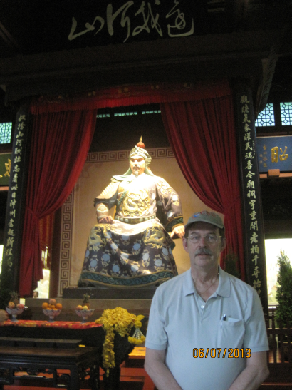
Explore Chinese Culture
Climb the Great Wall
Visit Palaces and Temples

Slide 8
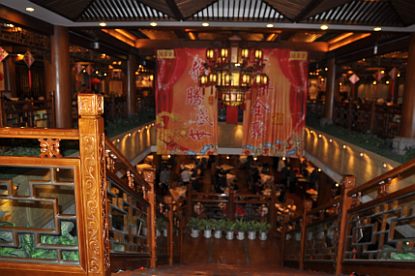
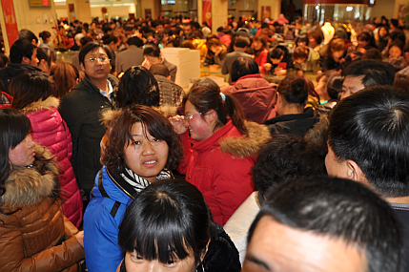
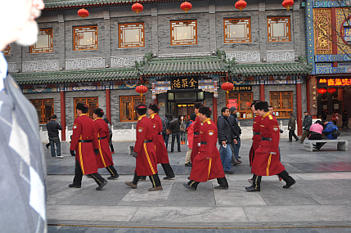
And the World’s Largest Cities

Slide 9
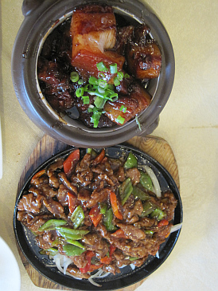
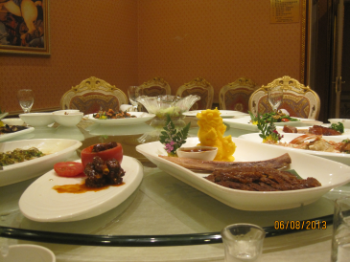
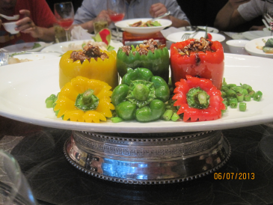
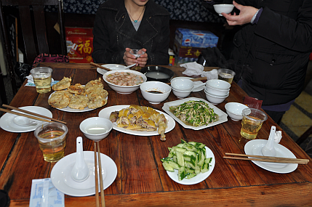
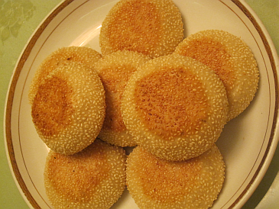
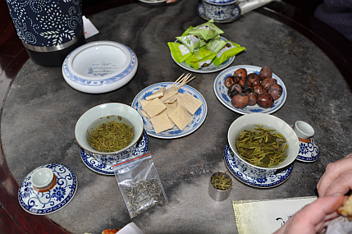
Eat Great Food

Slide 10
CSU-BIPT STUDY ABROAD PROGRAM IN BEIJING & SHANGHAI, CHINA Maymester: MAY 20 – June 4, 2014
CPSC2555 / CPSC5555U&G / ITDS5555:
Special Topics
(Chinese Contributions to Technology)
Total Cost: $3342 + tuition

Slide 11
QUESTIONS / MORE INFORMATION
For more information contact:
Dr. Jianhua Yang jianhua_yang@ColumbusState.edu
Dr. Wayne Summers wsummers@ColumbusState.edu
CCT453 / 706-507-8170
For information about the class:
http://csc.columbusstate.edu/summers/
Contact CIE for information about financial aid and to apply http://cie.columbusstate.edu/

Slide 12
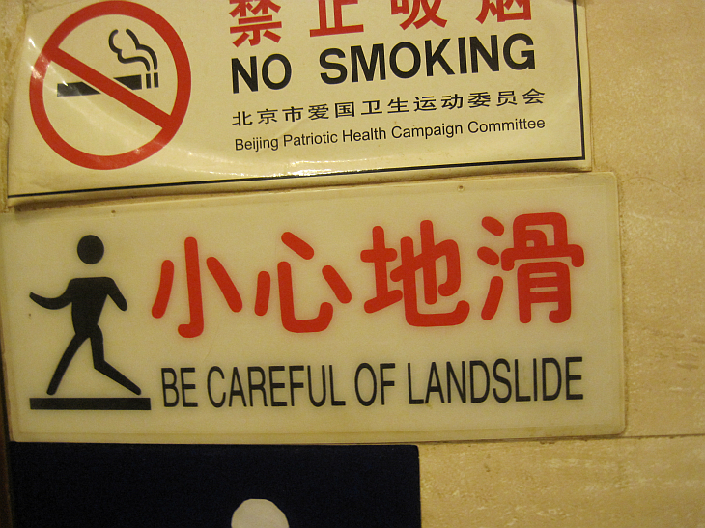
And have a great time:

