Slide 1
Identification Using Biometric Technology: Issues and Attitudes Shamim Khan & Pinar Gurkas khan_shamim@colstate.edu
Columbus State University
TSYS School of Computer Science

Slide 2
Outline
Introduction to biometric technology
Biometric categories
Operation of a biometric system
Biometric technology issues
Current research on user attitude
Our research on user attitude
Conclusions

Slide 3
Identity Matters …
Identification done for
Verification
Recognition
Identification required for
Preventing unauthorized access
Criminal justice

Slide 4
Traditional Methods of Identification
Based on something we know, something we have
Knowledge-based identification
Token-based identification

Slide 5
Knowledge-based Identification
Identity established by demonstrating possession of confidential information
– e.g., PINs, passwords
Passwords are
easy to implement (low cost)
largely acceptable by users
the most widely used authentication mechanism

Slide 6
Basic Password Authentication
Setup
User chooses password,
system encrypts password and stores in password file
Authentication
User supplies user ID and password,
system uses ID as index to get password from file,
compares supplied password with stored password for a match

Slide 7
Problems with Passwords
Inherent insecurity
Passwords can be
stolen
guessed
cracked using password-guesser program
Too many passwords to remember leads to
weak passwords
insecure storage

Slide 8
Password and People
According to one recent survey[1]:
25% manage more than 13 passwords
88% are frustrated with password management
25% saved passwords in unencrypted text on their PC
22% saved their passwords on a handheld device
15% had passwords written down on a piece of paper on or around their workstation.

Slide 9
Password Management Costs
Forgotten passwords is all too common
Time spent resetting passwords and unlocking machines
Loss of productivity due to password problems

Slide 10
Biometrics as the alternative
Based on some intrinsic characteristic of a human being
Physiological characteristics
data derived from direct measurement of a part of the human body
Behavioral characteristics
– based on measurements and data derived from an action

Slide 11
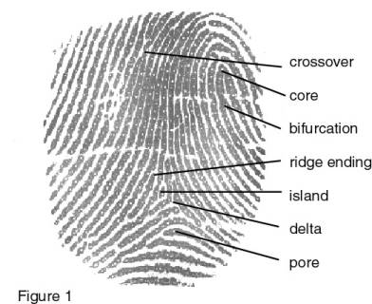
Common Biometrics
Fingerprints
Facial
Visual or thermogram
Hand geometry
Retinal Scan
Iris Scan
DNA pattern
Signature dynamics
Voice dynamics
Keystroke dynamics
Physiological
Behavioral

Slide 12
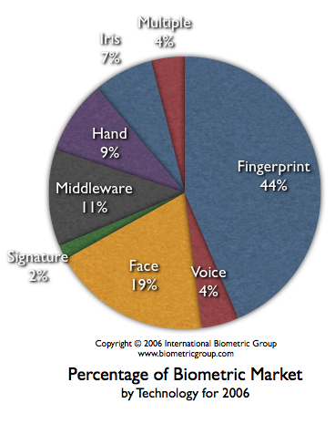
Market Share of Biometric Technologies
Source: www.biometricgroup.com

Slide 13
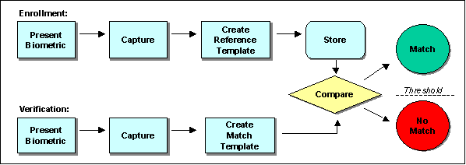
Biometric Identification– the Process

Slide 14
Characteristics of an ideal biometric[2]
Universal
- each person possesses it;
Unique
- no two persons should share it;
Permanent
- should neither change nor be alterable;
Collectable
- readily presentable to a sensor and easily quantifiable.

Slide 15
… and other issues
Performance
- system's accuracy, speed, robustness, resource requirements
Circumvention
- how easy it is to fool the system
Acceptability
- user acceptance;

Slide 16
Technological Issues
False Acceptance Rate (FAR)
Probability of impostors being accepted
False Rejection Rate (FRR)
Probability of genuine users being rejected
Failure to Enroll Rate (FTE)
Probability of failing to produce a template of sufficient quality to provide for subsequent verification

Slide 17
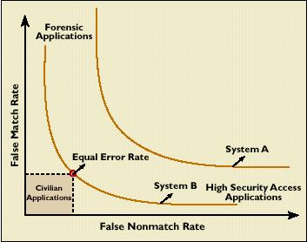
Tradeoff between FAR and FRR[2]
Less secure
(FAR)
FAR = FRR
More secure
(FRR)
Less user inconvenience
More user inconvenience

Slide 18
Evaluation of Biometric Systems (cont.)
Failure to Enroll Rate (FER)
Inability to enroll a template of sufficient quality to provide for subsequent verification.
Storage requirements
Depend on size of template, no. of templates per individual, any compression mechanism
Network bandwidth can be an issue
Time required for decision may be critical in many situations.

Slide 19
Evaluation of Biometric Systems (cont.)
Usability
difficult to apply in all environments
Setup requirements for enrolment and identification
False enrolment rates
Ranges from 0 to 11.97% (survey result over 1999-2002)

Slide 20
Technical limitations of biometrics [3]
Fingerprint
Cold finger
Dry/oily finger
High or low humidity
Angle of placement
Pressure of placement
Location of finger on platen (poorly placed core)
Cuts to fingerprint
Effects of manual activity on fingerprints (construction, gardening)

Slide 21
Technical limitations of biometrics (cont.)
Voice recognition
Cold or illness that affects voice
Different enrollment and verification capture devices
Different enrollment and verification environments (inside vs. outside)
Speaking softly
Variation in background noise
Poor placement of microphone / capture device
Quality of capture device

Slide 22
Technical limitations of biometrics (cont.)
Facial recognition
Change in hairstyle, facial hair
Lighting conditions
Adding/removing hat , glasses
Change in weight
Change in facial aspect (angle at which facial image is captured)
Quality of capture device
Change between enrollment and verification cameras (quality and placement)

Slide 23
Technical limitations of biometrics (cont.)
Iris-scan
Too much movement of head or eye
Glasses
Colored contacts
Retina-scan
Too much movement of head or eye
Glasses

Slide 24
Technical limitations of biometrics (cont.)
Hand geometry
Jewelry
Change in weight
Bandages
Swelling of joints
Signature-scan
Signing too quickly
Different signing positions (e.g., sitting vs. standing)

Slide 25
Legal and Ethical Issues
Need for standards
Guidelines for FAR, FRR, FTE rates, thresholds
Protection for biometric as private data
What data can be collected and stored, and how
Ownership of data
Alternatives for the disabled and elderly

Slide 26
Socio-cultural and Privacy Issues
Socio-cultural concerns
Depend on cultural and religious backgrounds
Association with criminality
Religious objections
Possible social exclusion due to
Disability
Age
Religion

Slide 27
Socio-cultural and Privacy Issues (cont.)
May reveal more than just identity
possible medical condition information
Fear of being tracked
Unlike traditional methods, biometric data subject to clandestine capture (give vs. grab )

Slide 28
Socio-cultural and Privacy Issues (cont.)
Function creep
Possible uses other than original intention
Already happening in traditional methods of identification
Every biometric database potentially a forensic identification database

Slide 29
Privacy concerns about biometrics (cont.)
Identity theft more serious than traditional methods because of the unchanging nature of biometrics such as fingerprints.
Alternative biometric must be found to replace stolen one.

Slide 30
Research on User Attitudes
Socio-cultural and privacy concerns may be influenced by user perception of the technology
Past surveys
Low percentage of exposure
User skepticism
Small sample size
Race, gender, personality traits not considered

Slide 31
Our Investigation
Involved 8 common biometrics
Facial image
Fingerprint
Voice dynamics
Hand geometry
Keystroke dynamics
Iris scan
Retina scan
Signature dynamics

Slide 32
Our Investigation (cont.)
Focus on 3 attitude domains
How comfortable?
How secure?
How intrusive?

Slide 33
Our Investigation (cont.)
Possible links between attitudes and user attributes
User attributes considered
Gender
Age
Race/Ethnicity
Education/Work background

Slide 34
Our Investigation (cont.)
Possible links between attitudes and personality
Big Five Inventory (BFI) of personality
Neuroticism
Extraversion
Agreeableness
Conscientiousness
Openness

Slide 35
Our Investigation (cont.)
On-line survey with 96 questions on
Background (5)
Personality (44)
Biometric technology knowledge/experience (3)
Attitudes towards the technology (44)

Slide 36
A Sample Question on Attitude
I would be comfortable if I have to use fingerprint analysis to identify myself.
Strongly Disagree
Disagree
Neither Agree Nor Disagree
Agree
Strongly Agree

Slide 37
Our Investigation (cont.)
Number of participants 184 (67 males, 117 females)
49% had a background in IT (study or work related);
Facial recognition, finger print, and voice analysis best known biometrics
63% had used biometric technologies before
Fingerprint and signature analysis most common (40% and 31%)

Slide 38
Findings on Attitudes
Comfort
Fingerprinting (82%)
Voice analysis (67%)
Security
Fingerprinting (76%)
Retina scan (66%)
Worse than traditional methods (9%)

Slide 39
Findings on Attitudes (cont.)
Intrusiveness
Facial image (43%)
Retina scan (40%)
Iris scan (37%)
Overall <50% worried
Standard deviation greater for security (0.19) than comfort(0.09) and intrusiveness (0.08)

Slide 40
Differences based on User Attributes
No significant difference on comfort, intrusiveness and security attitudes based on
Age
Gender
Race (European vs. African-Americans)

Slide 41
Differences based on Personality
Used correlations between scores on attitudes (comfort, security, intrusiveness) and scores on 5 personality dimensions (openness, conscientiousness, extraversion, agreeableness, and neuroticism)
No significant differences observed

Slide 42
Privacy Concerns
Trustworthiness of public and private institutions for keeping biometric data private
Business organizations the least trustworthy (16% had confidence)
Government institutions trusted by more (57%)

Slide 43
In Conclusion …
Biometrics technology is here to stay
People more aware, and have a more positive attitude towards it than previously reported
No significant differences in attitudes found based on gender, race/ethnicity, age

Slide 44
In Conclusion …
Deep-rooted concern observed about protection of privacy by organizations
Sample used not representative of population at large
Need further investigations

Slide 45
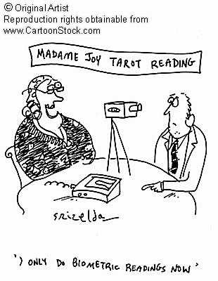
Questions? - Thank you!

