Slide 1
Computer Systems
MTSU CSCI 3240
Spring 2016
Dr. Hyrum D. Carroll
Materials from CMU and Dr. Butler

Slide 2
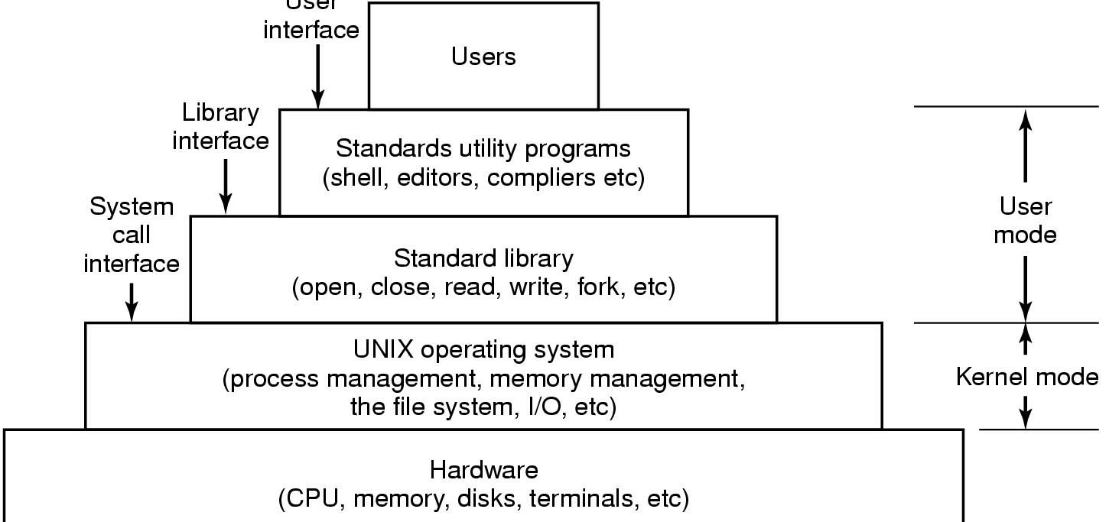
A software view
User Interface

Slide 3
How it works
hello.c program
#include <stdio.h>
int main()
{
printf(“hello, world\n”);
}

Slide 4
The Compilation system
gcc is the compiler driver
gcc invokes several other compilation phases
Preprocessor
Compiler
Assembler
Linker
What does each one do? What are their outputs?
printf.o
Pre-
processor
(cpp)
Compiler
(cc1)
Assembler
(as)
Linker
(ld)
hello.c
hello.i
hello.s
hello.o
hello
Source
program
(text)
Modified
source
program
(text)
Assembly
program
(text)
Relocatable
object
programs
(binary)
Executable
object
program
(binary)

Slide 5
1. Preprocessor (cpp)
First, gcc compiler driver invokes cpp to generate expanded C source
cpp just does text substitution
Converts the C source file to another C source file
Expands #defines, #includes, etc.
Output is another C source

Slide 6
1. Preprocesser
Included files:
#include <foo.h>
#include “bar.h”
Defined constants:
#define MAXVAL 40000000
By convention, all capitals tells us it’s a constant, not a variable.
Macros:
#define MIN(x,y) ((x)<(y) ? (x):(y))
#define RIDX(i, j, n) ((i) * (n) + (j))

Slide 7
1. Preprocesser
Conditional compilation:
#ifdef … or #if defined( … )
#endif
Code you think you may need again (e.g. debug print statements)‏
Include or exclude code based on #define/#ifdef
More readable than commenting code out
Portability
Compilers have “built in” constants defined
Operating system specific code
#if defined(__i386__) || defined(WIN32) || …
Compiler-specific code
#if defined(__INTEL_COMPILER)
Processor-specific code
#if defined(__SSE__)

Slide 8
2. Compiler (cc1)
Next, gcc compiler driver invokes cc1 to generate assembly code
Translates high-level C code into assembly
Variable abstraction mapped to memory locations and registers
Logical and arithmetic functions mapped to underlying machine opcodes
3. Assembler (as)
Next, gcc compiler driver invokes as to generate object code
Translates assembly code into binary object code that can be directly executed by CPU

Slide 9
4. Linker (ld)
Finally, gcc compiler driver calls linker (ld) to generate executable
Links together object code and static libraries to form final executable
m.o
a.o
Libraries
libc.a
Linker (ld)‏
p
This is the executable program

Slide 10
Summary of compilation process
Compiler driver (cc or gcc) coordinates all steps
Invokes preprocessor (cpp), compiler (cc1), assembler (as), and linker (ld).
Passes command line arguments to appropriate phases
printf.o
Pre-
processor
(cpp)
Compiler
(cc1)
Assembler
(as)
Linker
(ld)
hello.c
hello.i
hello.s
hello.o
hello
Source
program
(text)
Modified
source
program
(text)
Assembly
program
(text)
Relocatable
object
programs
(binary)
Executable
object
program
(binary)

Slide 11
The run-time system
Program runs on top of an operating system that implements
File system
Memory management
Processes
Device management
Network support
etc.

Slide 12
Operating system functions
Protection
Protects the hardware/itself from user programs
Protects user programs from each other
Protects files from unauthorized access
Resource allocation
Memory, I/O devices, CPU time, space on disks

Slide 13
Operating system functions
Abstract view of resources
Files as an abstraction of storage devices
System calls an abstraction for OS services
Virtual memory a uniform memory space abstraction for each process
Gives the illusion that each process has entire memory space
A process (in conjunction with the OS) provides an abstraction for a virtual computer
Slices of CPU time to run in

Slide 14
Unix file system
Key concepts
Everything is a file
Keyboards, mice, CD-ROMS, disks, modems, networks, pipes, sockets
One abstraction for accessing most external things
A file is a stream of bytes with no other structure.
on the hard disk or from an I/O device
Higher levels of structure are an application concept, not an operating system concept
No “records” (contrast with Windows/VMS)‏

Slide 15
Unix file systems
Managed by OS on disk
Dynamically allocates space for files
Implements a name space so we can find files
Hides where the file lives and its physical layout on disk
Provides an illusion of sequential storage
All we have to know to find a file is its name

Slide 16
Process abstraction
A fundamental concept of operating systems.
A process is an instance of a program when it is running.
A program is a file on the disk containing instructions to execute
A process is an instance of that program loaded in memory and running
Like you baking the cookies, following the instructions
A process includes
Code and data in memory, CPU state, open files, thread of execution

Slide 17
How does a program get executed?
The operating system creates a process
Including among other things, a virtual memory space
System loader reads program from file system and loads its code into memory
Program includes any statically linked libraries
Done via DMA (direct memory access)‏
System loader loads dynamic shared objects/libraries into memory
Then it starts the thread of execution running
Note: the program binary in file system remains and can be executed again

Slide 18
Where are programs loaded in memory?
To start with, imagine a primitive operating system.
Single tasking.
Physical memory addresses go from zero to N.
The problem of loading is simple
Load the program starting at address zero
Use as much memory as it takes.
Linker binds the program to absolute addresses
Code starts at zero
Data concatenated after that
etc.

Slide 19
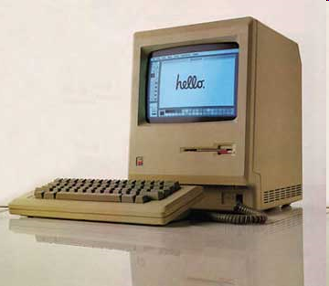
Where are programs loaded, cont’d
Next imagine a multi-tasking operating system on a primitive computer.
Physical memory space, from zero to N.
Applications share space
Memory allocated at load time in unused space
Linker does not know where the program will be loaded
Binds together all the modules, but keeps them relocatable
How does the operating system load this program?
Not a pretty solution, must find contiguous unused blocks
How does the operating system provide protection?
Not pretty either

Slide 20
Where are programs loaded, cont’d
Next, imagine a multi-tasking operating system on a modern computer, with hardware-assisted virtual memory
The OS creates a virtual memory space for each user’s program.
As though there is a single user with the whole memory all to itself.
Now we’re back to the simple model
The linker statically binds the program to virtual addresses
At load time, the operating system allocates memory, creates a virtual address space, and loads the code and data.
Binaries are simply virtual memory snapshots of programs

Slide 21
Example memory map
Nothing is left relocatable, no relocation at load time
0xffffffff
kernel virtual memory
(code, data, heap, stack)
memory
invisible to
user code
0xc0000000
user stack
(created at runtime)
%esp (stack pointer)‏
memory mapped region for
shared libraries
0x40000000
run-time heap
(managed by malloc)
brk
read/write segment
(.data, .bss)
loaded from the
executable file
read-only segment
(.init, .text, .rodata)
0x08048000
0
unused

Slide 22
The memory hierarchy
Operating system and CPU memory management unit gives each process the “illusion” of a uniform, dedicated memory space
i.e. 0x0 – 0xFFFFFFFF for IA32
Allows multitasking
Hides underlying non-uniform memory hierarchy
Notes:
Left off here 1/25/2016

Slide 23
Memory heirarchy motivation
In 1980
CPUs ran at around 1 mhz.
A memory access took about as long as a CPU instruction
Memory was not a bottleneck to performance
Today
CPUs are about 3000 times faster than in 1980
DRAM Memory is about 10 times faster than in 1980
We need a small amount of faster, more expensive memory for stuff we’ll need in the near future
How do you know what you’ll need in the future?
Locality
L1, L2, L3 caches

Slide 24
The memory heirarchy
Smaller
Faster
More Expensive
L0
Registers
L1
Level 1 Cache
On Chip
L2
Level 2 Cache
(off chip)‏
Larger
Slower
Cheaper
L3
Main Memory
L4
Local Secondary Storage
L5
Remote Secondary Storage

Slide 25
Hardware organization
The last piece…how does it all run on hardware?
CPU
Register File
Memory Bus
PC
ALU
System Bus
Main
Memory
.
.
.
Bus Interface
I/O Bridge
I/O Bus
USB
Controller
Graphics
Controller
. . .
Disk
Controller

Slide 26
Reading the hello command from the keyboard
Notes:
1. Shell process running, waiting for input
2. User types ./hello
3. Command read into registers
4. Before sent to main memory before being read by shell process

Slide 27
Loading the executable from disk into main memory
Notes:
5. Shell process creates new process through
OS and initiates DMA of hello executable from
disk to main memory

Slide 28
Writing the output string from memory to the display
Notes:
6. CPU executes hello code from main memory
7. CPU copies string “hello, world\n” from main memory to display

