Slide 1
GDB debugger

Slide 2
gdb
To compile a program for use with gdb, use the ‘-g’ compiler switch
Add debug symbols and do not reorder instructions
Better graphical interfaces
Most debuggers provide the same functionality
gdb -tui
layout split, layout regs
DDD: http://www.gnu.org/software/ddd/

Slide 3
Controlling program execution
run
Starts the program
step
Step program until it reaches a different source line.
next
Step program, proceeding through subroutine calls.
Single step to the next source line, not into the call.
continue
Continue program execution after signal or breakpoint.

Slide 4
Controlling program execution
break, del
Set and delete breakpoints at particular lines of code
watch, rwatch, awatch
Data breakpoints
Stop when the value of an expression changes (watch), when expression is read (rwatch), or either (awatch)

Slide 5
Printing out code and data
print
Print expression
Basic
print argc
print argv[0]
print {type} addr
(gdb) p {char *} 0xbfffdce4
print /x addr
‘/x’ says to print in hex. See “help x” for more formats
Same as examine memory address command (x)
printf “format string” arg-list
(gdb) printf "%s\n", argv[0]
list
Display source code (useful for setting breakpoints)

Slide 6
Other Useful Commands
where, backtrace
Produces a backtrace - the chain of function calls that brought the program to its current place.
up, down
Change scope in stack
info
Get information
‘info’ alone prints a list of info commands
‘info br’ : a table of all breakpoints and watchpoints
‘info reg’ : the machine registers
quit
Exit the debugger

Slide 7
Example Program
1 #include <stdio.h>
2 void sub(int i)
3 {
4 char* here[900];
5 sprintf((char *)here,"Function %s in %s", __FUNCTION__ , __FILE__);
6 printf("%s @ line %d\n", here, __LINE__);
7 }
8
9 void sub2(int j)
10 { printf("%d\n",j); }
11
12 int main(int argc, char** argv)
13 {
14 int x;
15 x = 30;
16 sub2(x);
17 x = 90;
18 sub2(x);
19 sub(3);
20 printf("%s %d\n",argv[0],argc);
21 return(0);
22 }

Slide 8
Walkthrough example
% gcc –g –o gdb_ex gdb_ex.c
% gdb gdb_ex
(gdb) set args a b c d set program arguments
(gdb) list 1,22 list source file
(gdb) break 14 break at source line at program start
(gdb) break sub subroutine break
(gdb) break 6
(gdb) run start program (breaks at line 14)
(gdb) p argv hex address of argv (char**)
(gdb) p argv[0] prints “gdb_ex”
(gdb) p argv[1] prints “a”
(gdb) p strlen(argv[1]) prints 1
(gdb) p argc prints 5
(gdb) p /x argc prints 0x5
(gdb) p x uninitialized variable
(gdb) n go to next line
(gdb) p x x now 30
(gdb) p /x &x print address of x
(gdb) x/w &x print contents at address of x

Slide 9
Walkthrough example
(gdb) n go to next line (execute entire call)
(gdb) s go to next source instr
(gdb) s go to next source instr (follow call)
(gdb) continue go until next breakpoint (breaks at line 6 in sub)
(gdb) where list stack trace
(gdb) p x x no longer scoped
(gdb) up change scope
(gdb) p x x in scope, prints 90
(gdb) del 3 delete breakpoint
(gdb) continue finish
(gdb) info br get breakpoints
(gdb) del 1 delete breakpoint
(gdb) break main breakpoint main
(gdb) run start program
(gdb) watch x set a data write watchpoint
(gdb) c watchpoint triggered

Slide 10
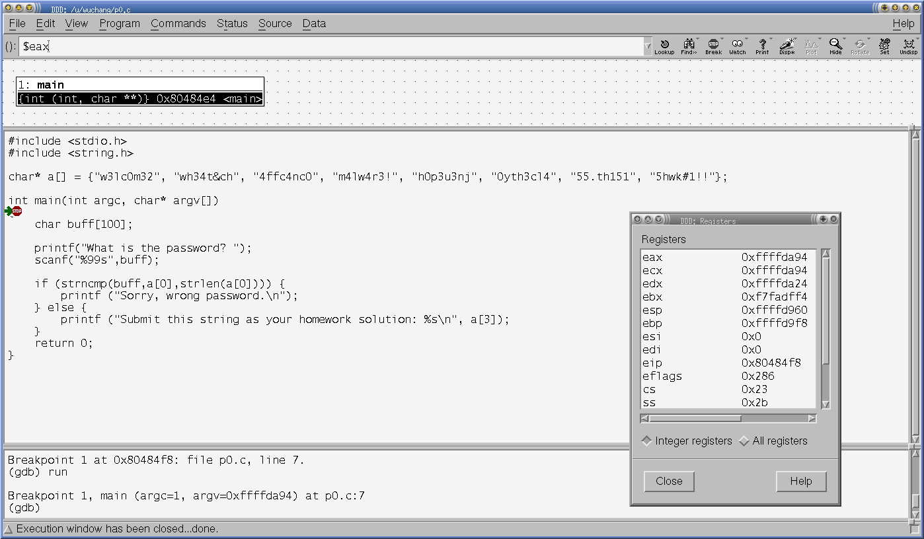
DDD

