Slide 1
Flowcharts
CPSC 1301K
Columbus State University
Dr. Hyrum Carroll
(based on material from Hillary Fleenor)

Slide 2
Flowcharts
A flowchart is a diagram that represents the steps of an algorithm using visual representations along with arrows indicating flow to illustrate a solution model to a given problem.

Slide 3
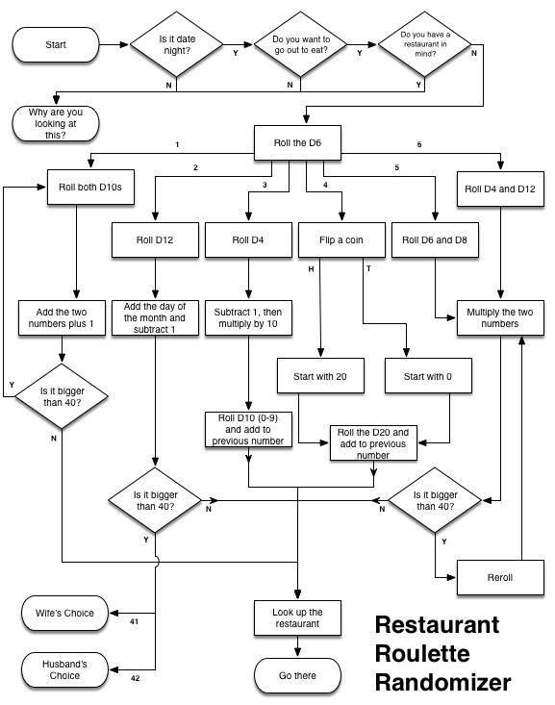
Example Flowcharts
How to make a friend

Slide 4
What are you going to do if the lamp does not work?
Check if the lamp is plugged in
If it is not plugged in
Then plug it in
else check the bulb
If the bulb is burned out
Then replace the bulb
else buy new lamp
ordered
unambiguous
executable
Algorithm
Notes:
An algorithm is a step-by-step set of instructions for solving a task.
For an algorithm to be valid, each step (instruction) must be

Slide 5
What are you going to do if the lamp does not work?
Check if the lamp is plugged in
If it is not plugged in
Then plug it in
else check the bulb
If the bulb is burned out
Then replace the bulb
else buy new lamp
Lamp doesn’t work
Lamp plugged in?
No
Plug in lamp
Yes
Bulb burned out?
Yes
Replace bulb
No
Buy new lamp
Notes:
An algorithm is a step-by-step set of instructions for solving a task.
For an algorithm to be valid, each step (instruction) must be

Slide 6
Lamp doesn’t work
Lamp plugged in?
No
Plug in lamp
Yes
Try bulb
Bulb burned out?
No
Use bulb
Yes
More bulbs?
No
Buy new lamp
Yes
Notes:
A flowchart is a type of diagram that represents an algorithm, workflow or process, showing the steps as boxes of various kinds, and their order by connecting them with arrows.

Slide 7
Flow Charts (another example)
Start
4
2
3
Read 1 line of input
Write the result of step 3 (output)
Add 14 to input
Multiply the result in step 2 by 6
1
End
Input : 3
0
n

Slide 8
Flow Charts (contd.)
Start
N = 0
Read a, b
Compute
T=a + b
T > 10?
Yes
Compute
N = N + 4T
Write N
No
Compute
N = 3T
End
Input : a = 3, b = 4
a = 4, b = 5
a = 5, b = 7

Slide 9
How to create an algorithm?
Principle 1: Solve a specific instance of the problem by hand using pencil and paper.
Principle 2: Generalize your solution by replacing your specific instance values with "variables".
Principle 3: Manually execute your algorithm on several test cases to verify that it produces correct answers. This is called desk checking or walking through the algorithm.
Principle 4: After a general solution to the task is known, write correct programming statements to implement your solution on the computer.

Slide 10
Flowcharts Symbols
Name | Symbol | Use in Flowchart
Oval |  | Beginning and ending nodes
Flow line |  | Direction of the logic flow
Rectangle |  | A process to be carried out
Diamond |  | A decision; the flow will continue along 1 of the 2 lines coming from it

Slide 11
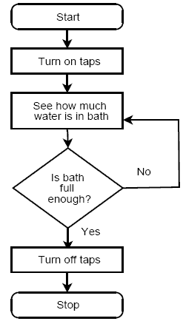

Slide 12
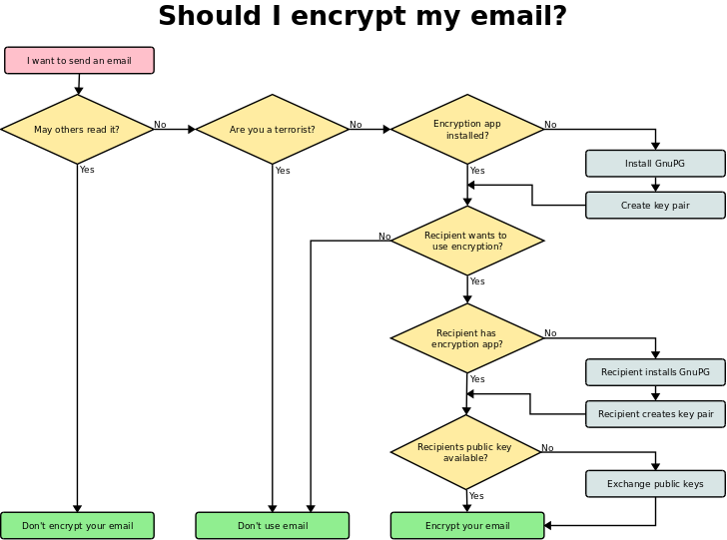
Notes:
http://dia-installer.de/shapes/Flowchart/images/Flowchart.svg

Slide 13
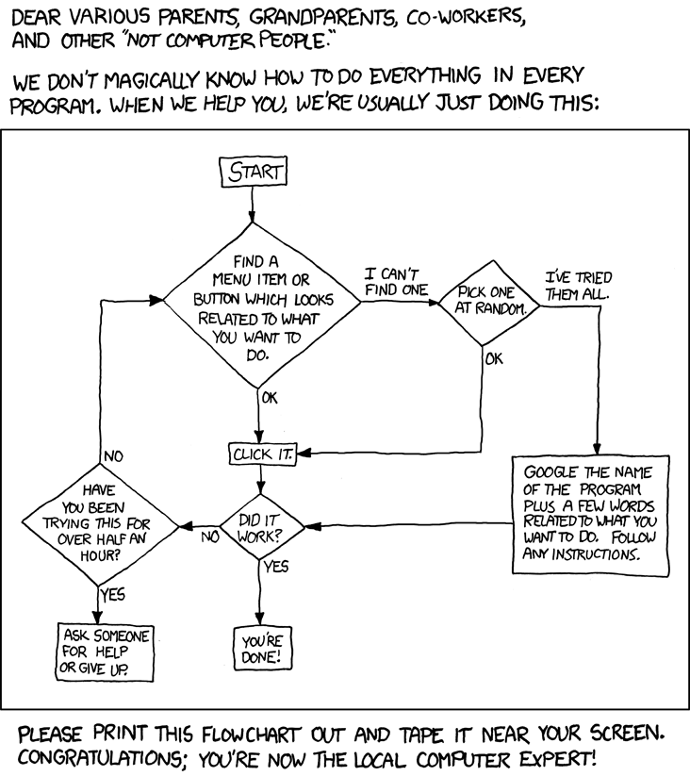
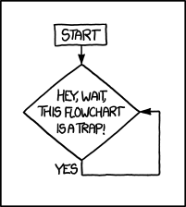
Flowcharts – xkcd.com
Notes:
https://xkcd.com/627/
https://xkcd.com/1195/

Slide 14
Pseudocode
Writing steps of an algorithm in plain English
http://www.unf.edu/~broggio/cop2221/2221pseu.htm
https://codehs.com/glossary/term/10
https://courses.cs.washington.edu/courses/cse190x/13au/Pseudocode_Reference.pdf

Slide 15
Simple Daily Examples of Computational Thinking
Looking up a name in an alphabetically sorted list
Linear: start at the top
Binary search: start in the middle
Standing in line at a bank, supermarket, customs & immigration
Performance analysis of task scheduling
Putting things in your child’s knapsack for the day
Pre-fetching and caching
Taking your kids to soccer, gymnastics, and swim practice
Traveling salesman (with more constraints)
Cooking a gourmet meal
Parallel processing: You don’t want the meat to get cold while you’re cooking the vegetables.
Cleaning out your garage
Keeping only what you need vs. throwing out stuff when you run out of space.
Storing away your child’s Lego pieces scattered on the LR floor
Using hashing (e.g., by shape, by color)
Doing laundry, getting food at a buffet
Pipelining the wash, dry, and iron stages; plates, salad, entrée, dessert stations
Even in grade school, we learn algorithms (long division, factoring, GCD, …) and abstract data types (sets, tables, …).
Jeanette Wing, 2008

