Slide 1
Computational Thinking
CPSC 1301
Columbus State University
Dr. Hyrum Carroll
(based on material from Hillary Fleenor)

Slide 2
Time

Slide 3
Introduction to programming
Computer science deals with solving problems using computing.
Researchers call this type of problem solving computational thinking

Slide 4
Computational Thinking
Computational thinking (CT) involves a set of problem-solving skills and techniques that software engineers use to write programs that underlie the computer applications you use such as search, email, and maps.
Computational thinking is applicable to nearly any subject. Students who learn computational thinking across the curriculum begin to see a relationship between different subjects as well as between school and life outside of the classroom.

Slide 5
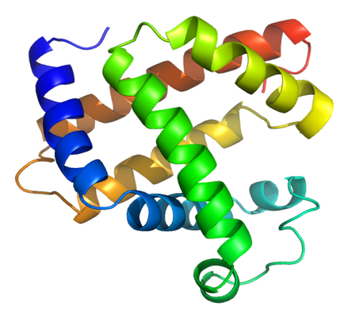
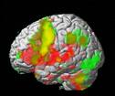
CT in Other Sciences, Math, and Engineering
Biology - Shotgun algorithm expedites sequencing of human genome - DNA sequences are strings in a language - Protein structures can be modeled as knots - Protein kinetics can be modeled as computational processes - Cells as a self-regulatory system are like electronic circuits
Credit: Wikipedia
Brain Science - Modeling the brain as a computer - Vision as a feedback loop - Analyzing fMRI data with machine learning
Jeanette Wing, 2008
Credit: LiveScience

Slide 6
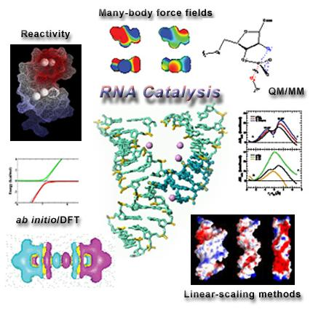
CT in Other Sciences, Math, and Engineering
Chemistry [Madden, Fellow of Royal Society of Edinburgh]
Atomistic calculations are used to explore chemical phenomena
Optimization and searching algorithms identify best chemicals for improving reaction conditions to improve yields
Credit: NASA
Credit: University of Minnesota
Geology - Modeling the earth from the inner core to the
surface
- Abstraction boundaries and hierarchies of complexity model the earth and our atmosphere
Jeanette Wing, 2008

Slide 7
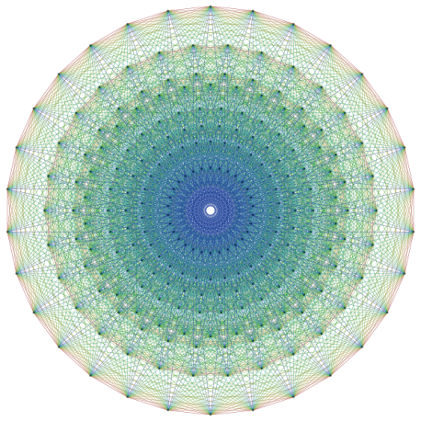
CT in Other Sciences, Math, and Engineering
Astronomy
- Sloan Digital Sky Server brings a telescope to every child - KD-trees help astronomers analyze very large multi-dimensional datasets
Credit: SDSS
Mathematics - Discovering E8 Lie Group: 18 mathematicians, 4 years and 77 hours of supercomputer time (200 billion numbers). Profound implications for physics (string theory) - Four-color theorem proof
Credit: Wikipedia
Engineering (electrical, civil, mechanical, aero & astro,…) - Calculating higher order terms implies more precision, which implies reducing weight, waste, costs in fabrication - Boeing 777 tested via computer simulation alone, not in a wind tunnel
Credit: Wikipedia
Jeanette Wing, 2008
Credit: Boeing

Slide 8
CT for Society
Economics - Automated mechanism design underlies electronic commerce, e.g., ad placement, on-line auctions, kidney exchange - Internet marketplace requires revisiting Nash equilibria model
Social Sciences - Social networks explain phenomena such as Facebook, YouTube - Statistical machine learning is used for recommendation and reputation services, e.g., Netflix, affinity card
Jeanette Wing, 2008

Slide 9
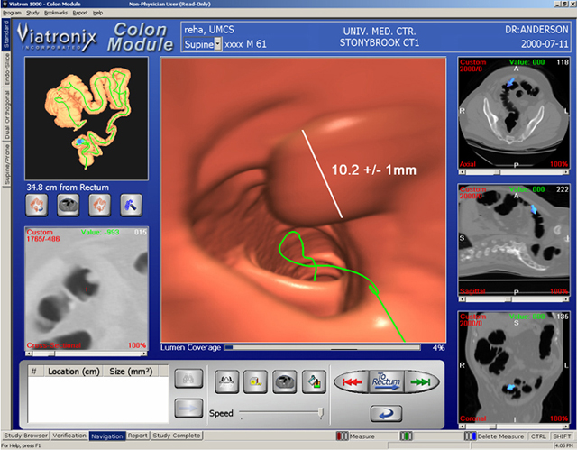
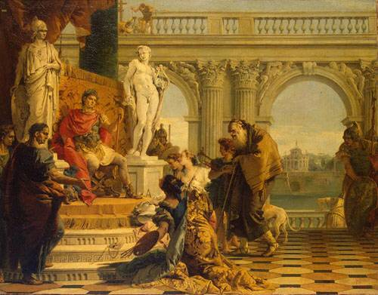
CT for Society
Medicine - Robotic surgery - Electronic health records require privacy technologies - Scientific visualization enables virtual colonoscopy
Credit: University of Utah
Humanities - What do you do with a million books? Nat’l Endowment for the Humanities Inst of Museum and Library Services
Law - Stanford CT approaches include AI, temporal logic, state machines, process algebras, petri nets - POIROT Project on fraud investigation is creating a detailed ontology of European law - Sherlock Project on crime scene investigation
Jeanette Wing, 2008

Slide 10
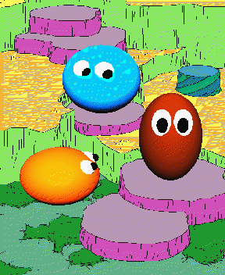
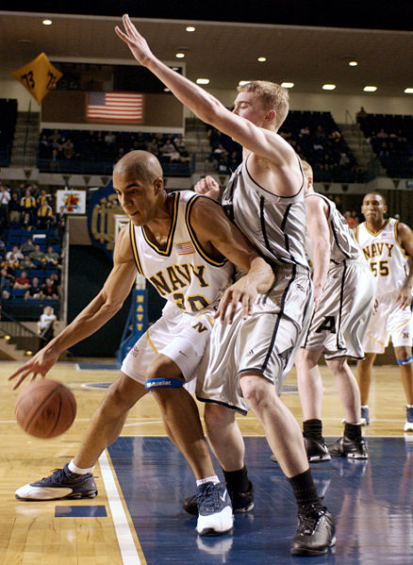
CT for Society
Entertainment
- Games
- Movies - Dreamworks uses HP data center to renderShrek and Madagascar - Lucas Films uses 2000-node data center to produce Pirates of the Caribbean.
Credit: Dreamworks SKG
Credit: Carnegie Mellon University
Arts
- Art (e.g., Robotticelli) - Drama - Music - Photography
Sports
- Lance Armstrong’s cycling computer tracks man and machine statistics
- Synergy Sports analyzes digital videos NBA games
Credit: Wikipedia
Jeanette Wing, 2008
Credit: Christian Moeller

Slide 11
CT for Society
Security -
- There were 82,000 new malware in 2013
The FBI’s Internet Crime Complaint Center had 262,813 complaints in 2013.
Government
- Leaders must understand the technology in order to
make sound policy decisions.
Credit: Christian Moeller
Notes:
Computational thinking is application to all industries & fields!
Goal of this class

Slide 12
Computational Thinking
Problem decomposition
Pattern recognition
Pattern generalization
Algorithm design

Slide 13
Decomposition
Breaking a problem down into steps (Divide and conquer!)

Slide 14
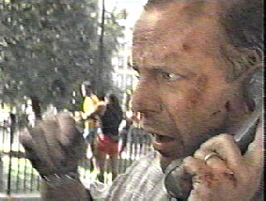
Decomposition
In the movie Die Hard 3, our heros, John McClain (Bruce Willis) and Zeus (Samuel L. Jackson), are at the bidding of the evil Peter Krieg (Jeremy Irons). First they are sent to the pay phone, then to the subway, and finally to the park

Slide 15
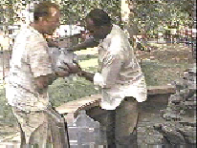
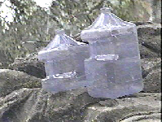
Decomposition
You need exactly 4 gallons of water to diffuse a bomb at the fountain in the park. But you only have a 3-gallon and a 5-gallon jug. How are you going to do it?
The operations allowed are:
Completely fill a jug from the source of water;
Pour the water existing in a jug to another jug;
Discard the water existing in a jug;
Notes:
5->3; discard; 5->3; 5->3 (4 is left)

Slide 16
Decomposition
Once upon a time a farmer went to market and purchased a fox, a goose, and a bag of corn. On his way home, the farmer came to the bank of a river and rented a boat. But in crossing the river by boat, the farmer could carry only himself and a single one of his purchases - the fox, the goose, or the bag of corn.
If left together, the fox would eat the goose, or the goose would eat the corn.
The farmer's challenge was to carry himself and his purchases to the far bank of the river, leaving each purchase intact. How did he do it?

Slide 17
Computational Thinking
Problem decomposition
Pattern recognition
Pattern generalization
Algorithm design

Slide 18
Pattern Recognition
Notice similarities or common differences that will help us make predictions or lead us to shortcuts. Pattern recognition is frequently the basis for solving problems and designing algorithms.

Slide 19
Pattern Recognition
What number should be placed in the empty triangle?

Slide 20
Pattern Recognition
Someone told me the following words were in alphabetical order. How did he prove it?
almost begins ghost biopsy empty first chintz

Slide 21
Pattern Recognition
Odd Man out:
Example: Food, Oxygen, TNT, Water
Adams, Jackson, Lincoln, Madison, Montgomery
Bro, Dad, Mom, Nun, Pop, Sis
Abraham, Charlie, Mike, Oscar, Victor, Whiskey
China, Grasshopper, Herring, Lobster, Robin
(By the way, none of our answers are based on the number of letters or syllables in the words.)

Slide 22
Pattern Recognition
If in a certain code language BOSTON can be written as SNSNSN, then how would you write CALIFORNIA in the same code language?
OAOAOA
LONLON
LOILOILOI
LONLONLON

Slide 23
Pattern Recognition
If NEW YORK can be encrypted as PGYAQTM, how can you code the word CHARLOTTE?
EICSNPVVG
EJCTNQVVG
EICTNPVVF
EJCSMPVVG

Slide 24
Pattern Recognition
More puzzles to try on your own:
http://williamarmstrong.com/brain/puzzle.html
https://tutor.fi.muni.cz/index.php?&changelang=en

Slide 25
Illusions of competence
It is not enough to see the answer and understand how it is reached. You must practice solving problems yourself.

Slide 26
Computational Thinking
Problem decomposition
Pattern recognition
Pattern generalization
Algorithm design

Slide 27
Simple Daily Examples of Computational Thinking
Looking up a name in an alphabetically sorted list
Linear: start at the top
Binary search: start in the middle
Standing in line at a bank, supermarket, customs & immigration
Performance analysis of task scheduling
Putting things in your child’s knapsack for the day
Pre-fetching and caching
Taking your kids to soccer, gymnastics, and swim practice
Traveling salesman (with more constraints)
Cooking a gourmet meal
Parallel processing: You don’t want the meat to get cold while you’re cooking the vegetables.
Cleaning out your garage
Keeping only what you need vs. throwing out stuff when you run out of space.
Storing away your child’s Lego pieces scattered on the LR floor
Using hashing (e.g., by shape, by color)
Doing laundry, getting food at a buffet
Pipelining the wash, dry, and iron stages; plates, salad, entrée, dessert stations
Even in grade school, we learn algorithms (long division, factoring, GCD, …) and abstract data types (sets, tables, …).
Jeanette Wing, 2008

Slide 28
Generalization and Abstraction
The ability to filter out information that is not necessary to solve a certain type of problem and generalize the information that is necessary.

Slide 29
Abstractions
Abstractions are our “mental” tools
The abstraction process includes
Choosing the right abstractions
Operating simultaneously at multiple layers of abstraction
Defining the relationships the between layers
Jeanette Wing, 2008

Slide 30
Generalization and Abstraction
Who is a “general” student?

Slide 31
Generalization and Abstraction
How is a map an abstraction?

Slide 32
Computational Thinking
Problem decomposition
Pattern recognition
Pattern generalization
Algorithm design

Slide 33
Algorithmic Thinking
The ability to develop a step-by-step strategy for solving a problem.
More specifically, thinking algorithmically is about representing the problem solution as an ordered sequence of exact steps that you can use to direct a computer to solve the problem
Algorithm design often involves decomposing a problem, identifying patterns, and creating abstractions to represent data.

Slide 34
Move a Robot
Turn right 90 degrees
Move forward 1 unit
Pick up object

Slide 35
Conclusion
Mistakes are an important part of learning
If you’re not uncomfortable, you’re not learning
Programming is a SKILL! You have to actually practice problem solving and coding, not just read about it or watch videos (or copy other code). Learning a skill takes time, you CANNOT CRAM!!!!!
Don’t fall behind!!!!! It’s very hard to catch up.

