Slide 1
HTML

Slide 2
Goals
How to use the Komodo editor
HTML coding and testing
List and Images
Tables and Links
At least 2 pages and navigation
http://www.w3schools.com

Slide 3
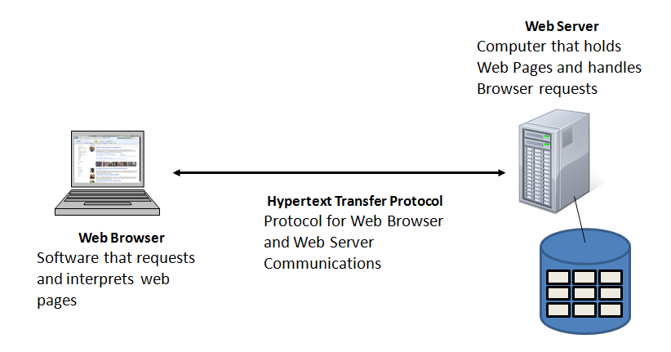
Browser and Web Server

Slide 4
Basic Syntax of HTML
<> denotes tags
For example:
<strong> indicates the following text will be bold
Most tags require and opening and closing tags to stop
</strong> indicates the closing tag
Example:
<strong> Bold me! </strong> but not me!
The result of the above will be:
Bold me! but not me!

Slide 5
Important note on style tags
HTML used to have style tags: <b></b>, <i></i>, etc…
*These tags have been deprecated*
-meaning: WE DON’T USE THEM ANYMORE
HTML was never meant to be about styles, that’s why we have CSS.
Instead lets use phrase tags:
<strong></strong>; <em></em>; etc.
These tags describe the text that surrounds it
We can use CSS to style these elements even further.

Slide 6
Example of phrase tags
<p> This is an <strong>example</strong> </p>
This is an example
Phrase tags are better suited to be used with HTML

Slide 7
HTML Tag Rules
Whitespace are ignored
Attribute values are enclosed in single or double quotes
Beware: HTML does no checking for syntax errors – it interprets what it can and ignores the rest. You will need to be the error checker for yourself

Slide 8
Start and End of HTML
<html> </html> Start and end of HTML
<head> </head> Start and end of head section
<body> </body> Start and end of body

Slide 9
Basic Structure of HTML Page
<!DOCTYPE html>
<html>
<head>
<title> The Title </title>
</head>
<body>
<strong>Test Page</strong> with text
<body>
</html>

Slide 10
Syntax
Headers
<h1> Header 1 </h1> - largest
<h2> Header 2 </h2>
<h3> Header 3 </h3>
<h4> Header 3 </h4>
<h5> Header 3 </h5>
<h6> Header 3 </h6> - smallest
Paragraphs
<p> Paragraph </p>

Slide 11
More Syntax
Next Line
<br/>
Changing text
<strong> </strong>
<em> </em>
<u> underline </u> (use CSS to do this now: style=“text-decoration: underline”)
Comment
<!-- Comment, does not show up on a browser -->

Slide 12
Linking Web Pages
<a href=“url_here”> Link Text </a>
The URL can be:
a page you created or
an external link (MUST HAVE HTTP)
<a href=“aboutMe.html”> About Me </a>
<a href =“http://www.mtsu.edu”> MTSU </a>
MTSU

Slide 13
Useful Attributes for Links
target=“_blank” – opens the link in a new window
title=“example of a link here” – the alt text of the link
Can anchor pages:
Add id=“linkName” inside of any tag
Then add, <a href="#linkName">here</a> to go to the anchor.

Slide 14
More Syntax!
&nbsp; one space
<marquee> Text scrolling </marquee>
**Again, this is HTML 4 and should really be done with CSS**

Slide 15
Styling

Slide 16
Styling
Three ways to style HTML
Inline*
<p style=“color:blue”>This is a blue paragraph.</p>
Internal Style sheet
All styling is done in the <head></head> tags of the HTML code
External Style sheet*
Styling is put in a separate file(s)
*What we’re using in this class

Slide 17
Inline styling
Appropriate when you want a unique style to be applied to one single occurrence of an element.
Use the style attribute in the relevant tag. It can contain any CSS property.
Example:
<p style=“color:blue; margin-left:20px”>This is a paragraph.</p>

Slide 18
What if I want to just style one word in a Sentence?
Since the style attribute allows us to style an element. What’s the best way to style just one word in an element?
<span></span> tags can go around one or more words!
Example
<p> My favorite font is <span style=“font-family: Futura”>Futura</span>!</p>

Slide 19
Lists

Slide 20
Lists
Two types of lists
Ordered:
First entry
Second entry
Third entry
Unordered
Entry
Entry
Entry

Slide 21
Ordered Lists
<ol>
<li> First Entry </li>
<li> Second Entry </li>
<li> Third Entry </li>
</ol>

Slide 22
Order List Attributes
Compact – less space between lines and indentation
<ol compact="compact">
Start – specifies the start number
<ol start="50">
Type – specifies the type of order (1, A, a, I, i)
<ol type="I">

Slide 23
Unordered Lists
<ul>
<li> Entry </li>
<li> Entry </li>
<li> Entry </li>
</ul>

Slide 24
Unordered Lists Attributes
Compact
<ul compact="compact">
Type (disc, square, circle)
<ul type="square">

Slide 25
Lists Within Lists
<ol>
<li> First Entry </li>
<ul>
<li> Sub Entry </li>
<li> Sub Entry </li>
</ul>
<li> Second Entry </li>
<ul>
<li> Sub Entry </li>
</ul>
<li> Third Entry </li>
</ol>
First Entry
Sub Entry
Sub Entry
Second Entry
Sub Entry
Third Entry

Slide 26
Images

Slide 27
Inserting Images
Two ways to insert:
Use an Internet link
Copy the image to your account, then link it
<img src=“www.some_site.com/image.jpg” />
<img src=“image.jpg” />

Slide 28
What is the Difference?
Link: You just include the URL
Taking up the resources of whatever site you got the link from
Copying: have to download the image
Include the location and image name.

Slide 29
Attributes of Inserting Images
Alt – the alternative text of the picture this shows up when you scroll over an image
Width – specifies the width of the image
Height – specifies the height of the image
Align – specifies the alignment (top, bottom, middle, left, right) (Going to use CSS for this)
<img src=“image.jpg" alt=“My Picture" width="304" height="228" />

Slide 30
Making an Image Your Background
For color:
<body style=“background-color:“color">
For background image:
<body background="bgimage.jpg">

Slide 31
Making a Picture a Link
<a href=“url”> <img src=“image.jpg” /> </a>

Slide 32
Tables

Slide 33
Tables
<table> </table> : Start and end of the table
<th> </th> : Start and end of a header cell
<tr> </tr> : Start and end of a row
<td> </td> : Start and end of a table data cell

Slide 34
Tables
<table border=1>
<tr>
<th> Header 1 </th>
<th> Header 2 </th>
</tr>
<tr>
<td> Data 1 </td>
<td> Data 2 </td>
</tr>
</table>
Header 1 | Header 2
Data 1 | Data 2

Slide 35
Attributes of Tables
table: align, bgcolor, border, cell padding, cell spacing, frame, rules, summary, width
tr: align, bgcolor, charoff, valign
th & td: abbr, align, axis, bgcolor, char, charoff, colspan, height, nowrap, rowspan, scope, valign, width

Slide 36
Changing your Webpage Layout
Div: http://www.w3schools.com/html/html_layout.asp

