Slide 1
Cascading Style Sheets (CSS)
CSCI 1150
Computer Orientation

Slide 2
Intro to CSS
Cascading Style Sheets – styles and enhances appearance of webpage
.css extension

Slide 3
What can CSS do?
Change the default attributes associated with a tag or set of tags.
Example: set the font color for all content tagged with the <h1> tag
You can set certain attributes that you can’t do in HTML
Example: collapsing the borders of tables
Set up multiple columns of content on a page
You can accomplish this in HTML but not as elegantly, using columns of a table

Slide 4
What can you do with CSS?
Define page sections, such as headers, footers, sidebars, etc., for consistent formatting
Setting the foreground and background page elements
Add different colors to visited/unvisited links
Text decoration on links
Floating and alignment
http://www.w3schools.com/css/tryit.asp?filename=trycss_float

Slide 5
CSS Basics
Can be used within an HTML page as a sheet, in an HTML page as lines, or in a separate sheet
Separate is better. Move the formatting away from content
Eliminates redundant files
Better background images

Slide 6
Basic CSS Syntax
Selector: tag you want to modify
Property: attribute you want to modify
Value: the value you want to give it

Slide 7
Ways of Inserting CSS
Inline: <p style="color:sienna;margin-left:20px">This is a paragraph.</p>
Internal Style Sheet: <head> <style type="text/css"> hr {color:sienna;} p {margin-left:20px;} body {background-image:url("images/back40.gif");} </style> </head> http://w3schools.com/css/tryit.asp?filename=trycss_background-color_elements

Slide 8
Basic CSS Syntax
External Style Sheet (better): h1{ color:blue; font-size:12px; }

Slide 9
CSS ID
An ID is used for a single element.
Specified by #
http://w3schools.com/css/tryit.asp?filename=trycss_syntax_id

Slide 10
CSS Backgrounds
http://w3schools.com/css/css_background.asp
Background-color
Background-image
Background-repeat
Background-attachment
Background-position

Slide 11
Styling Various Things in HTML
Text: http://www.w3schools.com/css/css_text.asp
Font: http://www.w3schools.com/css/css_font.asp
Lists: http://www.w3schools.com/css/css_list.asp
Tables: http://www.w3schools.com/css/css_table.asp

Slide 12
Styling Links
a:link - a normal, unvisited link
a:visited - a link the user has visited
a:hover - a link when the user mouses over it
a:active - a link the moment it is clicked
http://www.w3schools.com/css/css_link.asp

Slide 13
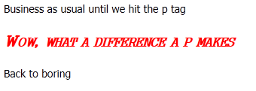
Font Property Example
<html>
<head>
<title> your name </title>
</head>
<style type=text/css>
P {
font-family: gungsuh;
font-style: italic;
font-variant: small-caps;
font-weight: bold;
font-size: 150%;
color: red;
}
</style>
<body>
Business as usual until we hit the p-tag
<p>Wow, what a difference a p-tag makes </p>
Back to boring
</body>
</html>

Slide 14
Background Image in CSS
body {background-image:url('paper.gif');}
Also can change the:
Attachment
Color: http://www.w3schools.com/cssref/playit.asp?filename=playcss_background-color
Image
Position: http://www.w3schools.com/cssref/playit.asp?filename=playcss_background-position
Repeat : http://www.w3schools.com/cssref/playit.asp?filename=playcss_background-repeat&preval=repeat-x

Slide 15
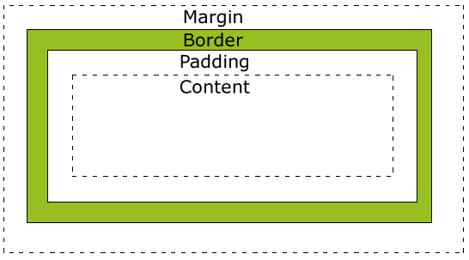
The CSS Box Model
Margin - Clears an area around the border. The margin does not have a background color, it is completely transparent
Border - A border that goes around the padding and content. The border is affected by the background color of the box
Padding - Clears an area around the content. The padding is affected by the background color of the box
Content - The content of the box, where text and images appear

Slide 16
Margins
Auto – the browser calculates a margin
Length – px, pt, cm
% - Percentage
margin-top:100px; margin-bottom:100px; margin-right:50px; margin-left:50px;

Slide 17
Border
Border-style: dotted, dashed, solid, double, groove, ridge, inset, outset
Border-width: # px
Border-color
border-top-style: dotted; border-right-style: solid; border-bottom-style: dotted; border-left-style: solid;

Slide 18
Padding
Length – px, pt, cm, etc.
% - percentage
padding-top:25px; padding-bottom:25px; padding-right:50px; padding-left:50px;

Slide 19
The CSS Box Model
http://w3schools.com/css/css_boxmodel.asp

Slide 20
Div Element Example
Use in Body
<div id=offset500>
<h2>The influences to the Blues included
</h2>
<ul>
<li>Spirituals</li>
<li>Work Songs</li>
<li>Field Hollers</li>
<li>Shouts</li>
<li>Chants</li>
<li>Rhymed Simple Narrative Ballads</li>
</ul>
Definition
<style>
#offset500 {
position: relative;
left: 500;
}
</style>
Results

Slide 21
Ways of Inserting CSS
External Style Sheet: In the HTML file: <head> <link rel="stylesheet" type="text/css" href="mystyle.css" /> </head> The style sheet will be saved with a .css extension and include: hr {color:sienna;} p {margin-left:20px;} body {background-image:url("images/back40.gif");}
http://w3schools.com/css/css_howto.asp

Slide 22
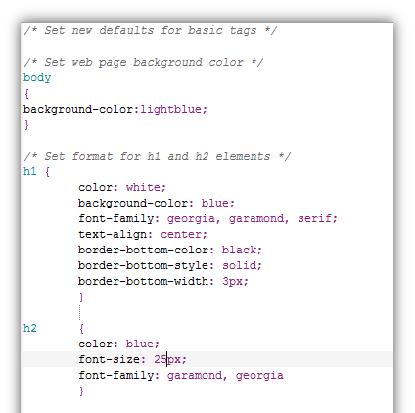
Basic CSS Syntax

Slide 23
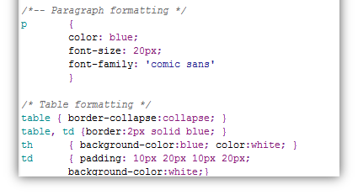
Basic CSS Syntax

Slide 24
Examples
http://www.w3schools.com/css/css_examples.asp

