Slide 1
Cipher Machines:
From Antiquity to the Enigma Machine
Dr. Wayne Summers
TSYS School of Computer Science
Columbus State University
wsummers@ColumbusState.edu
http://csc.ColumbusState.edu/summers

Slide 2


The Scientific Imagination:
Art and Science from Antiquity to Quantum Physics
with
Dr. WILLEM D. HACKMANN
Merton College
Oxford University, England

Slide 3
Introduction to Cryptography and Encryption
cryptography Greek words kryptos meaning hidden and grafi meaning writing and is the study of hiding written information through encoding or enciphering
code is the replacing of a word or phrase with a word, number or symbol
cipher involves making letter-for-letter substitutions.
Information can be hidden by either substituting other letters, words or symbols for the letters or words in the message or transposing the letters or words in the message.
Cryptology is the overall study of codes and ciphers
cryptoanalysis is the science of the decryption of codes and ciphers

Slide 4
Early Encryption
began in Egypt around 1900 BCE. The scribe for the Pharaoh Amenemhet II “used hieroglyphic substitutions to impart dignity and authority” to the inscriptions in the pyramids
500-1500 BCE, Assyrian and other cultures began hiding information
  tattooing the message on the heads of the messengers,
  “carving” the message in the stomach of animals,
  hiding the message under new wax
600 BCE, Hebrew scribes used a simple substitution cipher known as ATBASH using a reverse alphabet. (used in book of Jeremiah)

Slide 5
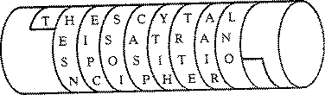
SCYTALE
The first appearance of a cipher device is the scytale used by the Greeks around 475 BCE
the message
“the scytale is a transposition cipher”
becomes
THESN EIPCS SOICA SPYTI HTRTE AAIRL NO

Slide 6
Caesar cipher
a | b | c | d | e | f | g | h | i | j | k | l | m | n | o | p | q | r | s | t | u | v | w | x | y | Z
D | E | F | G | H | I | J | K | L | M | N | O | P | Q | R | S | T | U | V | W | X | Y | Z | A | B | C
The message
“the caesar cipher is a substitution cipher”
becomes
WKHFD HVDUF LSKHU LVDVX EVWLW XWLRQ FLSKH U

Slide 7
Early Encryption
Arab Cryptanalysis developed around the 8th century A.D. by Abu 'Abd al-Rahman al-Khalil ibn Ahmad ibn 'Amr ibn Tammam al Farahidi al-Zadi al Yahmadi who solved a cryptogram in Greek for the Byzantine emperor; first to discover and write down the methods of cryptanalysis.
Another Arab of the 9th century, Abu Yusuf Ya'qub ibn Is-haq ibn as-Sabbah ibn 'omran ibn Ismail al-Kindi wrote "A Manuscript on Deciphering Cryptographic Messages“
1412, Arabic knowledge of cryptology fully described in the Subh al-a 'sha, 14-volume encyclopedia, written by Shihab al-Din abu 'l-Abbas Ahmad ben Ali ben Ahmad Abd Allah al-Qalqashandi
During the Middle Ages in Europe, encryption was primarily restricted to the monks. " Around 1250 A.D., Roger Bacon, wrote the "Epistle on the Secret Works of Art and the Nullity of Magic” describing seven deliberately vague methods of concealing a secret
Around 1392 A.D., Geoffrey Chaucer wrote six short passages in cipher in his "The Equatorie of the Planetis" notes to his "Treatise on the Astrolabe”

Slide 8
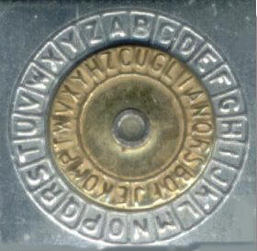
Early Cipher Machines
Leon Battista Alberti (1404-1472) developed a cipher machine for mechanical encryption
based on the Caesar cipher algorithm
Alberti developed and published the first polyalphabetic cipher and designed a cipher disk to simplify the process
"Father of Western Cryptography"

Slide 9
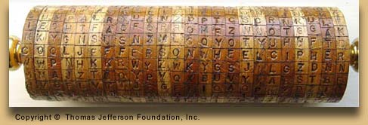
Jefferson Cylinder – built late 1790s

Slide 10
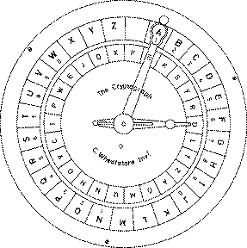
Wheatstone Cryptograph, originally invented by Wadsworth in 1817

Slide 11
Popular Cryptography
Jules Verne's - decipherment of a parchment filled with runic characters in the Journey to the Center of the Earth.
Sir Arthur Conan Doyle's detective, Sherlock Holmes, was an expert in cryptography. The Adventure of the Dancing Men, involves a cipher consisting of stick men, each representing a distinct letter.
Edgar Allan Poe issued a challenge to the readers of Philadelphia's Alexander Weekly Messenger, claiming that he could decipher any mono-alphabetic substitution cipher. He successfully deciphered all of the hundreds of submissions. In 1843, he wrote a short story, "The Gold Bug”

Slide 12
Mexican Army Cipher Disk (1913)
a | b | c | d | e | f | g | h | i | j | k | l | m | n | o | p | q | r | s | t | u | v | w | x | y | z
15 | 16 | 17 | 18 | 19 | 20 | 21 | 22 | 23 | 24 | 25 | 26 | 01 | 02 | 03 | 04 | 05 | 06 | 07 | 08 | 09 | 10 | 11 | 12 | 13 | 14
49 | 50 | 51 | 52 | 27 | 28 | 29 | 30 | 31 | 32 | 33 | 34 | 35 | 36 | 37 | 38 | 39 | 40 | 41 | 42 | 43 | 44 | 45 | 46 | 47 | 48
62 | 63 | 64 | 65 | 66 | 67 | 68 | 69 | 70 | 71 | 72 | 73 | 74 | 75 | 76 | 77 | 78 | 53 | 54 | 55 | 56 | 57 | 58 | 59 | 60 | 61
86 | 87 | 88 | 89 | 90 | 91 | 92 | 93 | 94 | 95 | 96 | 97 | 98 | 99 |  |  |  |  |  | 79 | 80 | 81 | 82 | 83 | 84 | 85
Use MERT as key m=1, e=27, r=53,t=79
The word “College” is ciphered as
  1703262619 2119 or
  6476269719 6890 etc.

Slide 13
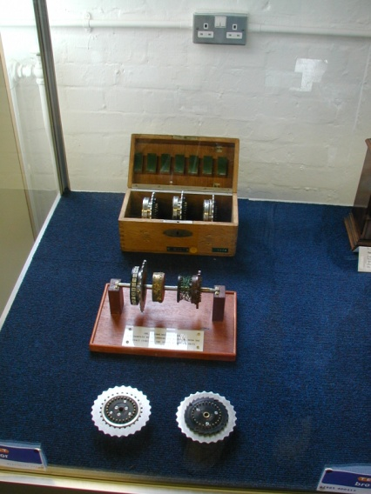
Rotor Cipher Machines
first rotor machine was built in 1915 by two Dutch naval officers, Theo A. van Hengel and R. P.C. Spengler (de Leeuw)
number of inventors independently developed similar rotor machines
Most of the rotor machines used a typewriter-like keyboard for input and lighted letters for the output. Some of the later devices used punched card and paper tape for input and/or output

Slide 14
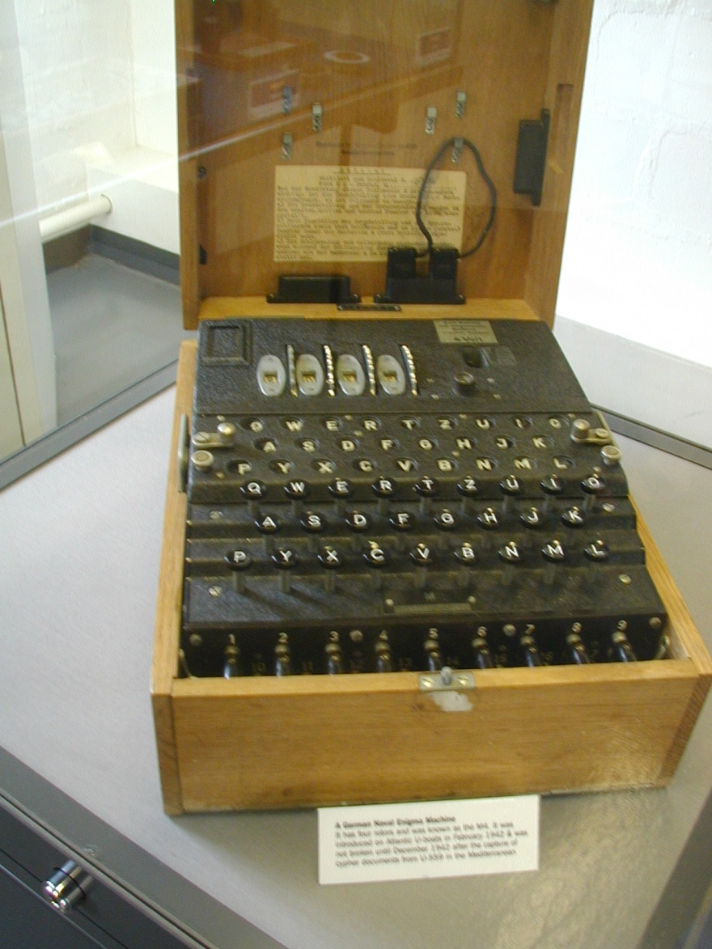
Enigma machine

Slide 15
Enigma machine
designed by Arthur Scherbius (~1918)
three interchangeable rotors geared together
  26 x 26 x 26 (17,576) combinations of letters
Steckerverbindungen (plug-board) was introduced in 1928.
  Initially Stecker allowed 6 pairs of letters to be swapped. later expanded to 10 pairs.
  increased the number of possible settings (keys) to 159,000,000,000,000,000,000 (159 million million million)
  if 1,000 cryptographers, each with a captured Enigma, tested 4 keys/minute, all day, every day, it would take 1.8 billion years to try them all.

Slide 16
Enigma machine
Enigma operators were provided a codebook each month that specified the key for each day during the month.
  Use rotors 2-4-3
  Set the rotors to V-F-P
  Use plugboard settings B/T – D/G – I/R - P/Y – S/V – W/Z
each message was assigned a random key.
  message key was transmitted twice prior to the message being transmitted.
  E.g. if the day key is V-F-P, the operator might pick a message key of WAS. Using the day key to encrypt the message key, the operator would then transmit WAS WAS followed by the message.

Slide 17
Cracking the Enigma machine
Polish mathematicians, Marian Rejewski, Henryk Zigalski, and Jerzy Rozycki, reduced the problem of cracking the enigma code significantly, concentrating on the rotor settings exploiting the fact that the message key was transmitted twice.
provided the design of the Enigma machine from a disgruntled German civil servant, Hans-Thilo Schmidt.
Rejewski and his team developed a machine called a bombe that simulated the working of six Enigma machines working in unison to try and determine the daily key.

Slide 18
Cracking the Enigma machine
British Government Code and Cipher School (GC&CS) opened secret site at Bletchley Park
team of codebreakers was led by Alan Turing and Gordon Welchman
Turing and Welchman’s bombe consisted of twelve sets of electrically linked Enigma scramblers
crib - piece of plaintext associated with a piece of ciphertext (ex. Wetter)
Over 400 bombes built for use at Bletchley Park

Slide 19
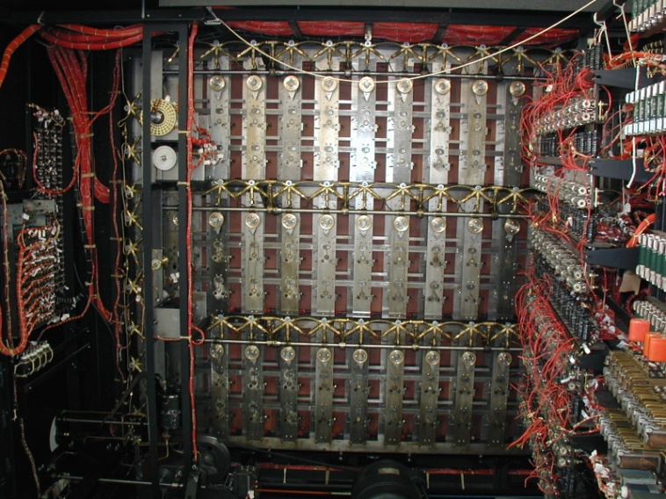
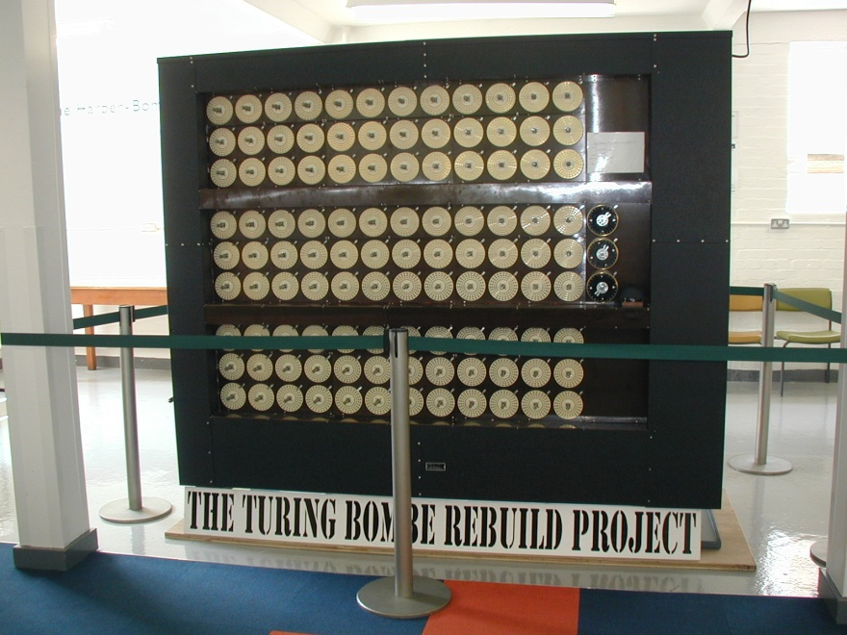
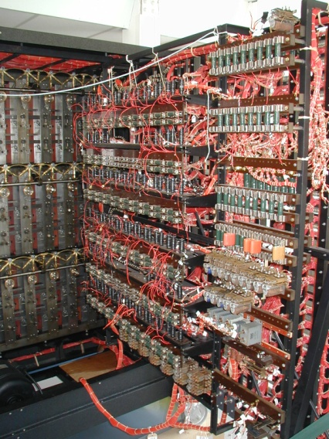
Bombe

Slide 20
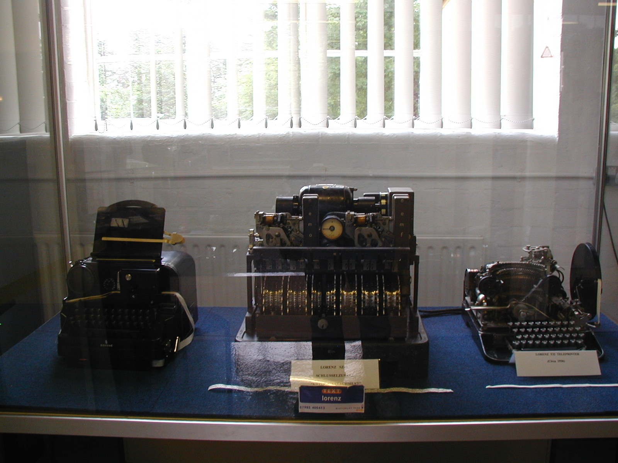
Lorenz

Slide 21
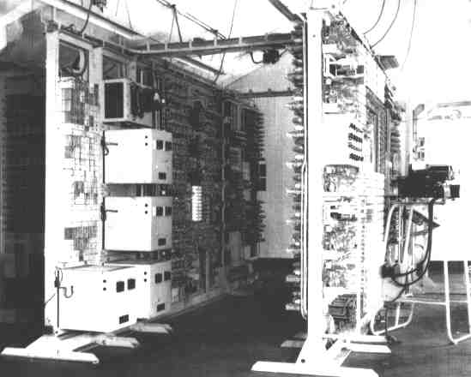
Colossus http://www.codesandciphers.org.uk/lorenz/colossus.htm

Slide 22
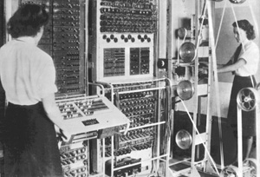
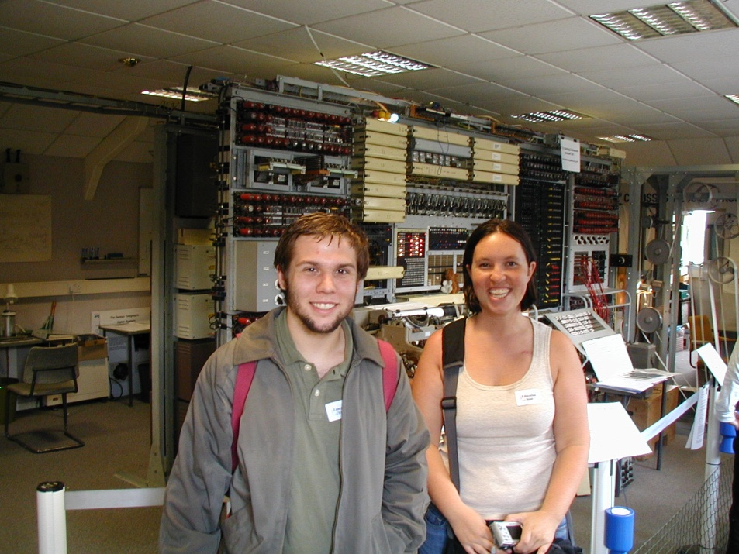
Colussus (Then and Now)
1940s
2007

Slide 23
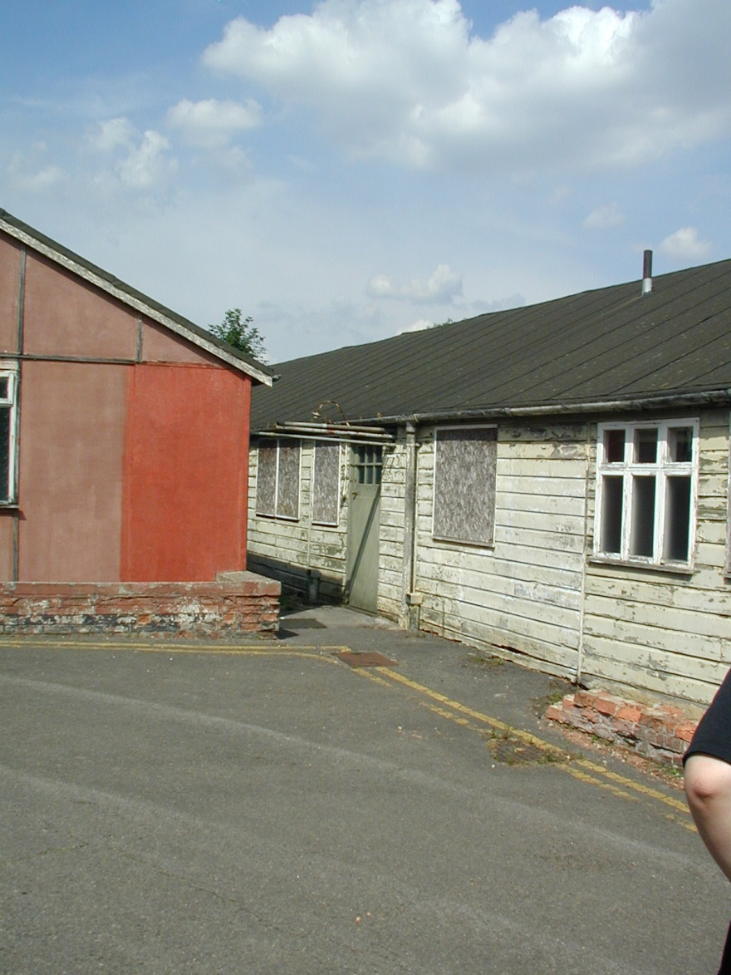
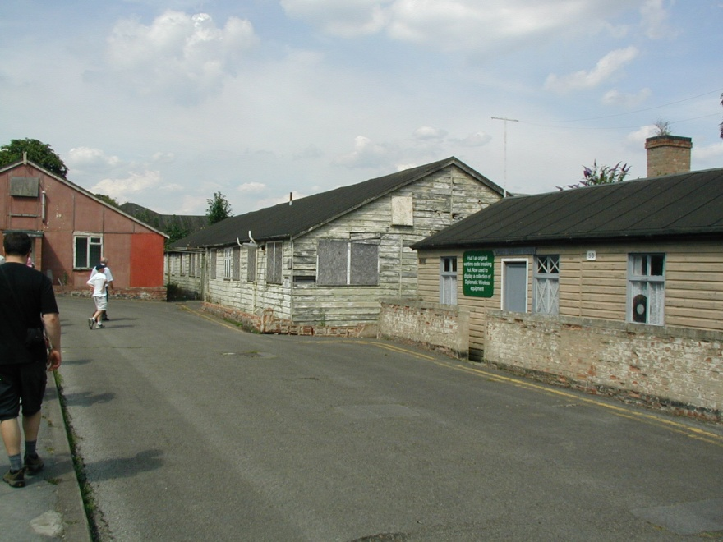
Bletchley Park

Slide 24
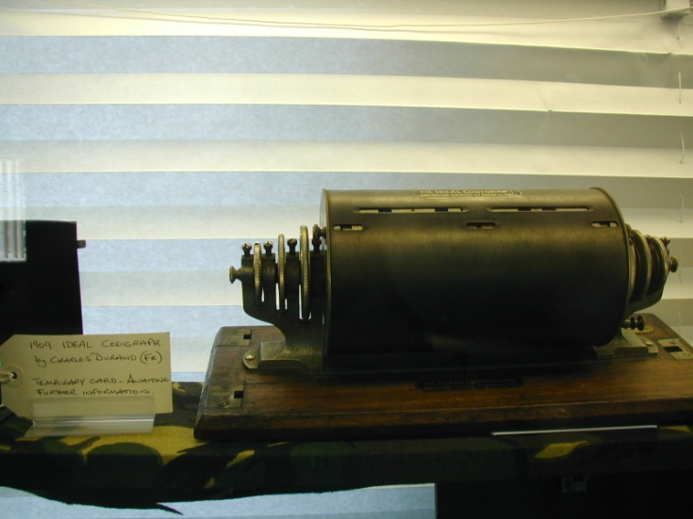
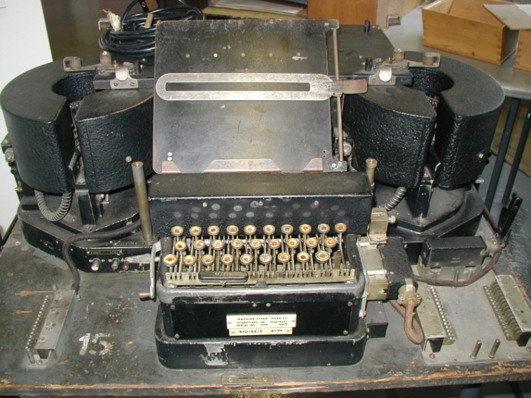
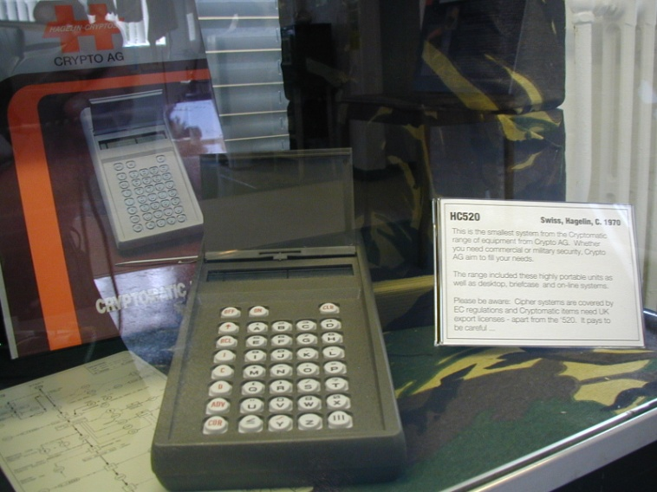
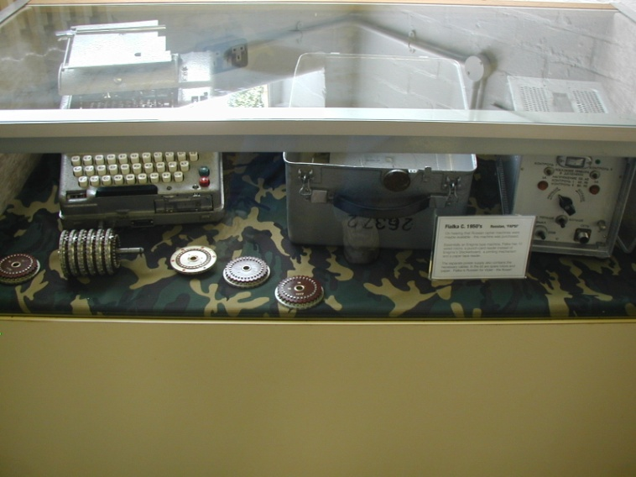
Other Rotor Machines

Slide 25
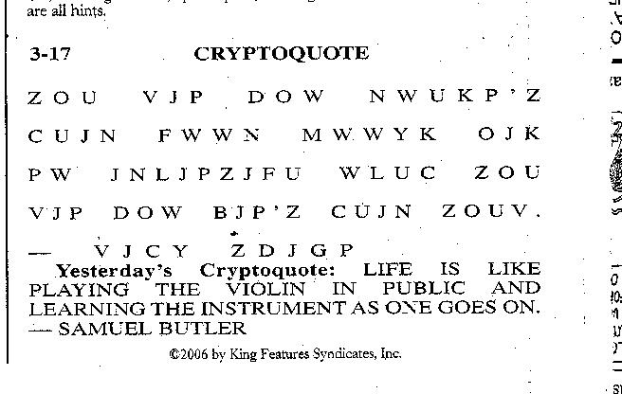
CRYPTOQUOTES

Slide 26
CRYPTOQUOTES
THE MAN WHO DOESN’T READ GOOD BOOKS HAS NO ADVANTAGE OVER THE MAN WHO CAN’T READ THEM. -– MARK TWAIN

Slide 27
Resources
Codes and Ciphers in History, Part 1 - To 1852, (last viewed 14 July 2005), http://www.smithsrisca.demon.co.uk/crypto-ancient.html
Copeland, B. Jack (ed), The Essential Turing, (Oxford: Oxford University Press, 2004).
English Heritage – Bletchley Park, (last viewed 14 July 2005), http://www.english-heritage.org.uk/bletchleypark
History of Encryption, (last viewed 14 July 2005), http://www.deathstar.ch/security/encryption/history/history.htm
Kahn, David, The Codebreakers: The Story of Secret Writing (New York: Macmillan, 1967).
Kallis, Jr., Stephen A., (last viewed 14 July 2005), Codes and Ciphers, http://www.otr.com/ciphers.html
Singh, Simon(1999), The Code Book. Doubleday.

Slide 28
Questions?
Dr. Wayne Summers
TSYS School of Computer Science
Columbus State University
Columbus, GA
wsummers@ColumbusState.edu

