Slide 1
How can we build enrollment?
Wayne Summers
TSYS School of Computer Science
Columbus State University
Columbus, GA
June 7, 2011

Slide 2
Need
“Innovations in computing and more broadly, information technology (IT), drive our economy, underlie many new advances in science and engineering, and contribute to our national security. Projected job growth in IT is very strong.”
NSF Computing Education for the 21st Century (CE21) call for proposals, http://www.nsf.gov/pubs/2010/nsf10619/nsf10619.htm

Slide 3
The 10 fastest-growing jobs between now and 2018 http://careerplanning.about.com/
1. Biomedical Engineers | 6. Environmental Engineers
2. Network Systems and Data Communications Analysts | 7. Computer Systems Software Engineers
3. Financial Examiners | 8. Survey Researchers
4. Athletic Trainers | 9. Personal Financial Advisors
5. Computer Applications Software Engineers | 10. Market Research Analysts

Slide 4
Occupation Total Job Openings 2008–2018
Elementary school teachers 597,000
Accountants and auditors 498,000
Secondary school teachers 412,000
Middle school teachers 251,000
Computer systems analysts 223,000
Computer software engineers, applications 218,000
Network systems and data communications analysts 208,000
Computer software engineers, systems software 153,000

Slide 5
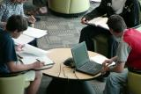
Top 10 best jobs http://money.cnn.com/magazines/moneymag/bestjobs/
MONEY Magazine and Salary.com researched hundreds of jobs, considering their growth, pay, stress-levels and other factors. These careers ranked highest.
1. Software Engineer
2. College professor
7. Computer IT analyst

Slide 6
Problem
“Despite these very positive indicators, student interest in computing has declined dramatically over the last decade.
For example, the percentage of college freshmen indicating an intent to major in computing has declined overall by 70% in the last decade; for women, the decline was 80% (HERI, 2000-2009).
Recent data show that student interest in computing majors has fallen behind projected job openings by a factor of five and a half (ACT, 2010).”
ACT: American College Testing Program (2010), The Condition of College and Career Readiness.
Higher Education Research Institute (HERI), College Freshmen Survey, 2000-2009.

Slide 8
% Decline in freshman interest
—Source: NCWIT, Data: HERI 2010

Slide 9
The missing 70%
—Source: CSTA, Data: College Board

Slide 10
Challenge
The number of Computer Science majors dropped 40-50% nationwide between 2001-2008
The percentage of women has dropped to about 10%
From a high of about 40% in the early 80s
Projections of 46% job growth over the next 10 years!

Slide 11
Challenge
By 2018, there will be 1.4 million computer specialist job openings.
US universities will have generated enough graduates to fill about 1/3 of these openings.
—By the Numbers, NCWIT 2009

Slide 12
Jobs vs. Education in Georgia
Total AP Computer Science test-takers | 692
Total AP Calculus test-takers | 9420
Total AP Physics test-takers | 4141
Number of intended Computer Science majors | 254
Number of intended Engineering majors | 739
Number of intended Physics majors | 794
Number of intended Mathematics majors | 55
Number of intended Biology majors | 849
Total number of Associate's degrees in CIS | 818
Total number of Bachelor's degrees in CIS | 1168
Total number of Master's degrees in CIS | 467
Total number of Doctoral degrees in CIS | 58
WORKFORCE
District: | Overall State
Annual number of openings, computing occupations | 4660
Annual number of openings, engineering occupations | 1060
Percent/rate of growth, computing occupations (%) | 24.8
Percent/rate of growth, engineering occupations (%) | 13.1
Total projected increase in jobs, computing occupations | 24050
Total projected increase in jobs, engineering occupations | 3770

Slide 13
Malaysia
“The battle for skilled IT talents in Malaysia continues unabated especially in the IT Outsourcing arena and IT shared services sectors. This shortage of skilled workforce is attributed to the exodus of talented Malaysians and compounded by the fact that technical and vocational schools are producing declining number of graduates and quality of graduates is inadequate….”
Employment Outlook & Salary Guide for Malaysia
(http://www.kellyservices.com.my/web/my/services/en/pages/salaryguide.html)

Slide 14
Malaysia
“Career opportunities have evolved to include niche areas such as the interactive entertainment industry where graduates with strong skills in computer programming, animation, computer graphics and software development have a potential of earning a salary of RM2,000 – RM4,000 per month, depending on their experience. There will also be an increasing demand for ICT professionals with skills in networking, security and creative multimedia within the next three (3) years. Other staffing trends include rich Internet applications (an aftermath of Web 2.0) and mobile development arising from smartphones impact into the markets….”
Employment Outlook & Salary Guide for Malaysia
(http://www.kellyservices.com.my/web/my/services/en/pages/salaryguide.html)

Slide 15
Malaysia
“A recent assessment by the World Bank suggests that organizations have become increasingly concerned about information technology (IT) skills, technical and professional skills of Malaysian workers as well as complaints about the mismatch of skills sets in graduates and inadequate proficiency in the English language. ”
Employment Outlook & Salary Guide for Malaysia
(http://www.kellyservices.com.my/web/my/services/en/pages/salaryguide.html)

Slide 16
Malaysia
“Job opportunities for fresh graduates with internship exposures or those with apprenticeship experiences remain favourable.”
Employment Outlook & Salary Guide for Malaysia
(http://www.kellyservices.com.my/web/my/services/en/pages/salaryguide.html)

Slide 17
Enrollment data & programs for Malaysian universities
Bidang Pengajian Utama | Kemasukan |  |  | Enrolmen |  |  | Keluaran
Teknologi Maklumat & Kommunikasi | L | P | Jumlah | L | P | Jumlah | L | P | Jumlah
Matrikulasi | 69 | 130 | 199 | 130 | 179 | 309 | 58 | 132 | 190
Sijil |  |  | 0 | 22 | 11 | 33 | 32 | 9 | 41
Diploma | 588 | 903 | 1491 | 2183 | 3328 | 5511 | 484 | 889 | 1373
Sarjana Muda | 1797 | 2449 | 4246 | 5968 | 8263 | 14231 | 1245 | 2069 | 3314
Diploma Lepasan | 27 | 2 | 29 | 21 | 1 | 22 | 1 |  | 1
Sarjana | 615 | 532 | 1147 | 1548 | 1258 | 2806 | 376 | 308 | 684
Kedoctoran | 162 | 106 | 268 | 504 | 314 | 818 | 35 | 25 | 60
Pra sesi dan Diploma Lanjutan | 66 | 18 | 84 | 48 | 10 | 58 |  |  | 0
(Buku_Perangkaan_2008 == http://www.portal.mohe.gov.my/portal/page/portal/ExtPortal/STUDENT/LOCAL_STUDENT/Student_Local_Statistic/pdf/Buku_Perangkaan_2008.pdf)

Slide 18
Data from UMS

Slide 19
Employability Survey of SKTM Graduates

Slide 20
Employability Survey of SKTM Graduates

Slide 21
STPM Results
Subjects | Total number of candidates |  | Number of government school candidates
 | 2009 | 2010 | 2009 | 2010
Pengajian Perniagaan | 20,602 | 19,687 | 18,598 | 17,602
Perakaunan | 2,799 | 2,847 | 2,455 | 2,470
Mathematics S | 2,128 | 1,924 | 1,870 | 1,689
Mathematics T | 9,261 | 8,988 | 8,687 | 8,444
Further Mathematics T | 16 | 22 | 1 | 9
Computing | 499 | 446 | 381 | 345
Physics | 3,973 | 3,780 | 3,712 | 3,557
Chemistry | 9,078 | 8,869 | 8,572 | 8,378
Biology | 5,337 | 5,301 | 4,996 | 4,945
Sains Sukan | 1,461 | 1,728 | 1,349 | 1,594
Subject | 2009 | 2010 | Difference %
COMPUTING | 68.18 | 69.53 | 1.35

Slide 22
BILANGAN SEKOLAH MATA PELAJARAN ICT SPM
MENGIKUT PPD, TAHUN 2011
BIL | PPD | JUM. SEK
1 | Beaufort | 2
2 | Keningau | 4
3 | Kinabatangan | 1
4 | Kota Belud | 6
5 | Kota Kinabalu | 7
6 | Kota Marudu | 3
7 | Kuala Penyu | 1
8 | Kudat | 4
9 | Kunak | 1
10 | Labuk Sugud | 1
11 | Lahad Datu | 4
12 | Papar | 4
13 | Penampang | 5
14 | Pitas | 1
15 | Ranau | 3
16 | Sandakan | 10
17 | Semporna | 2
18 | Sipitang | 2
19 | Tambunan | 2
20 | Tawau | 2
21 | Tenom | 2
22 | Tongod | 1
23 | Tuaran | 4
JUMLAH |  | 72

Slide 23
SEKOLAH PELUASAN ICT 2009 & PELUASAN ICT 2010 JPN SABAH
Bil | Kod Sek | Sekolah | PPD | CATATAN
1 | XEA1059 | SMK KENINGAU 2 | KENINGAU | PELUASAN ICT 2009
2 | XFE4021 | SM TINGGI KOTA KINABALU | KOTA KINABALU | PELUASAN ICT 2009
3 | XEA4130 | SMK LIMBANAK | PENAMPANG | PELUASAN ICT 2009
4 | XFE4117 | SMK ST MICHAEL | PENAMPANG | PELUASAN ICT 2009
5 | XEA1057 | SMK APIN-APIN | KENINGAU | PELUASAN ICT 2010
6 | XEA5355 | SMK PEKAN 2 | KOTA BELUD | PELUASAN ICT 2010
7 | XEA5105 | SMK KOTA MARUDU 2 | KOTA MARUDU | PELUASAN ICT 2010
8 | XEA5024 | SMK MATUNGGONG | KUDAT | PELUASAN ICT 2010
9 | XEA5221 | SMK PITAS II | PITAS | PELUASAN ICT 2010
10 | XEA2072 | SMK BATU SAPI | SANDAKAN | PELUASAN ICT 2010
11 | XEA2080 | SMK MERPATI | SANDAKAN | PELUASAN ICT 2010
12 | XFE2032 | SMK TIONG HUA | SANDAKAN | PELUASAN ICT 2010

Slide 24
SPM Courses in ICT
Code Subject (Official Name)
3765 Information and Communications Technology
8401 Fundamentals of Programming
8402 Programming and Development Tools
8701 Aplikasi Komputer Dalam Perniagaan
8703 Teknologi Pejabat Perniagaan

Slide 25
Challenge
“Finding a way to attract new talent to develop the new systems and applications that are becoming available from major vendors and startups alike may be the biggest technological issue we face for the rest of the decade.”
Editorial Director Eric Lundquist, eweek.com, May 7, 2007.

Slide 26
Columbus State University Efforts
NSF BPC Grant - GaComputes extended
Outreach to underrepresented groups
Teacher training
Develop a Computer Science teacher endorsement curriculum
This work was supported by Broadening Participation in Computing grant from National Science Foundation (award number: 0940495, PI: Wayne Summers)

Slide 27
CSU’s Initiatives
Summer Computer Camps for kids
First Lego League Robotics
Teacher Workshops
Computer Science Teacher Endorsement

Slide 28
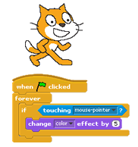
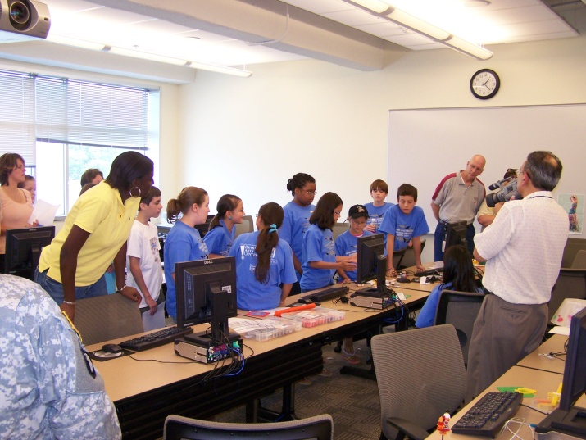
Summer Computer Camps
Activ8 Computing Camps
Computerized Craft Building with Pico Crickets
Create your own adventure - Game and Movie making through programming with Scratch
Web Design
Web Design & Flash® Animation
Animating with Alice
Lego robots
GameMaker
3D Game Art and Design with Blender
Python Programming

Slide 29
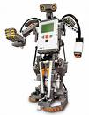
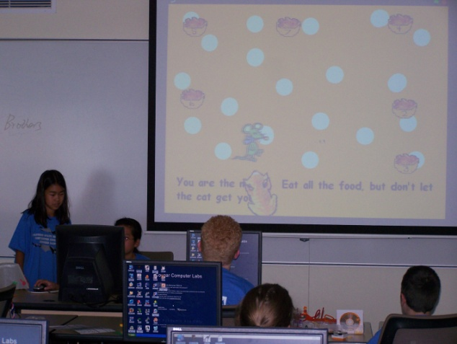
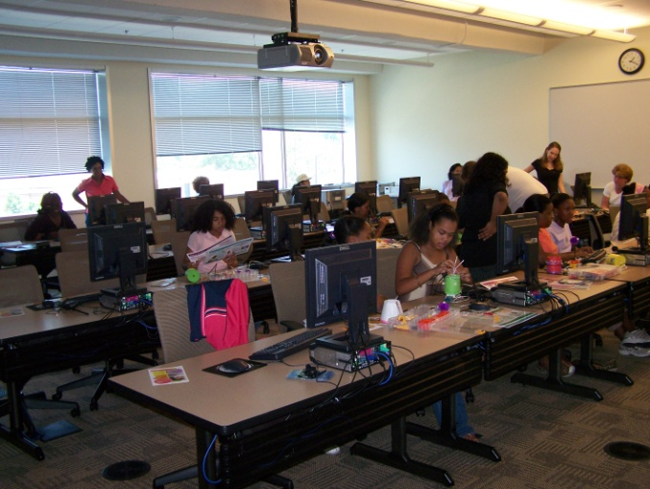
Summer Computer Camps
AGES: 8-11 or 11-14 or high school
2010: 12 camps: : 147 kids [114 boys & 33 girls]
2009: 15 camps: 160 kids [126 boys & 34 girls]
2008: 13 camps: 161 kids [119 boys & 42 girls]
2007: 4 camps: 75 kids [52 boys & 23 girls]
partial funding by GA Computes

Slide 30
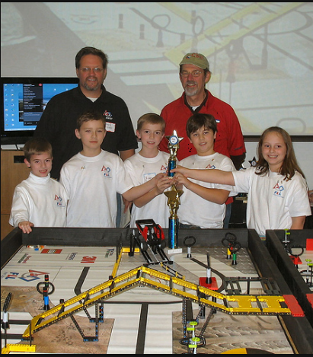
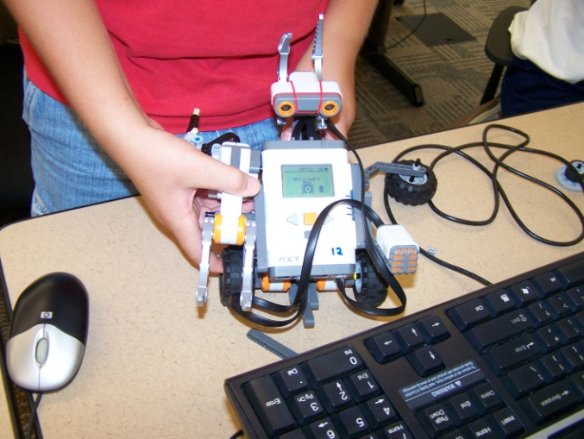
First Lego League Robotics
Dec. 2009 – hosted 10 teams from throughout South GA
Dec. 2010 –hosted 18 teams

Slide 31
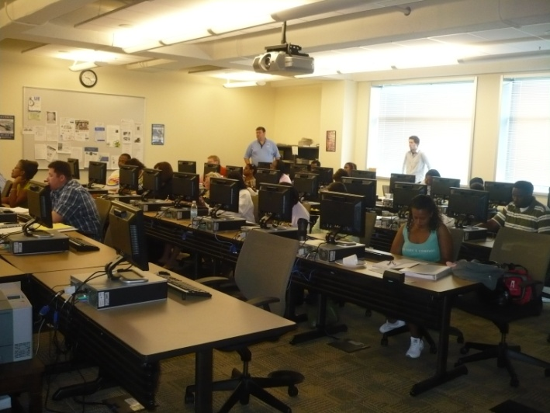
Weekend Teacher Workshops

Slide 32
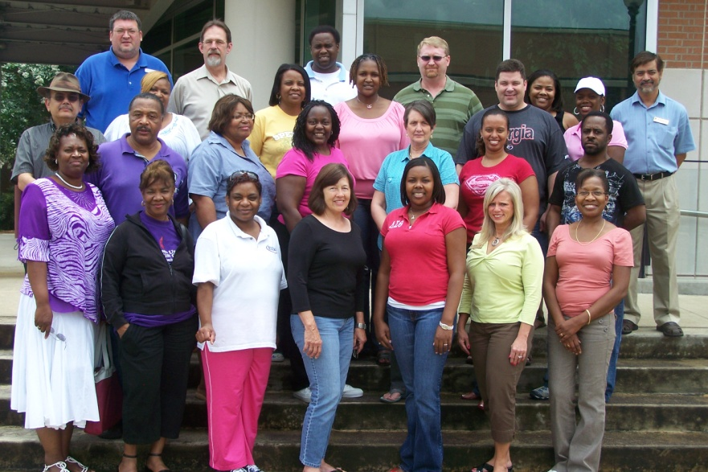
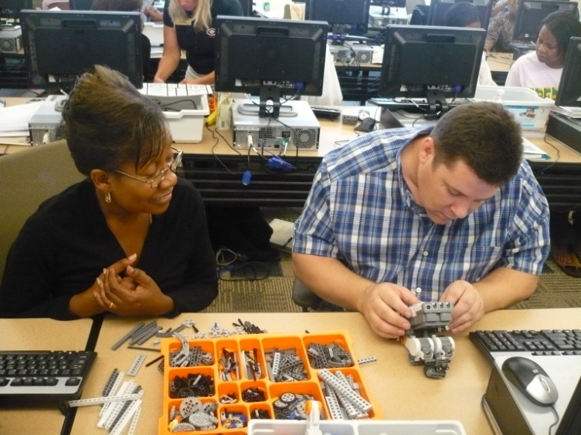
Summer Teacher Workshops
Scratch / CS Unplugged
Alice / CS Unplugged
Lego Robots / CS Unplugged
Programming mobile devices / Web 2.0
Lesson Plans

Slide 33
State of Computer Science Education in Georgia
Sound curriculum
Based on the ACM K-12 Model Curriculum
Computing in the Modern World
Beginning Programming
Intermediate Programming
AP Computer Science
GA Professional Standards Commission (GAPSC) approved a Computer Science Endorsement
Based on ISTE guidelines
Approved May 15, 2009

Slide 34
New Initiative
Computing Education for the 21st Century (CE21)
Increase the number and diversity of K-14 students and teachers who develop and practice computational competencies in a variety of contexts
Increase the number and diversity of early postsecondary students who are engaged and have the background in computing necessary to successfully pursue degrees in computing-related and computationally-intensive fields of study
http://www.nsf.gov/pubs/2010/nsf10619/nsf10619.htm

Slide 35
Computer Science Teacher Endorsement
There are two targets:
people who already have a teaching certificate, who are just looking for an add-on endorsement
students who are currently work on a certification in another field and want to add an endorsement ( there are both undergraduate and graduate options)
Mode of Delivery
the graduate classes will be offered online.
the pre-service undergraduate option will be taught only on campus at this time.

Slide 36
Computer Science Teacher Endorsement
Graduate endorsement
CPSC 6105. Fundamental Principles of Computer Science
CPSC 6106. Fundamentals of Computer Programming and Data Structures
CPSC 5135G. Programming Languages
CPSC 5157G. Computer Networks
EDUT 5125G. Methods of Teaching Computer Science
EDUT 5455G. Practicum in Computer Science
Aligned to the GAPSC Standards (based on ISTE Standards)

Slide 37
Computer Science Teacher Endorsement
Undergraduate endorsement
CPSC 1105. Introduction to Information Technology
CPSC 1301/1301L. Computer Science 1
CPSC 1302. Computer Science 2
CPSC 2105. Computer Organization
CPSC 2108. Data Structures
CPSC 5135G. Programming Languages
CPSC 5157G. Computer Networks
EDUT 5125U. Methods of Teaching Computer Science
EDUT 5455U. Practicum in Computer Science

Slide 38
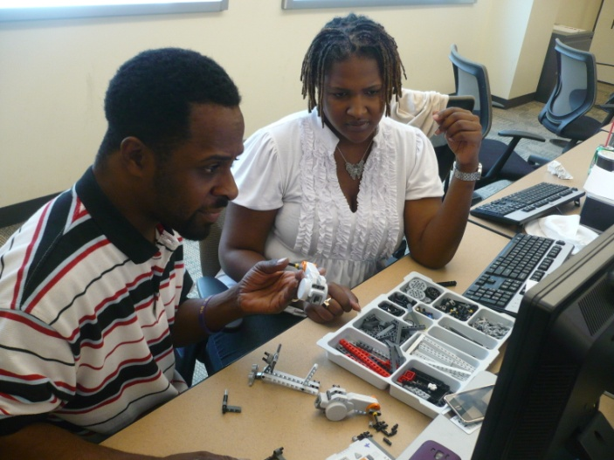
Computer Science Teacher Endorsement
Assessments and Evidence for Meeting Standards
Content GPA (content knowledge)
Professional Portfolio (Field Experiences and Clinical Practice)
Field Experience Evaluation
Dispositions Evaluation
Graduate and Employer Surveys

Slide 39
Other CSU Initiatives
Dr. Chouchane’s Stars Alliance Grant ($10K /year)
Visiting High Schools
Supporting Undergraduate student research
REU Supplement ($4K) – Undergraduate Research
School Visits
Supporting HS Academy of Computer Science
Supporting Girls Inc. Technology Activities
Using the Mass Media to get the word out

Slide 40
What can UMS do?
Support the 72 SMKs that teach ICT
Invite local SMK students and parents to campus for an open house
Offer student competitions (e.g. programming, FIRST Lego League Robotics, website, graphics)
Offer “summer camps”
Advertise the “bragging points”
Build a robust website
Use the Mass Media (newspapers, radio)

Slide 41
QUESTIONS?
Wayne Summers
TSYS School of Computer Science Columbus State University
http://cs.columbusstate.edu
cs@columbusstate.edu
(706) 568-2410
summers_wayne@columbusstate.edu

