Slide 1
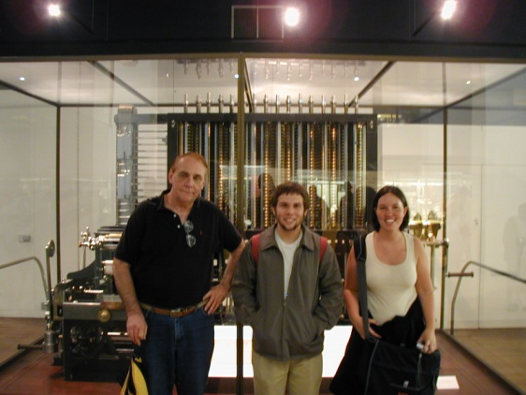
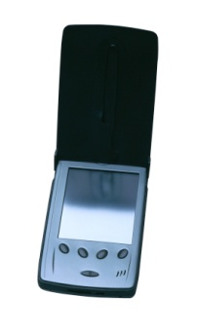
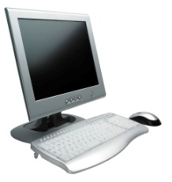
PRESENTATION to BEIJING INSTITUTE of PETROCHEMICAL TECHNOLOGY
Dr. Wayne Summers
TSYS School of Computer Science
Columbus State University
7 May 2012

Slide 2
AGENDA
Overview of Columbus State University
Q&A
Overview of School of Computer Science
Q&A
Guidelines for BIPT Students
Q&A

Slide 3
STEP 1- March-November (in China)
Prepare for the TOEFL Test and take no later than October (http://www.ets.org/toefl/ibt/prepare/)
IF minimum Internet based score of 79, or ILETS exam showing a minimum of 6.
Apply for undergraduate admission to CSU by November 1st (http://admissions.columbusstate.edu/international/ ) for a F-1 visa to pursue “Computer Science Undergraduate Research Certificate” commencing Spring Semester (January)
Submit BIPT transcripts (in English), TOEFL score, proof of financial support, and immunization records

Slide 4
STEP 2 (Spring (Jan-May) at CSU)
Computer Science Undergraduate Research Certificate
CPSC 4205 Senior Project & Portfolio (3 Credits),
CPSC 4899 Independent Study (3 Credits),
CPSC 4500 Undergraduate Research (6 Credits)
at least one additional three-credit upper division computer science class approved by the School of Computer Science.
TOTAL 15 credit hours

Slide 5
STEP 3- (Spring (Jan-June) at CSU)
While completing research in Spring,
prepare for GRE exam
Request results of research be reported back to BIPT while earning Research Certificate
Take GRE exam and send scores to CSU
Apply for admissions to graduate program at CSU before June 1st
Submit final BIPT transcripts (in English) and proof of financial support

Slide 6
STEP 4 -MS Applied Computer Science
36 hours of computer science coursework
Program Core (12 Hours)
Program Concentration (15 Hours):
Information Assurance
Courses in Computer Networking and Security
Software Development
Courses in Programming and Software Engineering
Modeling and Simulation
Courses in Simulation and Visualization
Program Electives (9 Hours)
Thesis recommended
Exit Exam

Slide 7
TSYS School of Computer Science
Columbus State University
Center for Commerce and Technology
http://cs.ColumbusState.edu
cs@columbusstate.edu
wsummers@columbusstate.edu

