Slide 1
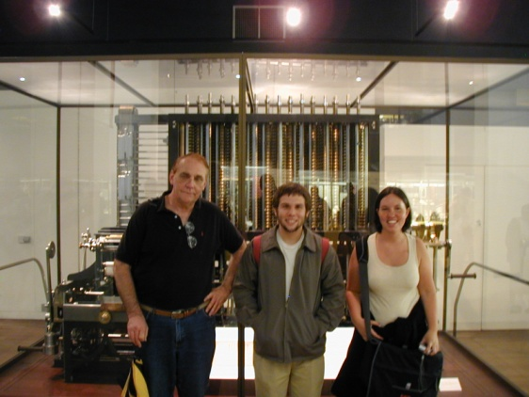
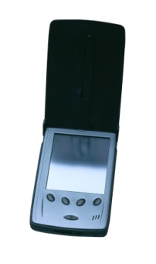
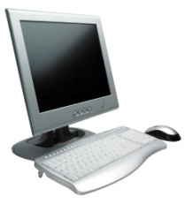
PRESENTATION to BEIJING INSTITUTE of PETROCHEMICAL TECHNOLOGY
Dr. Wayne Summers
TSYS School of Computer Science
Columbus State University
7 May 2012

Slide 2
AGENDA
Overview of Columbus State University
Q&A
Overview of School of Computer Science
Q&A
Guidelines for BIPT Students

Slide 3
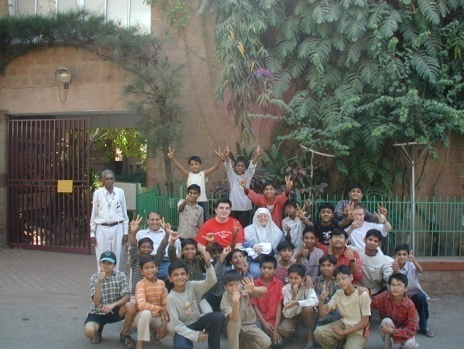
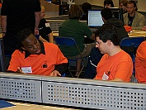
Some Quick Facts about CS Students
Approximately 300 undergraduates
Approximately 90 graduate students
Student research opportunities
Currently fund 6 graduate students &
8 undergraduate students
Variety of internship and coop opportunities
Study-abroad opportunities
ACM Student Chapter

Slide 4
Challenges in the U.S.
The number of Computer Science majors dropped 40-50% nationwide between 2001-2008
The percentage of women has dropped to about 10%
From a high of about 40% in the early 80s
Projections of 46% job growth over the next 10 years!
“Computer Science major is cool again”
“Want a job? Get a computer science degree”

Slide 5
Challenge
Professionals in computing say that you should like:
Problem solving
Working with others in a team
Being creative
Problem solving
Problem solving

Slide 6
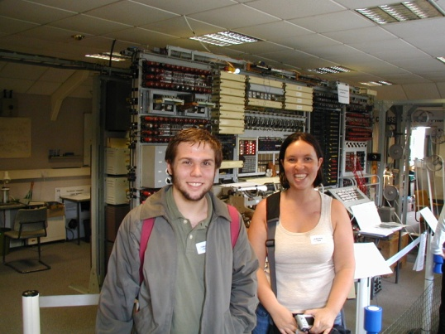
Computers in the 1940s
Trick questions:
How many computers in this picture?
What was the average weight of a computer in the early 1940’s?

Slide 7
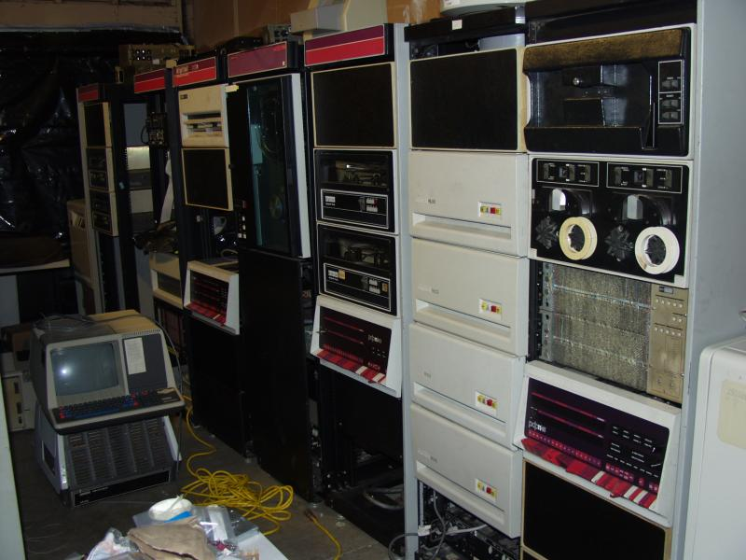
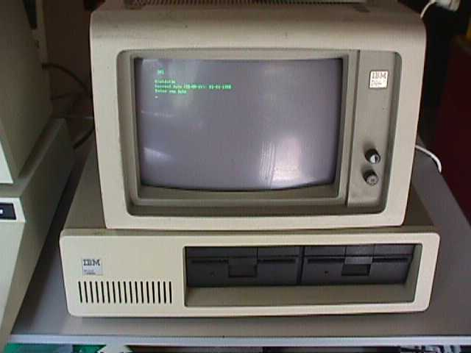
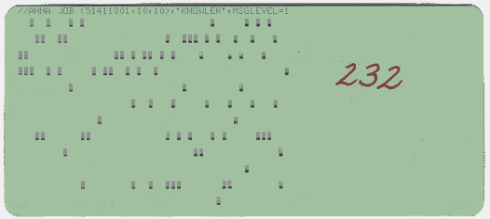
What Computing Was in 70-80s

Slide 8
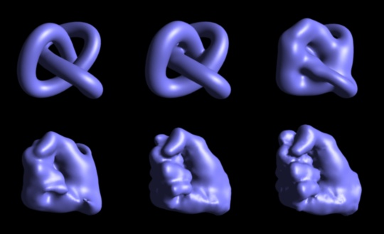
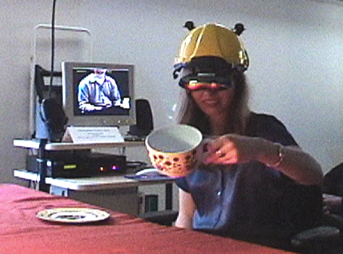
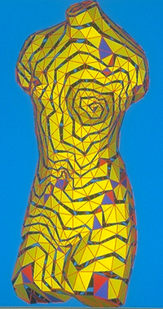
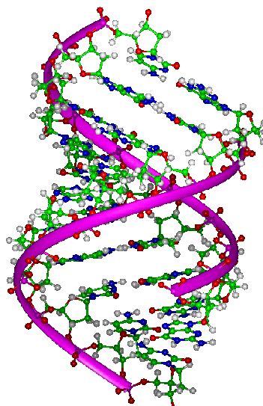
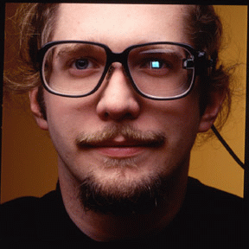
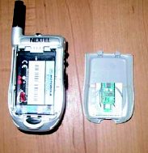
What Computing is Today
Virtual Environments
Graphics
Bioinformatics
Wearable Computing

Slide 9
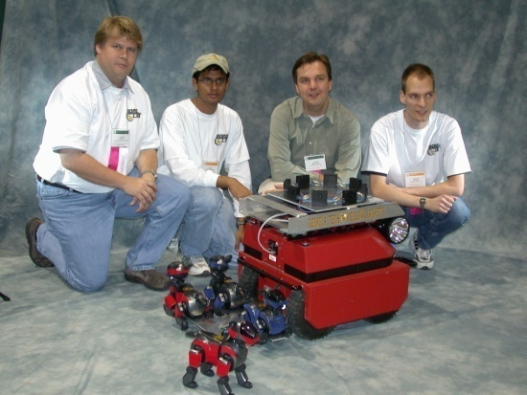
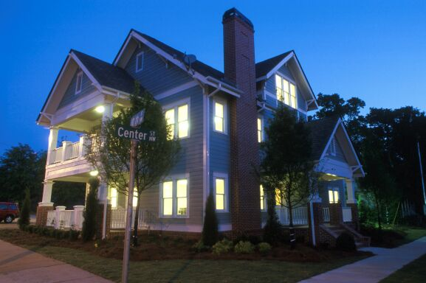
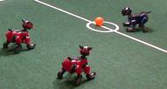
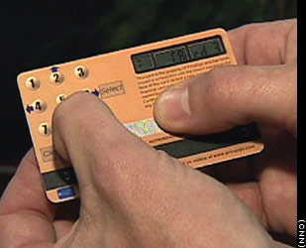
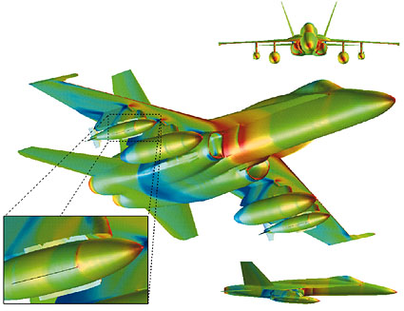
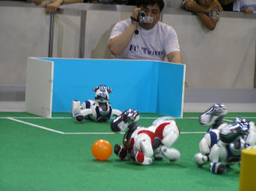
What Computing is Today
Ubiquitous Computing
Databases
Information Security
High Performance Simulation

Slide 10
Academic Programs in Computer Science
BS Computer Science - Applied Track
BS Computer Science - Games Track
BS Computer Science - Systems Track
BS Information Technology
BS Information Technology (online)
Combined BS/MS Computer Science

Slide 11
Academic Programs in Computer Science
MS Applied Computer Science
Information Assurance
Software Development
Modeling and Simulation
Computer Science Undergraduate Research Certificate
Graduate Certificates:
Modeling and Simulation
Information Systems Security Officer
Information Systems Security Professional
Computer Science Endorsement

Slide 12
Academic Programs in Computer Science
Bachelor of Science in Computer Science
Systems
designed for students who plan on continuing to a graduate program in Computer Science or who want a more traditional and theoretical degree
Applied
less theoretical with a focus on mainframe programming and web programming
Games
designed for students who plan on continuing to a graduate program in Computer Science or who want to work in the gaming, modeling, and simulation industry
Minor Computer Science (18 semester hours)

Slide 13
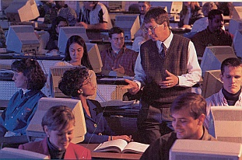
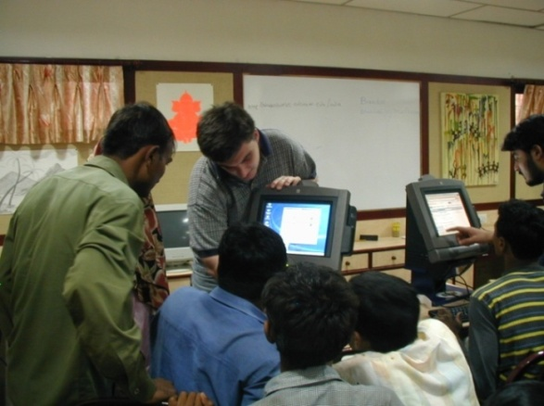
Academic Programs in Computer Science
Bachelor of Science in Information Technology
provides students with a combination of knowledge, hands–on experience, and application of theory.
The curriculum emphasizes quantitative and communication skills as well as providing a basic foundation in understanding the business process and the role of Information Technology in supporting that process.
Computer Science Teacher Endorsement

Slide 14
Computer Science Undergraduate Research Certificate
Prepare undergraduate students for the rigors of a graduate program that encompasses a research emphasis
Designed for who wish to continue into the M.S. in Applied Computer Science.
Students must have finished the equivalent of seven semesters of Computer Science in good standing including courses in data structures, operating systems, databases, computer architectures, and algorithms.
Requirements include:
CPSC 4205 Senior Project & Portfolio (3 Credits),
CPSC 4899 Independent Study (3 Credits),
CPSC 4500 Undergraduate Research (6 Credits), and
at least one additional three-credit upper division computer science class approved by the School of Computer Science.

Slide 15
MS Applied Computer Science
36 hours of computer science coursework
Program Core (12 Hours)
Program Concentration (15 Hours):
Information Assurance
Courses in Computer Networking and Security
Software Development
Courses in Programming and Software Engineering
Modeling and Simulation
Courses in Simulation and Visualization
Program Electives (9 Hours)
Thesis recommended
Exit Exam

Slide 16
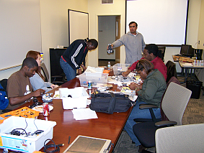
Students are educated to be:
Software Engineers / Architects
(Most Satisfying Job Rating by CNN Survey 4/13/07)
Computer Programmers / Software Developers
Java, C++, VB, C#, .NET, COBOL, Assembler,...
Game & Simulation Programmers
Computer and Network Security Specialists
Web Developers
Systems Analysts
Database Administrators
Network Managers

Slide 17
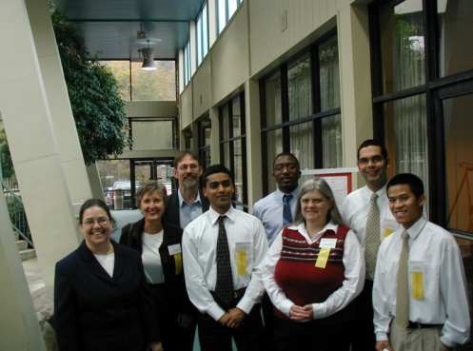
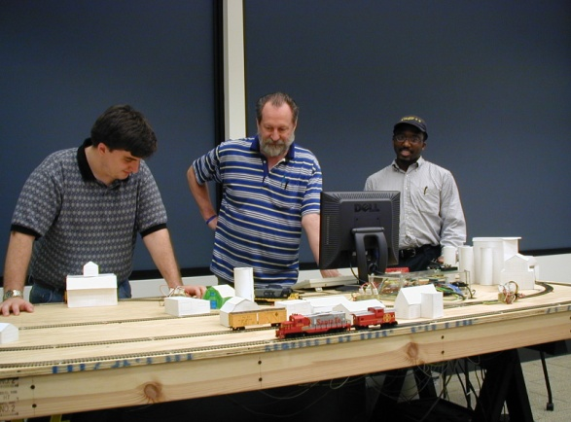
Student research opportunities
Simulation & Modeling
Wireless and Network Security
Malware Detection
Forensics
Game Programming
Mobile Applications
Embedded Computing
Robotics/mechatronics
Software Evaluation
Legacy Code Transformation
Ubiquitous Computing

Slide 18
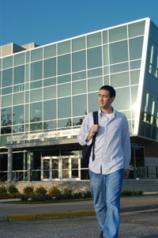
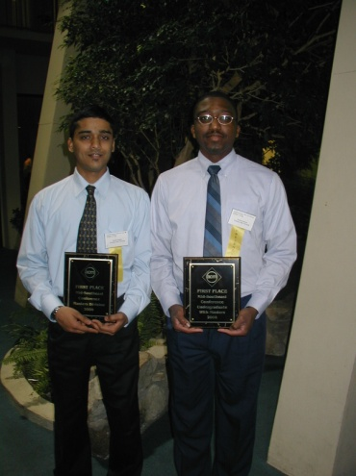
Internship and coop opportunities
TSYS
AFLAC
Synovus
Columbus Waterworks
Ft. Benning Simulation Battle Lab
Ft. Benning Virtual Soldier Lab
Ft. Benning Martin Army Hospital
Columbus Ledger-Enquirer
Wellpoint
Georgia Power
And many others

Slide 19
Computer Science Faculty
Thirteen full-time and five part-time
8 tenured, 12 with PhDs
Information Assurance Team
Games, Educational, Modeling and Simulation Team
Enterprise Computing Team
Broadening Participation in Computing Team

Slide 20
Information Assurance Team
Dr. Jianhua Yang - Associate Professor
Dr. Radhouane Chouchane - Assistant Professor
Dr. Lydia Ray - Assistant Professor
Dr. Edward Bosworth - Associate Professor
Dr. Wayne Summers- Professor
Our program is recognized as a National Center of Academic Excellence in Information Assurance Education and our curriculum has been recognized by the National Security Agency (NSA) as meeting their criteria for training Information Systems Security Professionals and Information Systems Security Officers.

Slide 21
Games, Educational, Modeling and Simulation Team
Dr. Shamim Khan – Professor
Dr. Rodrigo Obando - Associate Professor
Dr. Vladimir Zanev – Professor
Dr. Wayne Summers- Professor
???? – Assistant / Associate Professor [M&S]
(ret) Col John Fuller – Project Manager
George Khouri – Knowledge Engineer
Robert Smith – Senior Programmer
GEMS Institute received a $1.6 million gov’t funding and is currently pursuing additional funding from DoD

Slide 22
Enterprise Computing Team
Dr. David Woolbright – Professor
Dr. Neal Rogers – Assistant Professor
Mr. Burley Wright – Assistant Professor
Works closely with IBM in development and delivery of mainframe computer curriculum to industry

Slide 23
Broadening Participation in Computing Team
Dr. Wayne Summers – Professor
Dr. Rodrigo Obando – Associate Professor
Dr. Shamim Khan – Professor
Dr. Lydia Ray – Assistant Professor
Dr. Chris Whitehead – Associate Professor
Dr. Jianhua Yang – Associate Professor
Dr. Rahouane Chouchane – Assistant Professor
Received National Science Foundation funding and working on additional support for teacher training, summer camps, and other outreach activities

Slide 24
Computer Science projects
Navigating CSU with an Android
Embedded Computing
Microsoft Surface (games and simulations)
Games Showcase
Parallel Computing
Poetry on Demand
Combating Malware
Filtering Spam
Euclid’s Elements
Robotics

Slide 25
The PC of tomorrow
MIT Media Lab's "Sixth Sense“: http://video.computerworld.com/services/player/bcpid1351827287?bctid=14706015001

Slide 26
TSYS School of Computer Science
Columbus State University
Center for Commerce and Technology
http://cs.ColumbusState.edu
cs@columbusstate.edu
wsummers@columbusstate.edu

